Slide 1
Orientation
Culture and Personality
University of Minnesota Duluth
Tim Roufs
© 2010-2018

Slide 2
One item you will see often (and often repeated) is that American Anthropology traditionally has a four-fold approach to the study of humans and closely related species.
These four fields include . . .

Slide 3
One item you will see often (and often repeated) is that American Anthropology traditionally has a four-fold approach to the study of humans and closely related species.
These four fields include . . .

Slide 4
American Anthropology
cultural / social
physical / biological
archaeology
linguistics

Slide 5
So why study
Culture and Personality?
Ryan Adams
of IUPUI (Indiana University-Purdue University Indianapolis)
best summarized the case . . .

Slide 6
Lots of people
find these topics interesting . . .
There have been well over a million
page views of the UMD
Culture and Personality
WebPages in the last couple of years . . .

Slide 7
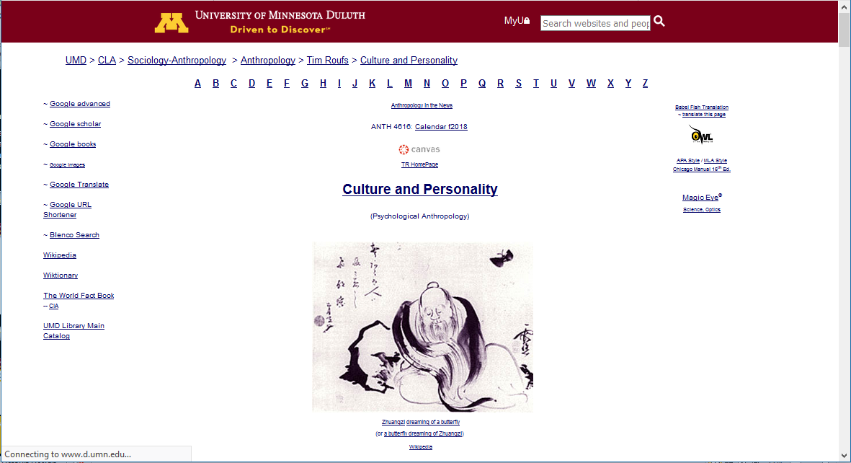

Slide 8
in recent years there have been
1,160,846
page visits to the
Culture and Personality course page . . .

Slide 9
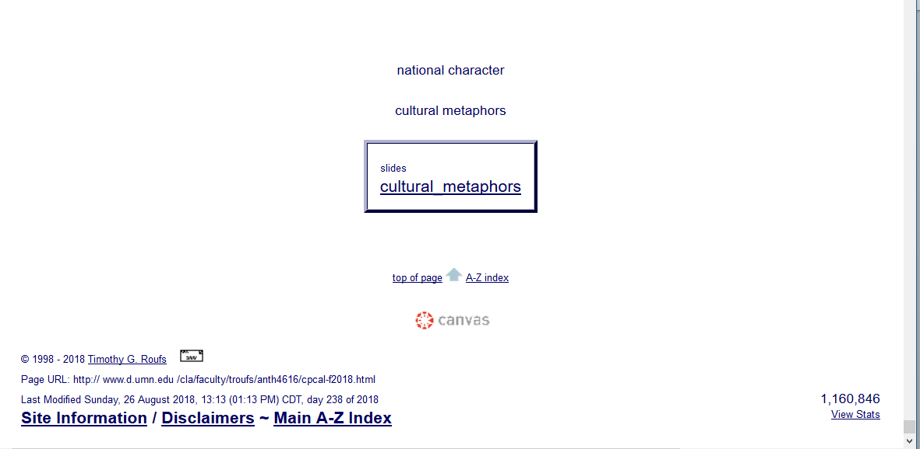

Slide 10
So . . . we’re going to have a look at . . .

Slide 11
So . . . we’re going to have a look at . . .
Culture and Personality and their . . .
cultural / social
physical / biological
archaeological
linguistical
aspects

Slide 12
These areas are also commonly known as . . .

Slide 13
So . . . we’re going to have a look at . . .
Culture and Personality and their . . .
sociocultural
biophysical
archaeological
linguistical
aspects

Slide 14
So . . . we’re going to have a look at . . .
Culture and Personality and their . . .
sociocultural
biophysical
archaeological
linguistical
cultural / social
physical / biological
archaeological
linguistical
aspects

Slide 15
And you’ll visit the same four fields as you go through your text . . .

Slide 16
http://www.d.umn.edu/cla/faculty/troufs/anth3635/cehandout_first-day.html

Slide 17
. . . and as you go through
your other class materials . . .

Slide 19
And you’ll visit these fields with your term project . . .

Slide 20
“Block 1” contains the basic information on the course . . .

Slide 21
“Block 1” contains the basic information on the course . . .
but more at a later date . . .

Slide 22
And to study Culture and Personality in this tradition there are a few basic characteristics of anthropology to keep in mind . . .

Slide 23
Main Characteristics
the four fields of general anthropology
2. culture as a primary concept
3. comparative method as major approach to the study of human behavior
4. holism or the study of "humankind" as a whole, as a primary theoretical goal
5. fieldwork as a primary research technique of gathering data, involving “participant observation”

Slide 24
Main Characteristics
the four fields of general anthropology
2. culture as a primary concept
3. comparative method as major approach to the study of human behavior
4. holism or the study of "humankind" as a whole, as a primary theoretical goal
5. fieldwork as a primary research technique of gathering data, involving “participant observation”
more at a later date . . .

Slide 25
Finally, to round off our theoretical perspectives, we’ll have a brief look at . . .

Slide 27
a few “Other Important Terms” including . . .

Slide 28
a few “Other Important Terms” including . . .
1. ethnocentrism
cultural relativism
absolute cultural relativism
critical cultural relativism
3. “multiple cultural worlds”

Slide 29
a few “Other Important Terms” including . . .
1. ethnocentrism
cultural relativism
absolute cultural relativism
critical cultural relativism
3. “multiple cultural worlds”
more at a later date . . .

Slide 30
and “Units of Analysis” including . . .

Slide 31
“units of analysis” may include:
one person
the family
the community
a region
a “culture area”
a culture / “subculture”
a nation
the world
an item or action itself
a “cultural metaphor”

Slide 32
“units of analysis” may include:
one person
the family
the community
a region
a “culture area”
a culture / “subculture”
a nation
the world
an item or action itself
a “cultural metaphor”
more at a later date . . .

Slide 33
and we’ll have a brief look at Three Major Perennial Debates including . . .

Slide 34
three major contemporary debates
Biological Determinism vs. Cultural Constructionism
Ideationism vs. Cultural Materialism
Individual Agency vs. Structuralism (“free will” vs. “power structures”)

Slide 35
three major contemporary debates
Biological Determinism vs. Cultural Constructionism
Ideationism vs. Cultural Materialism
Individual Agency vs. Structuralism (“free will” vs. “power structures”)
more at a later date . . .

Slide 36
First thing . . .
(if you are not already in Moodle)
go to your
course management site
and check it out . . .

Slide 37
How do you find
in the first place?

Slide 38
Further instructions follow,
but if you want,
and your browser permits,
clicking on the URL that follows
in the next slide
will take you to your Canvas home . . .
(your browser may require that you double-click)
There is another link at the end of this program

Slide 39
https://canvas.umn.edu
(your browser may require that you double-click)
If your browser does not allow you to click on the above URL just enter it in your browser window . . .
Continue on here for further instructions . . .
There is another link at the end of this program

Slide 40
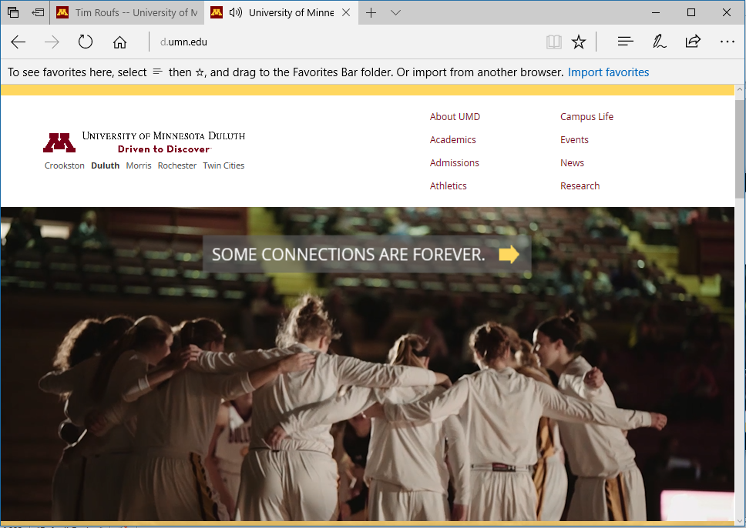

Slide 41
enter:
canvas.umn.edu

Slide 43
enter:
canvas.umn.edu

Slide 44
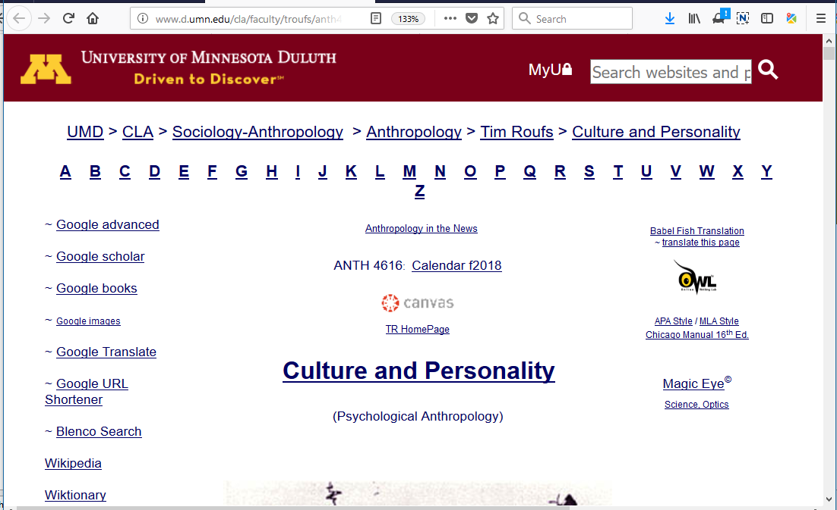
You may also access your Canvas folder from any of the many
course index and content
web pages . . .

Slide 45
You may also access your Canvas folder from any of the many
course index and content
web pages . . .

Slide 46
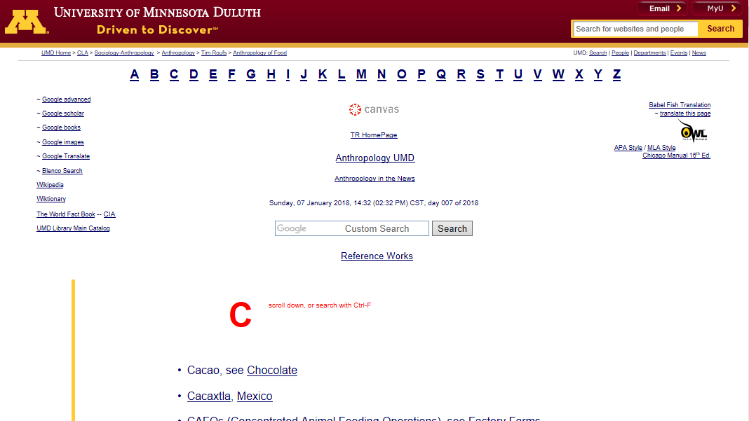

Slide 47
Your log-in page will then look something like the following . . .
Log in using your “x.500” information . . .
(that’s the log-in information you use for your e-mail)

Slide 48
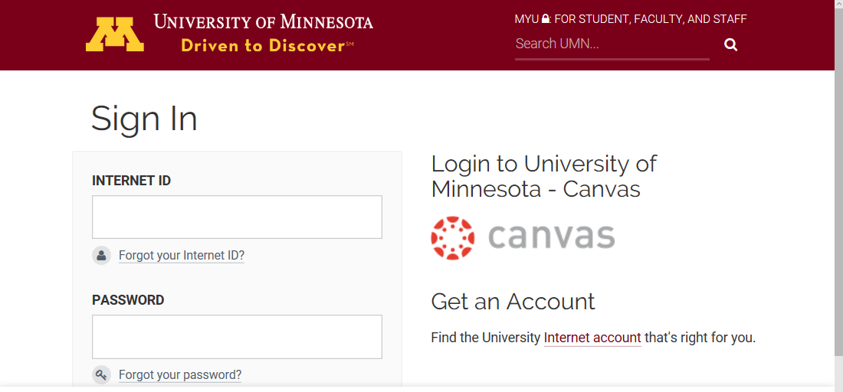
Log in using your “x.500” information . . .
(that’s the log-in information you use for your e-mail)

Slide 49
Log in using your “x.500” information . . .
(that’s the log-in information you use for your e-mail)
Log in using your “x.500” information . . .

Slide 50
Your Canvas “Dashboard”
will look something like the following . . .
https://canvas.umn.edu/

Slide 51
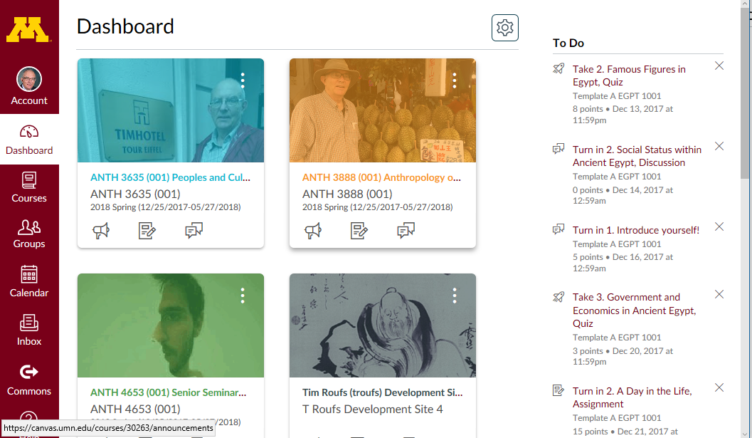
Your Canvas “Dashboard” will look something like this . . .

Slide 52
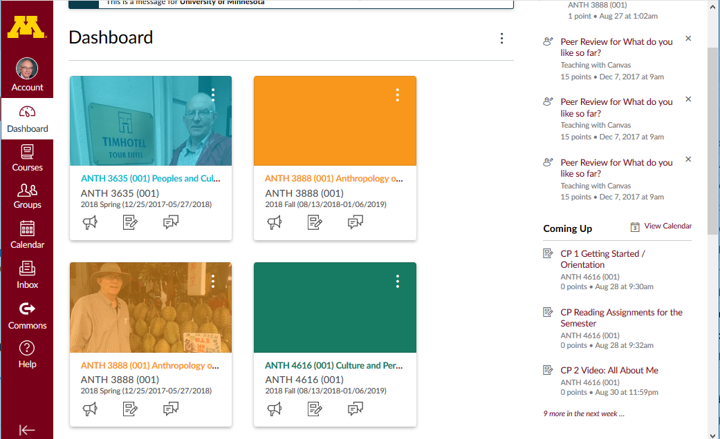
Select ANTH 4616 Culture and Personality

Slide 53
Your Canvas “Home” screen will look something like this . . .

Slide 54
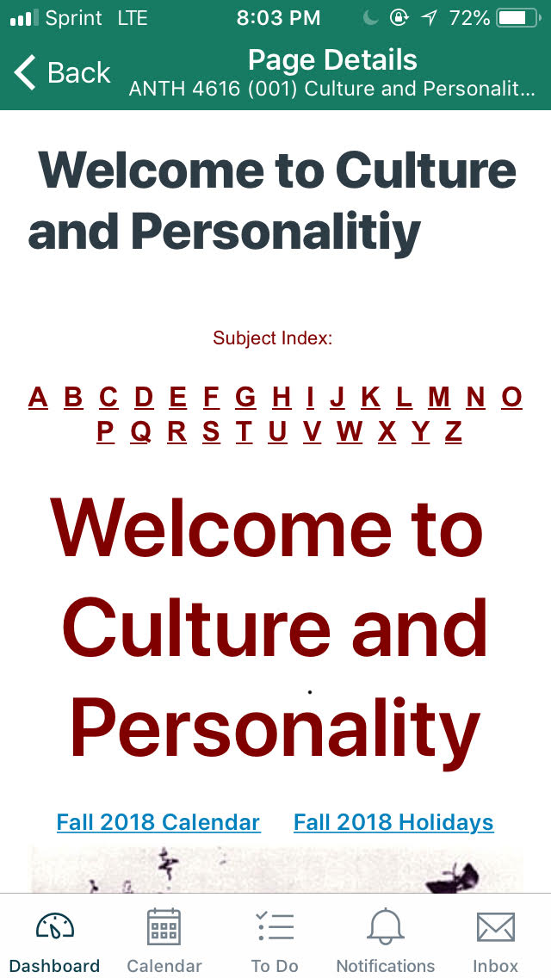
Your Canvas iPhone app
“Home” screen, for e.g.,
will look
something like this . . .

Slide 55
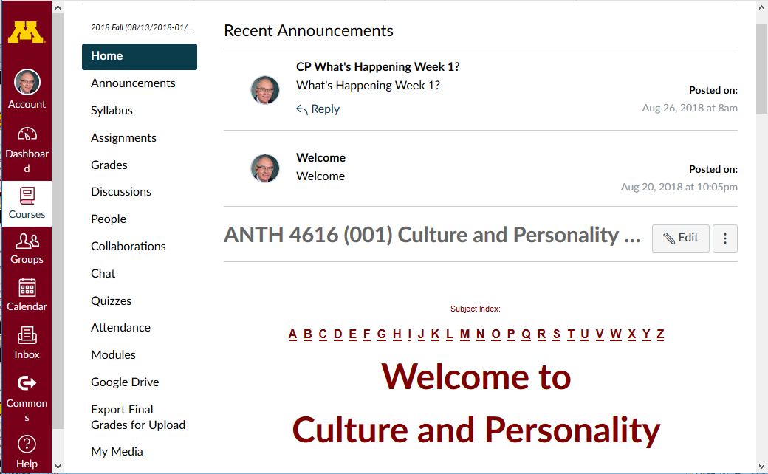
Course “Home” Page

Slide 56
course navigation

Slide 57
global navigation

Slide 58
Which option should you use to keep track of the semester?

Slide 59
It depends on your style . . .

Slide 60
Use one of these:
“Calendar”
or “Assignments”
or “Syllabus”

Slide 62
use one of these 3

Slide 63
Use one of these:
“Calendar”
or “Assignments”
or “Syllabus”

Slide 64
“Calendar”

Slide 65
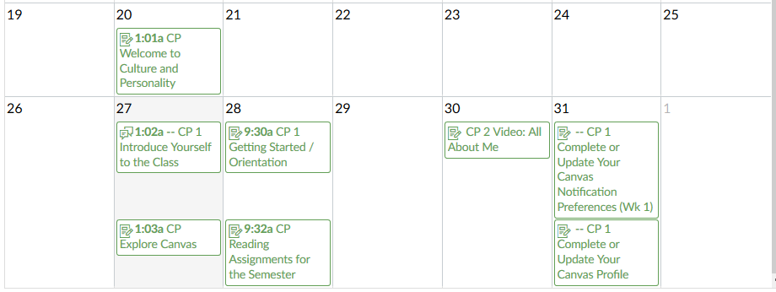
Culture and Personality Calendar

Slide 66
Use one of these:
“Calendar”
or “Assignments”
or “Syllabus”

Slide 67
“Assignments”

Slide 68
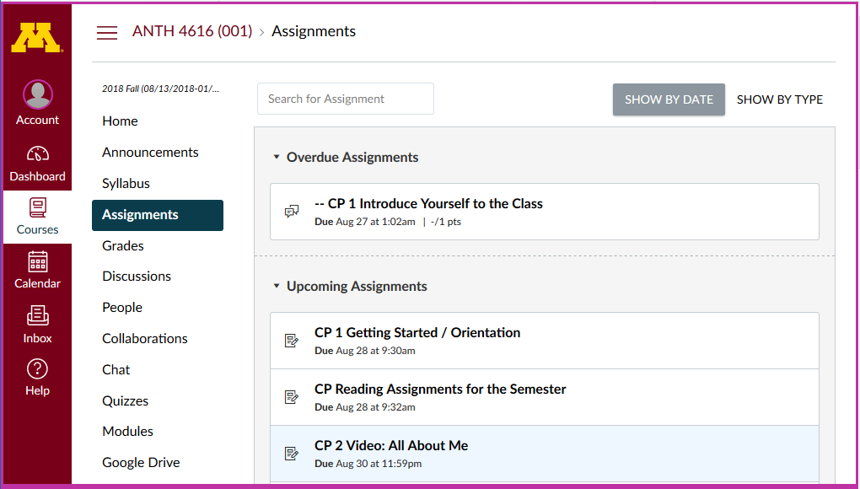

Slide 69
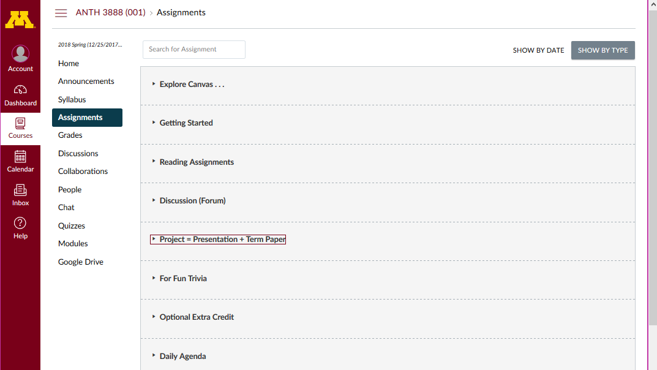
“Daily Agenda”

Slide 70
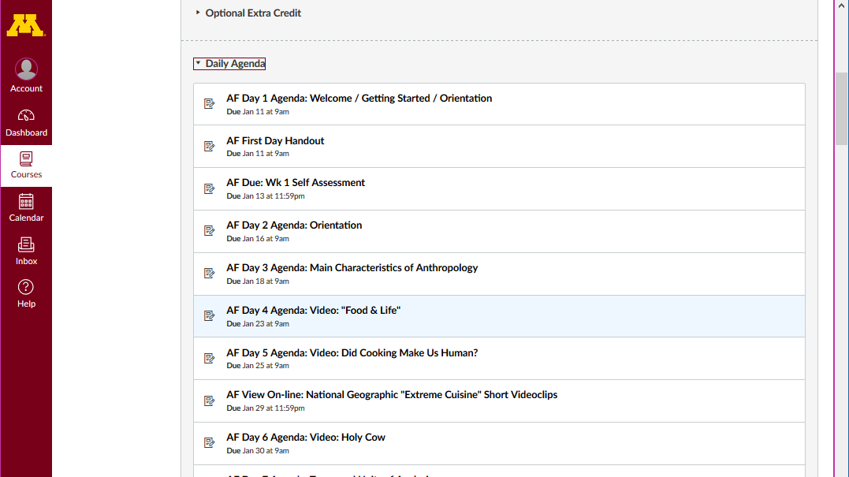
“Daily Agenda” expanded

Slide 71
Use one of these:
“Calendar”
or “Assignments”
or “Syllabus”

Slide 72
“Syllabus”

Slide 73
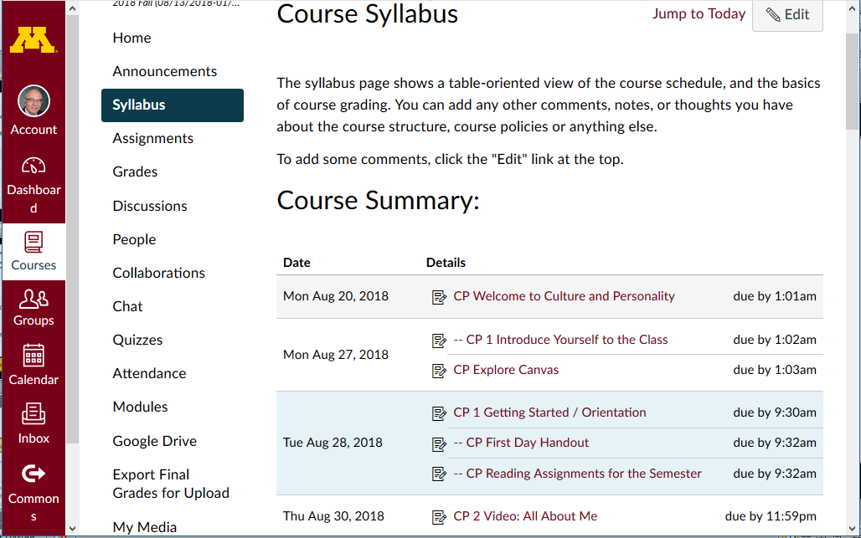

Slide 74
Scroll down for basic information . . .

Slide 75
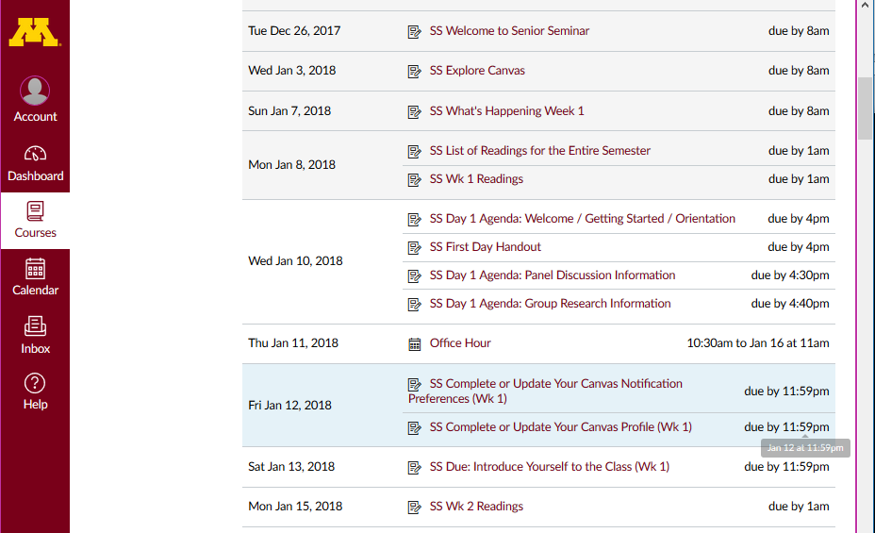

Slide 77
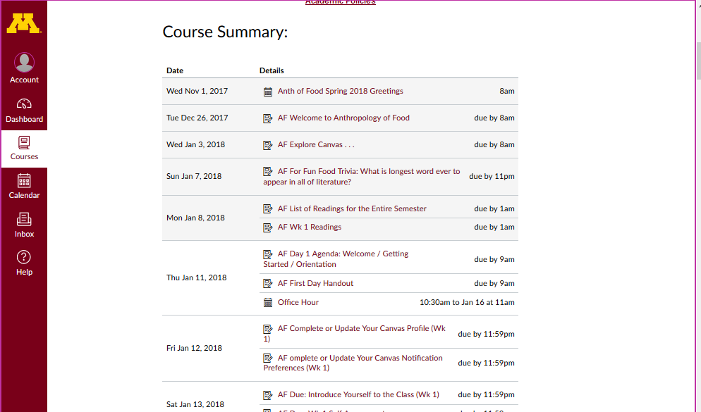

Slide 78
Personally, I like the
calendar version (even though it is slower)

Slide 79
Culture and Personality Calendar

Slide 80
And if you have more than one course using Canvas
you can have all of the information on one calendar . . .
and . . . in addition . . .
you can have it on your Google calendar too

Slide 81
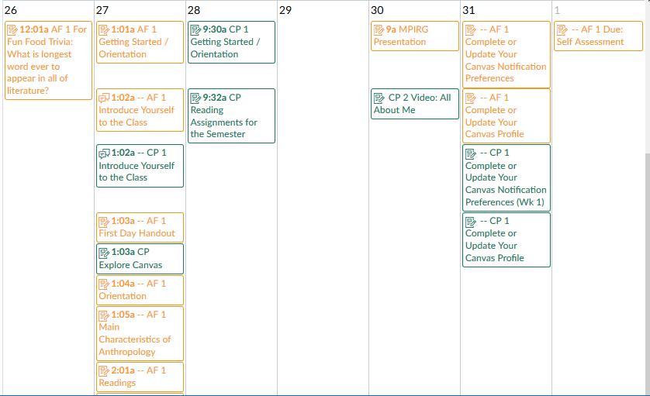
All Courses Calendar

Slide 82
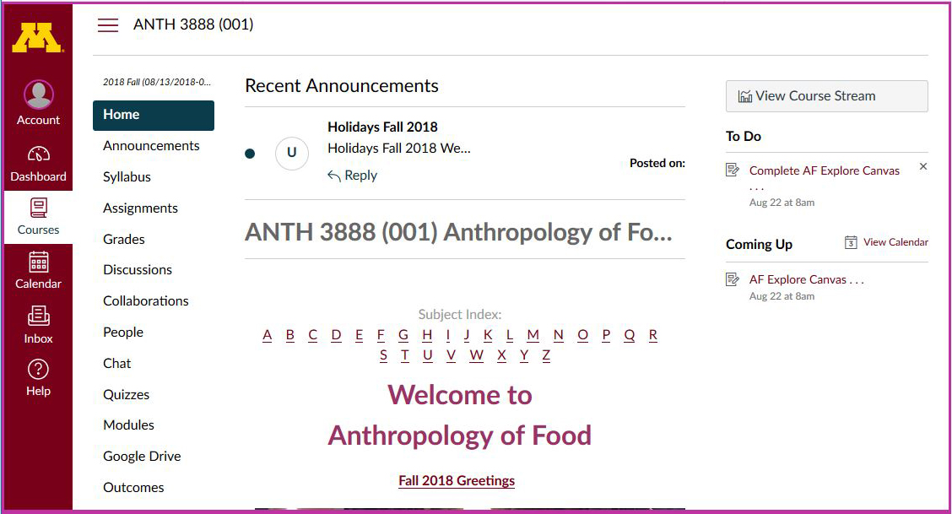
And if you have more than one course using Canvas
you can have all of the information on one calendar . . .
and . . . in addition . . .
you can have it on your Google calendar too

Slide 83
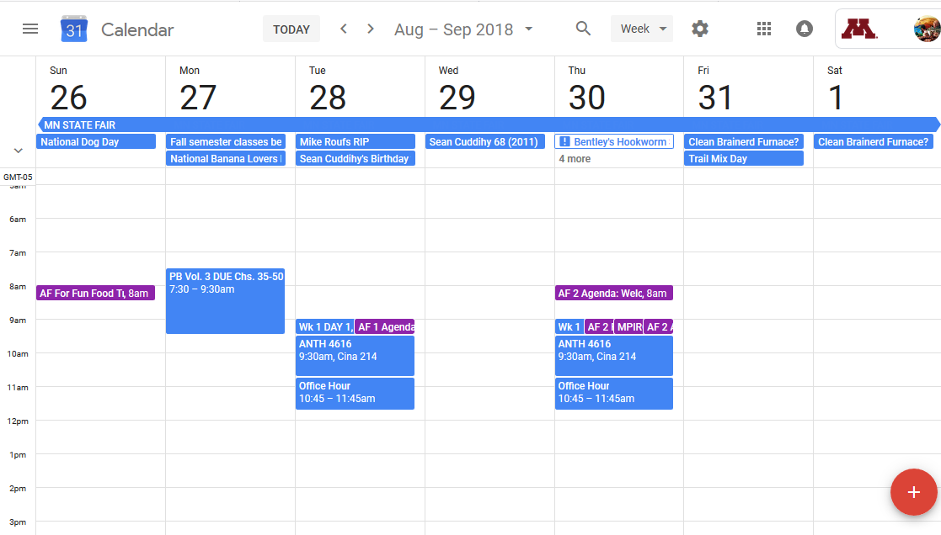
UM Google Calendar

Slide 84
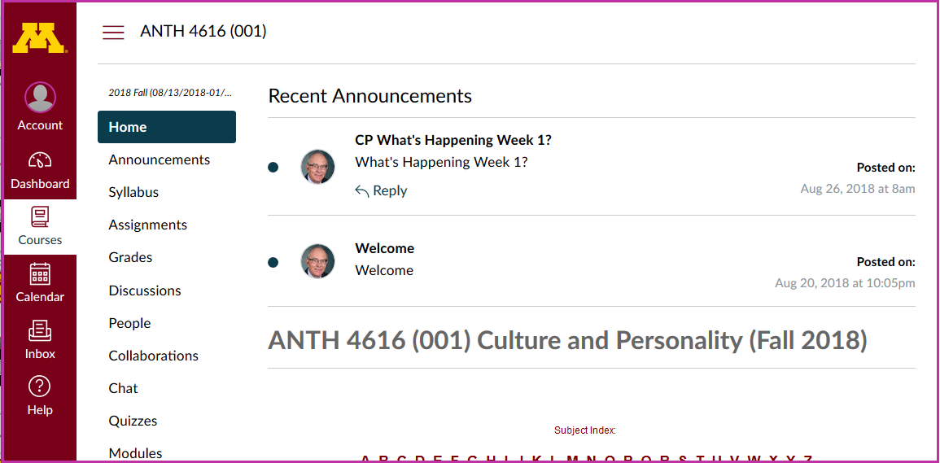
course navigation

Slide 85
hide course navigation panel here

Slide 86
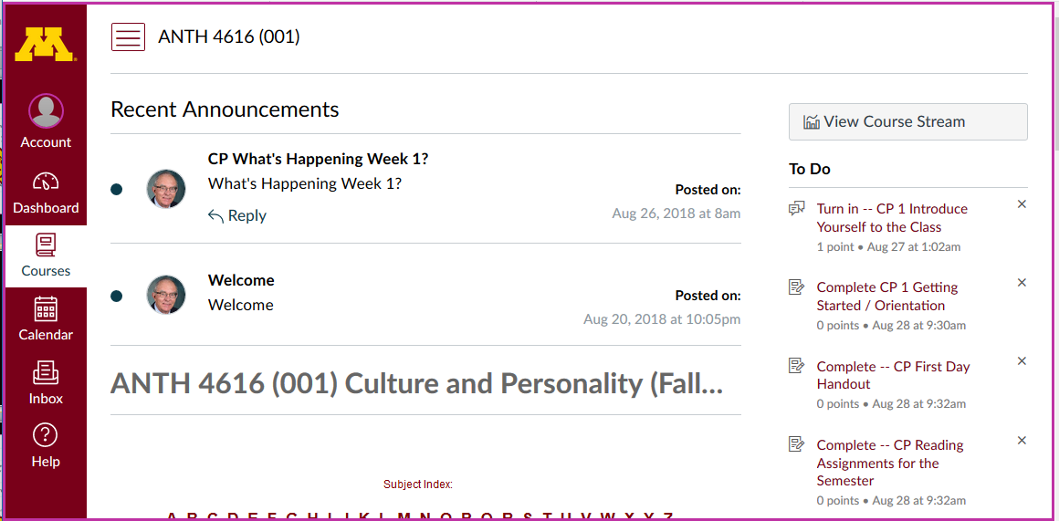

Slide 87
global navigation remains

Slide 88
unhide course navigation panel

Slide 89
Course “Home” Page

Slide 90
Scroll down for basic information . . .

Slide 91
Basic information . . .

Slide 92
Have a look at the
“First Day Handout” . . .
Basic information . . .

Slide 93
The “First-Day” Handout information contains the basic information . . .
It’s the syllabus
It look something like the following . . .
https://canvas.umn.edu/

Slide 94
The “First-Day” Handout information contains the basic information . . .
It’s the “syllabus”
It look something like the following . . .
https://canvas.umn.edu/

Slide 95
The “First-Day” Handout information contains the basic information . . .
It’s the “syllabus”
It look something like the following . . .
https://canvas.umn.edu/

Slide 96
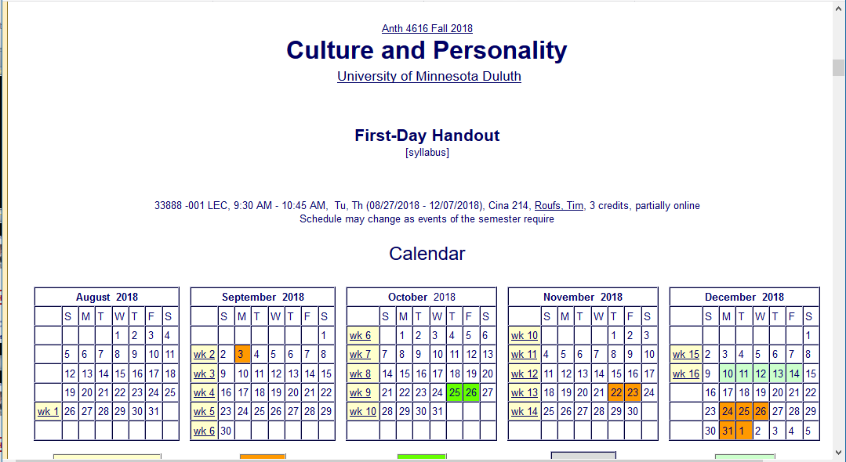
“First-Day Handout” Information . . .

Slide 97
“First-Day Handout” Information . . .
scroll down

Slide 98
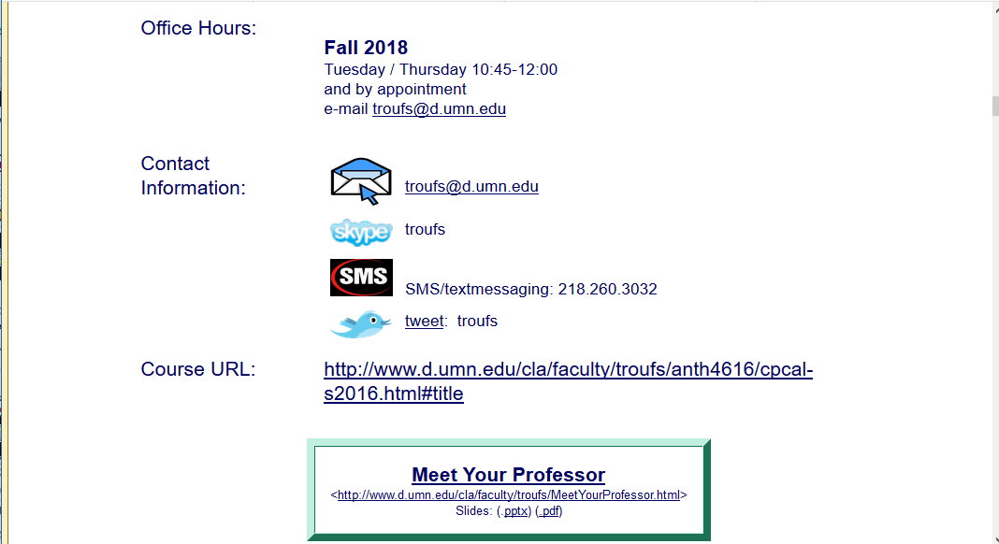
Basic Contact Information . . .

Slide 99
scroll down

Slide 100
Textbook Information . . .

Slide 101
Textbook Information . . .
scroll down

Slide 102
The Course Outline in a Nutshell

Slide 103
Course “Home” Page

Slide 104
course navigation

Slide 105
Basic information . . .

Slide 107
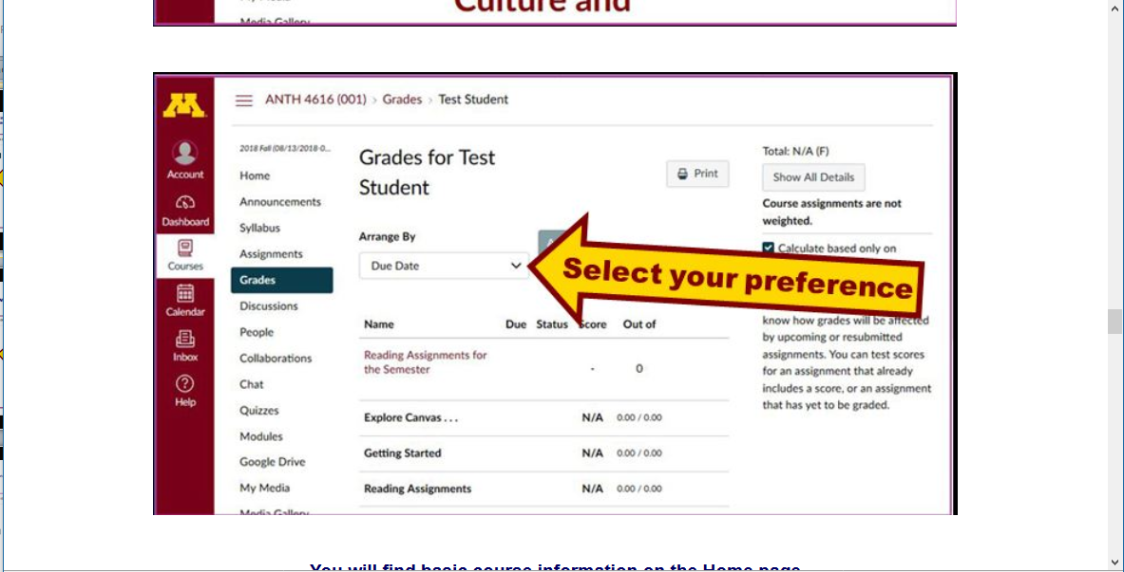

Slide 108
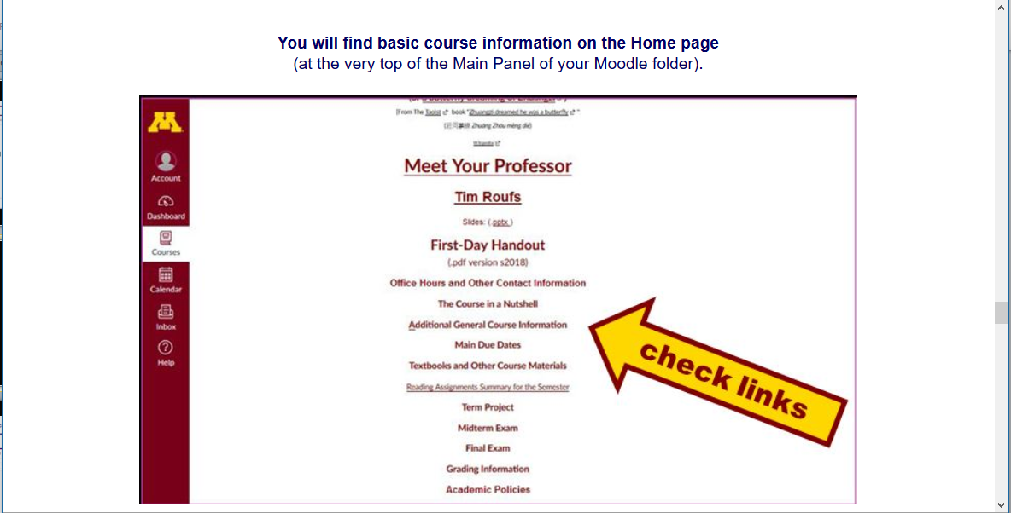

Slide 110
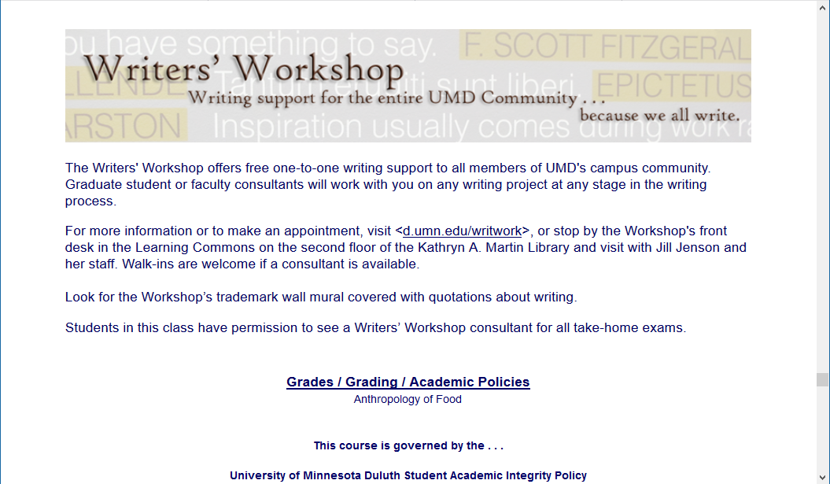

Slide 111
Governing Procedures
pay attention . . .

Slide 112
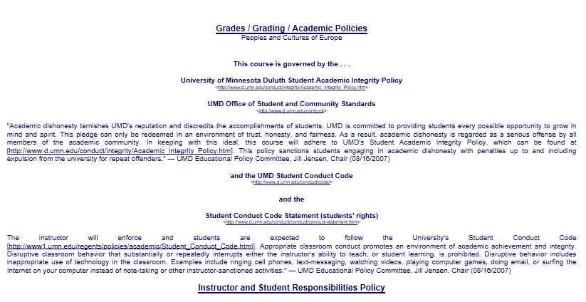

Slide 113
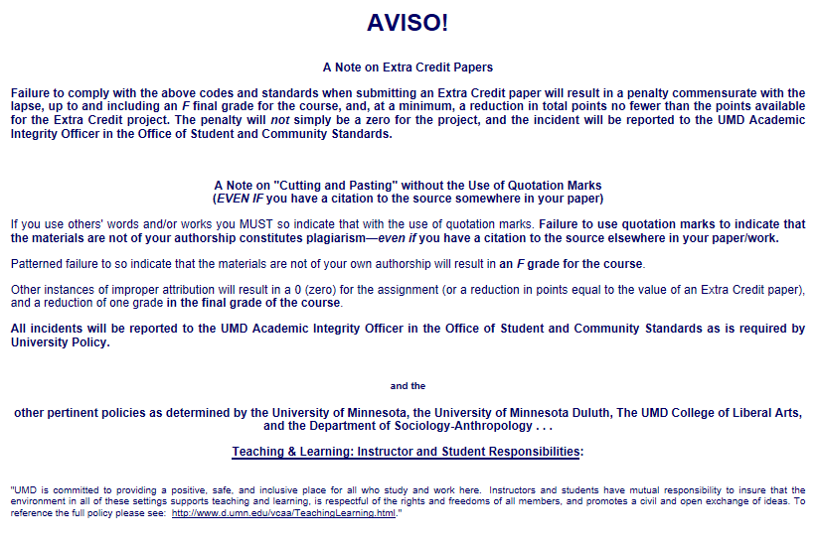

Slide 114
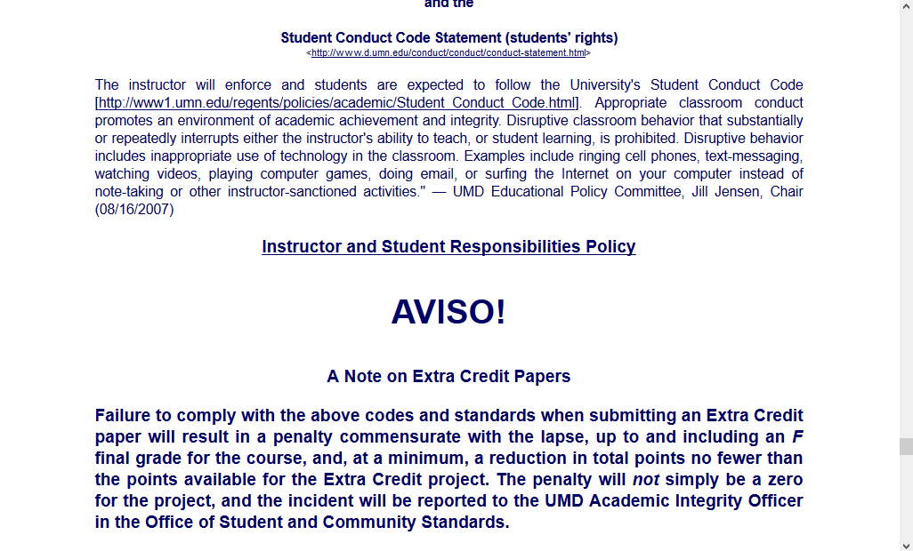
NB: Governing Procedures
note on Extra Credit Papers

Slide 116
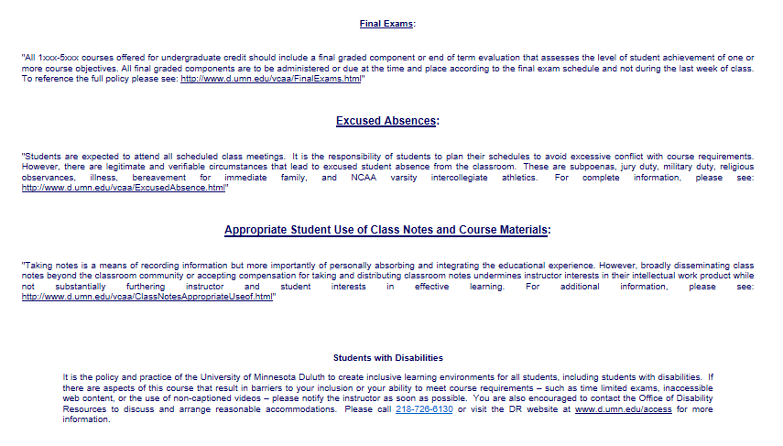

Slide 117
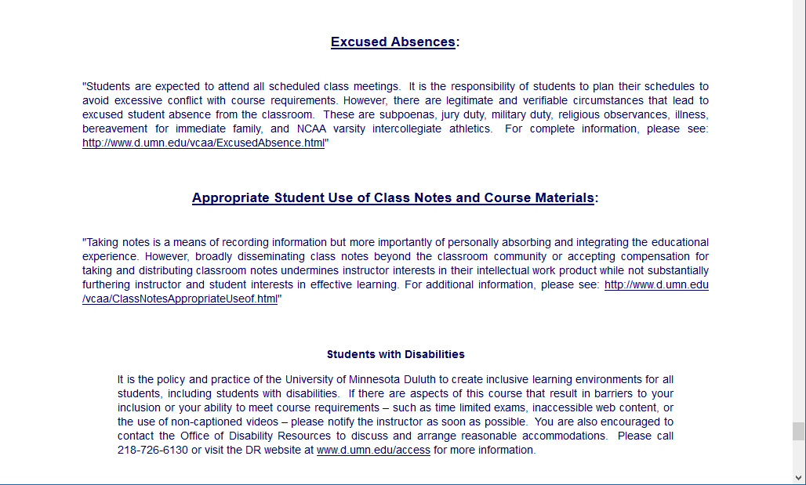
Special Facilities Information

Slide 119
Just for the fun of it, have a look around at the rest of the materials in Canvas . . .
Basic information . . .

Slide 120
Have a look at
“Meet Your Professor”
Basic information . . .

Slide 121
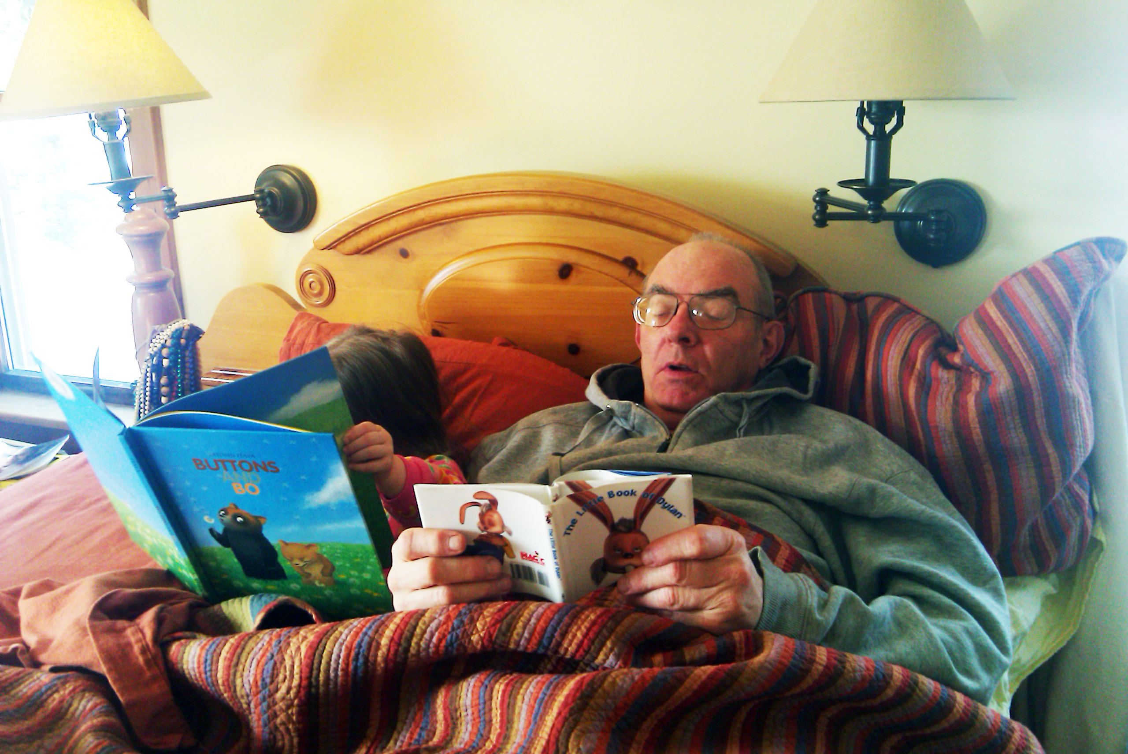
Yes, for the fun of it,
have a look at the
“Meet Your Professor” Materials

Slide 122
Why?

Slide 123
Research shows that people who know a little about their teachers . . .

Slide 124
Research shows that people who know a little about their teachers . . .
Learn more . . .

Slide 125
Research shows that people who know a little about their teachers . . .
Learn more . . .
Remember it better . . .

Slide 126
Research shows that people who know a little about their teachers . . .
Learn more . . .
Remember it better . . .
Have more fun learning . . .

Slide 127
one more piece
of useful information . . .

Slide 130
At the top of your “Home” page you will see an alphabet.
Clicking on a letter will bring you to a page that indexes course WebPages for virtually all of the scheduled topics and items in the course.

Slide 131
At the top of your “Home” page you will see an alphabet.
Clicking on a letter will bring you to a page that indexes course WebPages for virtually all of the scheduled topics and items in the course.

Slide 132
This information is very useful

Slide 133
How useful?

Slide 134
Lots of people
find these topics interesting . . .
There have close to a million
page views of the UMD
Culture and Personality
WebPages in the last couple of years . . .

Slide 136
in recent years there have been
1,160,846
page visits to the
Culture and Personality course page . . .

Slide 138
to access a topic simply click on its first letter to go to an index page . . .

Slide 139
to access a topic simply click on its first letter to go to an index page . . .

Slide 140
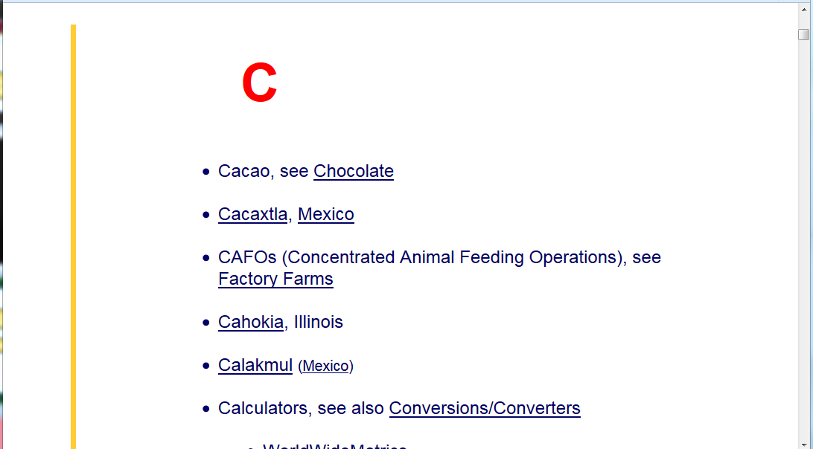
on the index page, search for item using Ctrl + F
or scroll down for the item

Slide 141
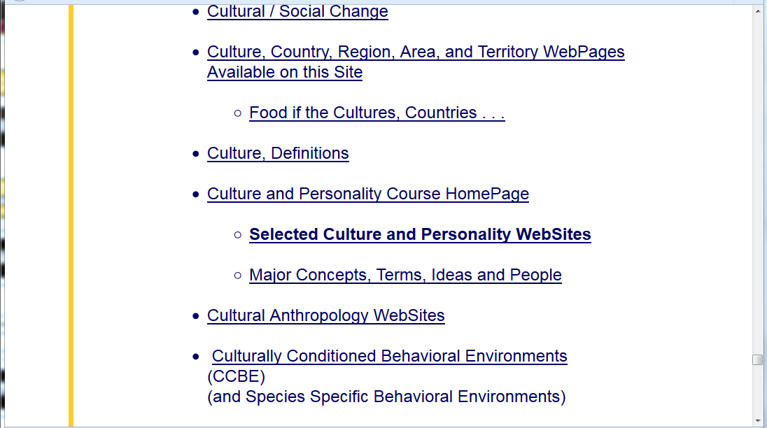

Slide 142
click on item . . . and . . .

Slide 143
voilá

Slide 145
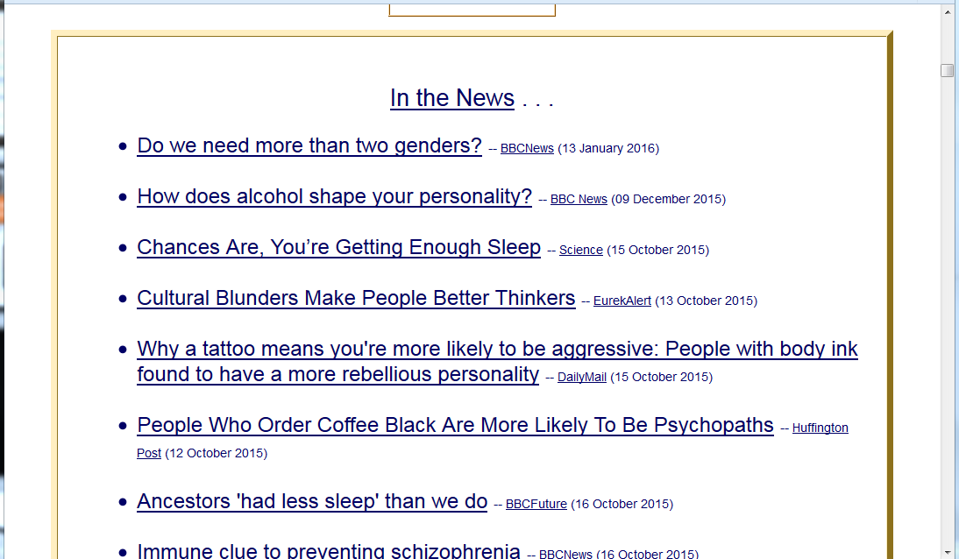

Slide 146
this should also be very useful when it comes time to start thinking about your class project

Slide 147
REM . . .

Slide 148
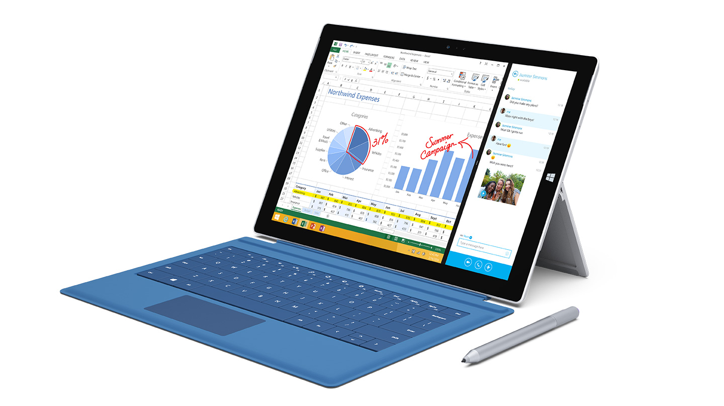
Laptops
Welcome
(in fact, they’re encouraged)

Slide 150
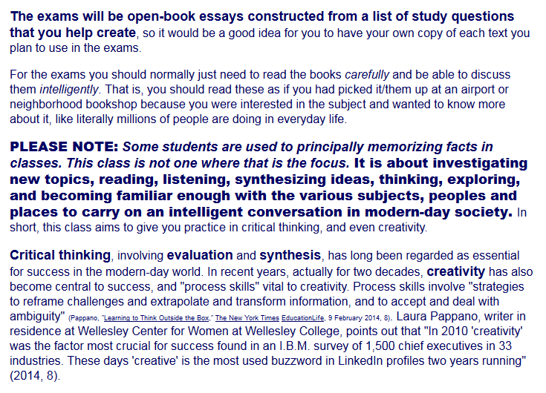
Be sure to read the note on exams from the Welcome Memo . . .

Slide 151
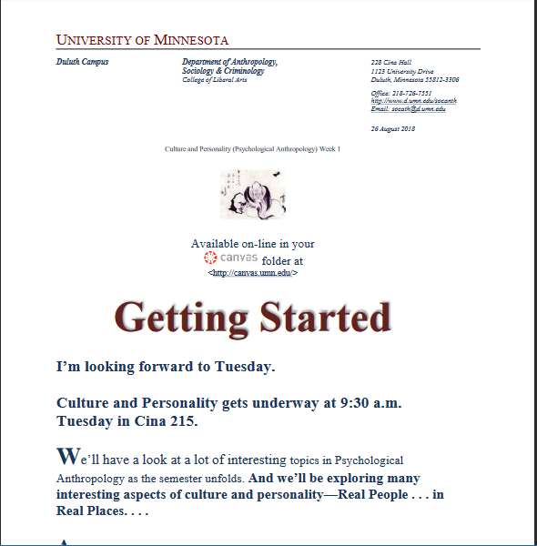

Slide 152
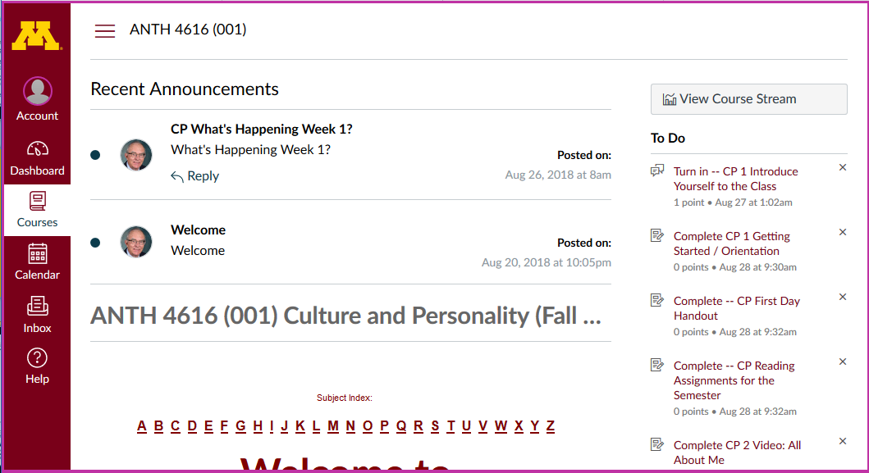
Weekly Memos are available here . . .
and you will receive one via e-mail (usually on Sunday)

Slide 153
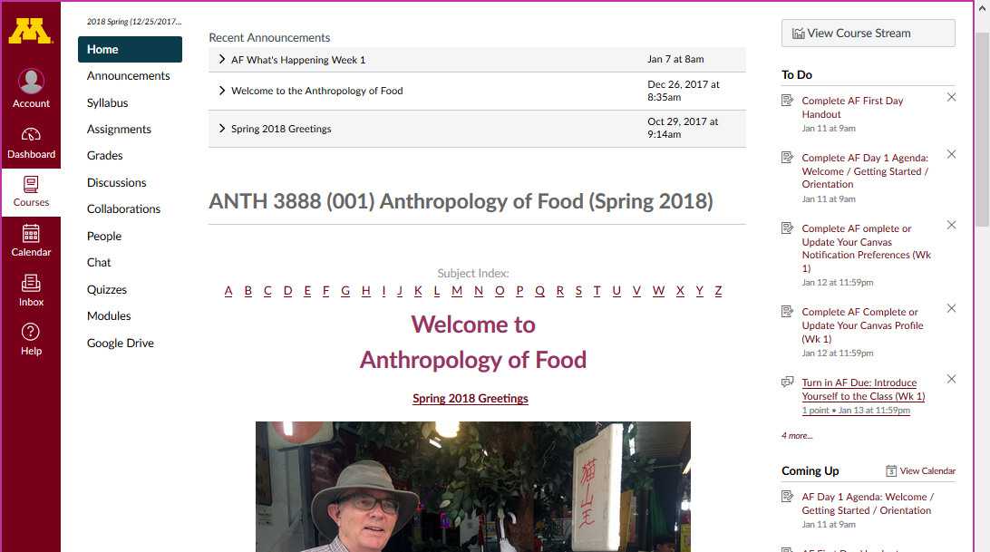
Weekly Memos are available here . . .
and you will receive one via e-mail (usually on Sunday)

Slide 154
Once again . . .
Welcome to
Culture and Personality
Enjoy your stay!
University of Minnesota Duluth
Tim Roufs
© 2010-2018

