Slide 1
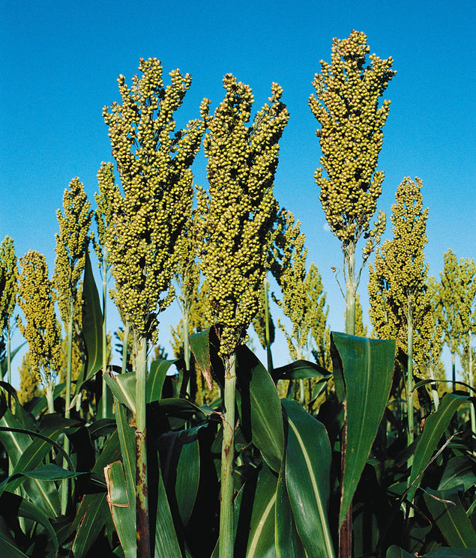
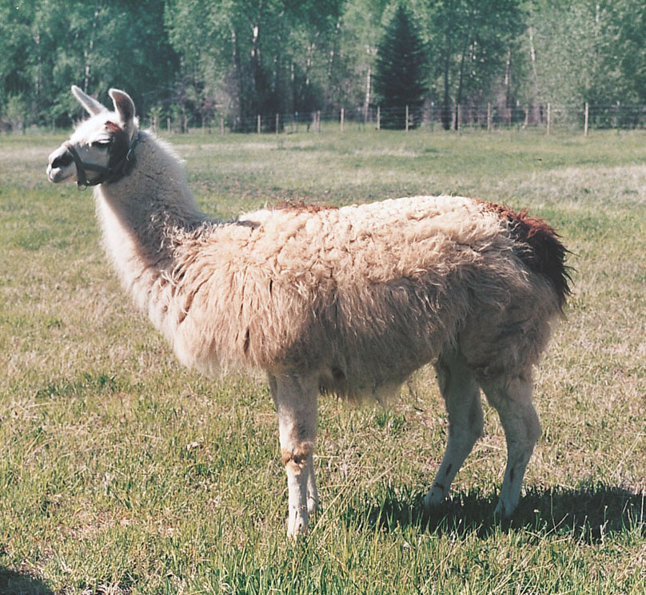
The Neolithic
Ch. 14 Food Production: A Biocultural Revolution
Understanding Humans,10th Ed., pp. 366 and 361
University of Minnesota Duluth
Tim Roufs’ ©2009-2012

Slide 2
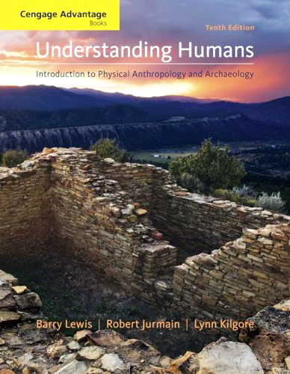
. . . or how to make sense out of Ch. 14 of the text . . .

Slide 3
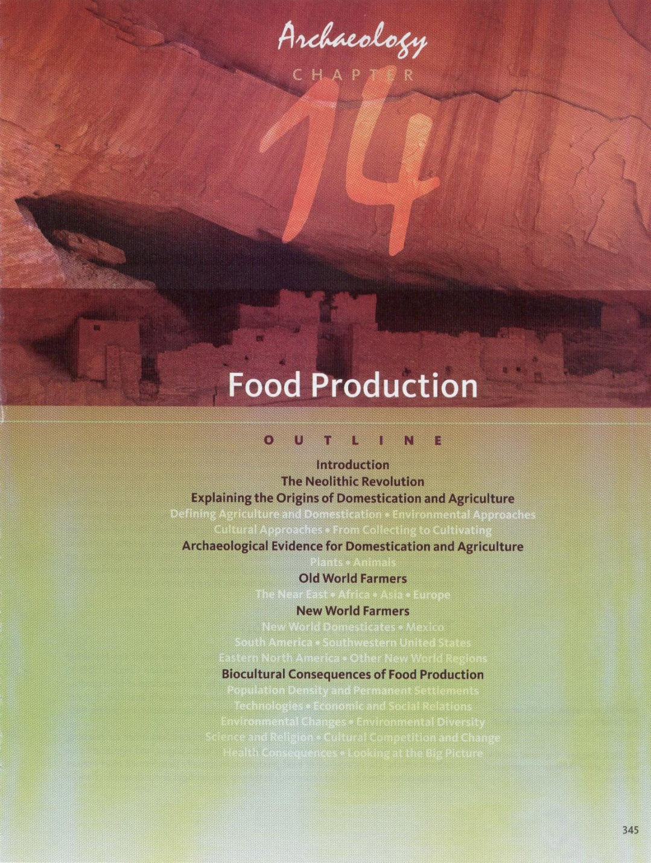

Slide 4
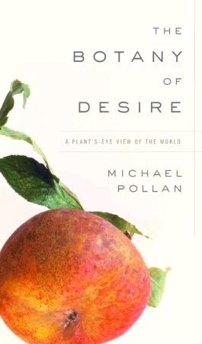
www.randomhouse.com/catalog/display.pperl?isbn=9781588360083

Slide 5
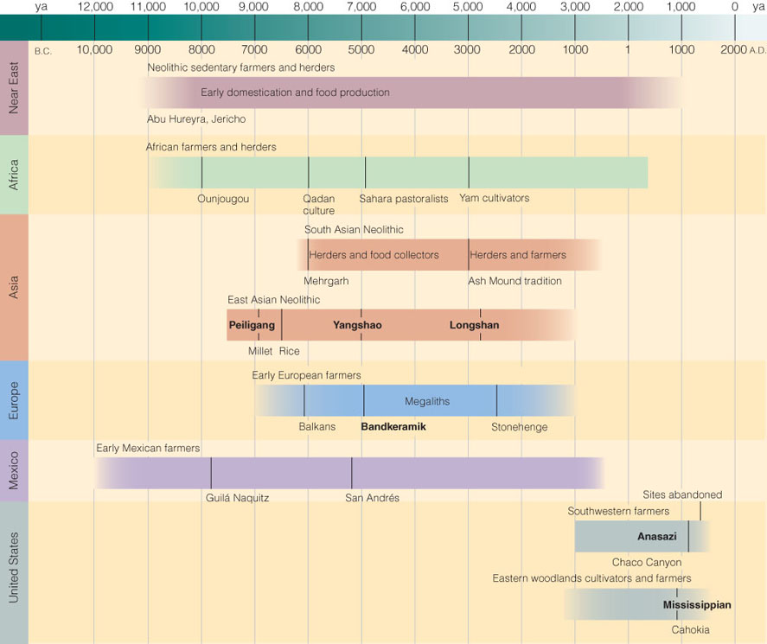
Chapter 14 Food Production:
A Biocultural Revolution
Time line for Ch.14 "Food Production”
Understanding Humans,10th Ed., p. 347

Slide 6
Neolithic
Time line for Ch.14 "Food Production”
Understanding Humans,10th Ed., p. 347

Slide 7
Chapter 15 The First Civilizations:
Old World Civilizations
Chapter 15 The First Civilizations:
Old World Civilizations
Time line for Ch.14 "Food Production”
Understanding Humans,10th Ed., p. 347

Slide 8
Chapter 15 The First Civilizations:
New World Civilizations
Time line for Ch.14 "Food Production”
Understanding Humans,10th Ed., p. 347

Slide 9
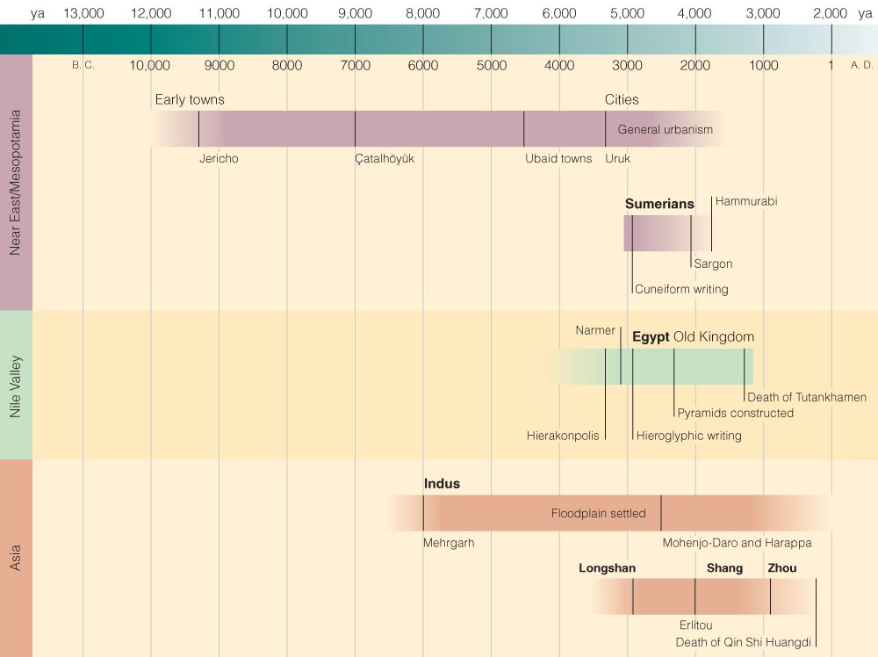
Neolithic
Time line for Ch.15 “Old World Civilizations”
Understanding Humans,10th Ed., p. 397

Slide 10
Chapter 15 The First Civilizations:
Old World Civilizations
Time line for Ch.15 “Old World Civilizations”
Understanding Humans,10th Ed., p. 397

Slide 11
Chapter 15 The First Civilizations:
New World Civilizations
Time line for Ch.14 "Food Production”
Understanding Humans,10th Ed., p. 347

Slide 12
Ch. 14 Food Production: A Biocultural Revolution
The Neolithic Revolution
neo, meaning "new”
lith, meaning "stone“
“New Stone Age”
period of farmers

Slide 13
The Three Great Ages
of Prehistoric Time
3. Iron Age
2. Bronze Age
1. Stone Age
Jurgensen Thomsen, 1807

Slide 14
The Three Great Ages
of Prehistoric Time
3. Iron Age
2. Bronze Age
1. Stone Age
Jurgensen Thomsen, 1807

Slide 15
“Stone Age”
Neolithic
“The New Stone Age”
Mesolithic
“The Middle Stone Age”
Paleolithic
“The Old Stone Age”

Slide 16
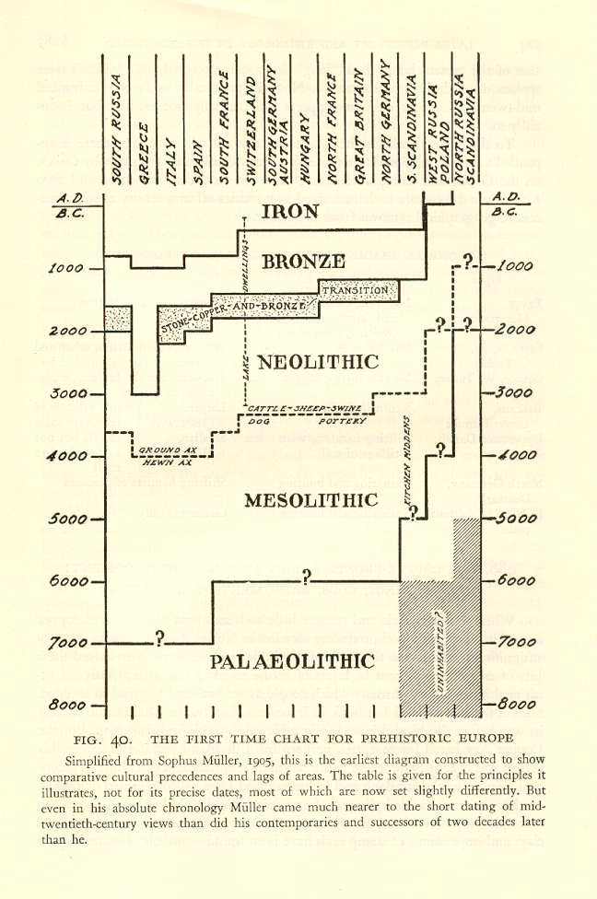
The First
Time Chart
for
Prehistoric
Europe
After
Sophus Müller,
1905
Alfred Louis Kroeber,
Anthropology.
NY: Harcourt,
Brace & World, 1948,
p. 703.

Slide 17
Paleolithic
“The Old Stone Age”

Slide 18
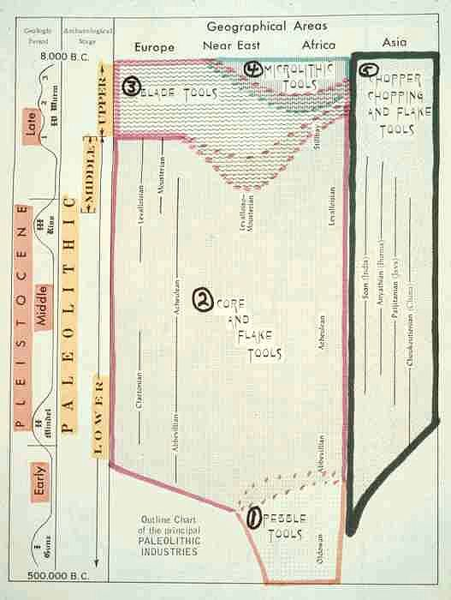
Paleolithic
“The Old Stone Age”

Slide 19
The First
Time Chart
for
Prehistoric
Europe
After
Sophus Müller,
1905
Alfred Louis Kroeber,
Anthropology.
NY: Harcourt,
Brace & World, 1948,
p. 703

Slide 20
Mesolithic
“The Middle Stone Age”
22 November 2002

Slide 21
Mesolithic
“The Middle Stone Age”

Slide 22
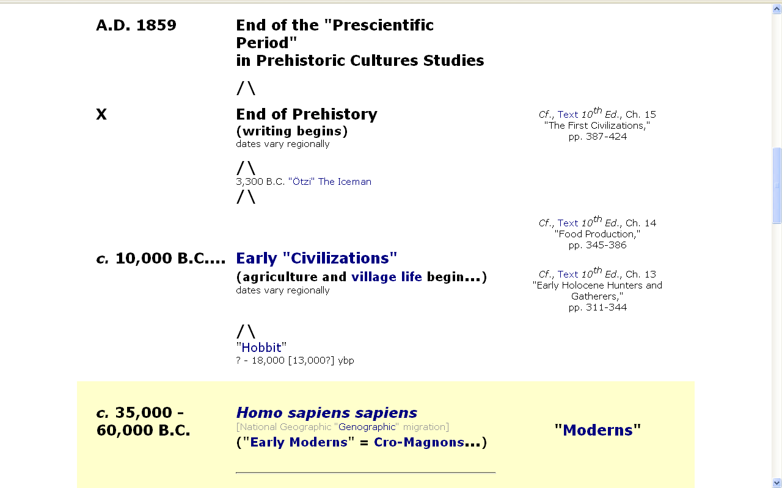
ca. 9,500 BP
in Europe, but
varies with
each geographic
region
The Mesolithic

Slide 23
Mesolithic
“The Middle Stone Age”
Post-Paleolithic period of intensive foraging and experimentation with new food resources
Post-Pleistocene (since ca. 8,000 B.C.), but before the local appearance of domesticated plants and animals

Slide 24
The First
Time Chart
for
Prehistoric
Europe
After
Sophus Müller,
1905
Alfred Louis Kroeber,
Anthropology.
NY: Harcourt,
Brace & World, 1948,
p. 703

Slide 25
Neolithic
“The Middle Stone Age”

Slide 26
Neolithic
“The New Stone Age”
the first era of village farmers in any region
stage marked by the appearance of ground stone tools and/or the domestication of plants and animals

Slide 27
The Neolithic

Slide 28
In many parts of the world
prehistoric times become historic times
– with the appearance of writing
Major area focus shifts to looking at
various regions of the world
for example, instead of focusing on Africa
anthropologists look at individual sites
and regions
e.g., Mesoamerica and Tehuacán, Mexico

Slide 29
In many parts of the world
prehistoric times become historic times
– with the appearance of writing
Major area focus shifts to looking at
various regions of the world
for example, instead of focusing on Africa
anthropologists look at individual sites
and regions
e.g., Mesoamerica and Tehuacán, Mexico

Slide 30
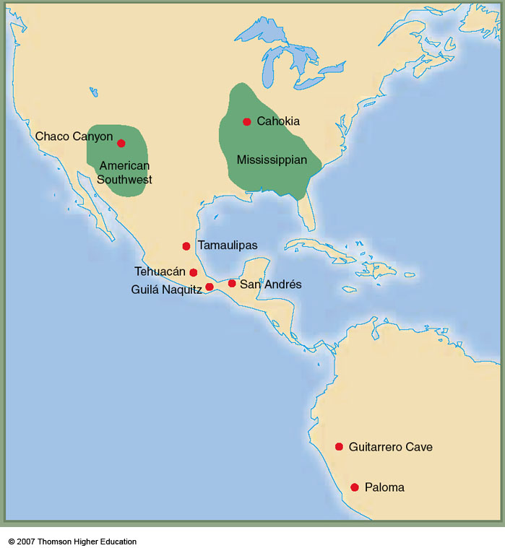
Tehuacán
Early farming in the Americas
Understanding Humans,10th Ed., p. 374

Slide 31
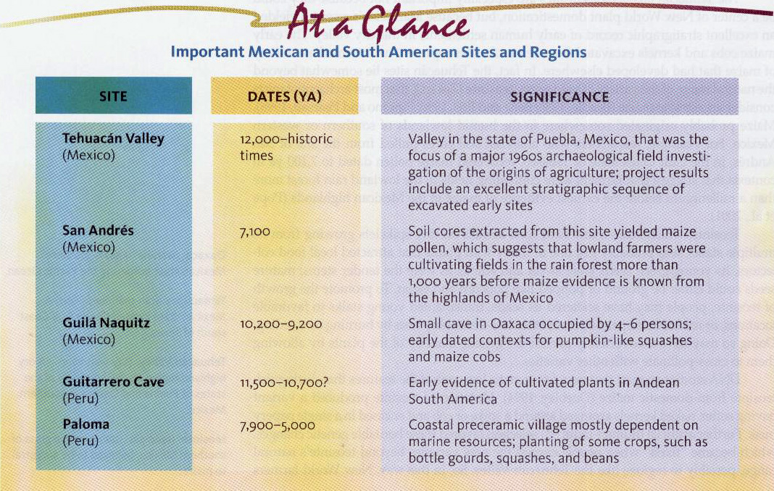
Important Mexican and South American Sites and Regions
Understanding Humans,10th Ed., p. 374

Slide 32
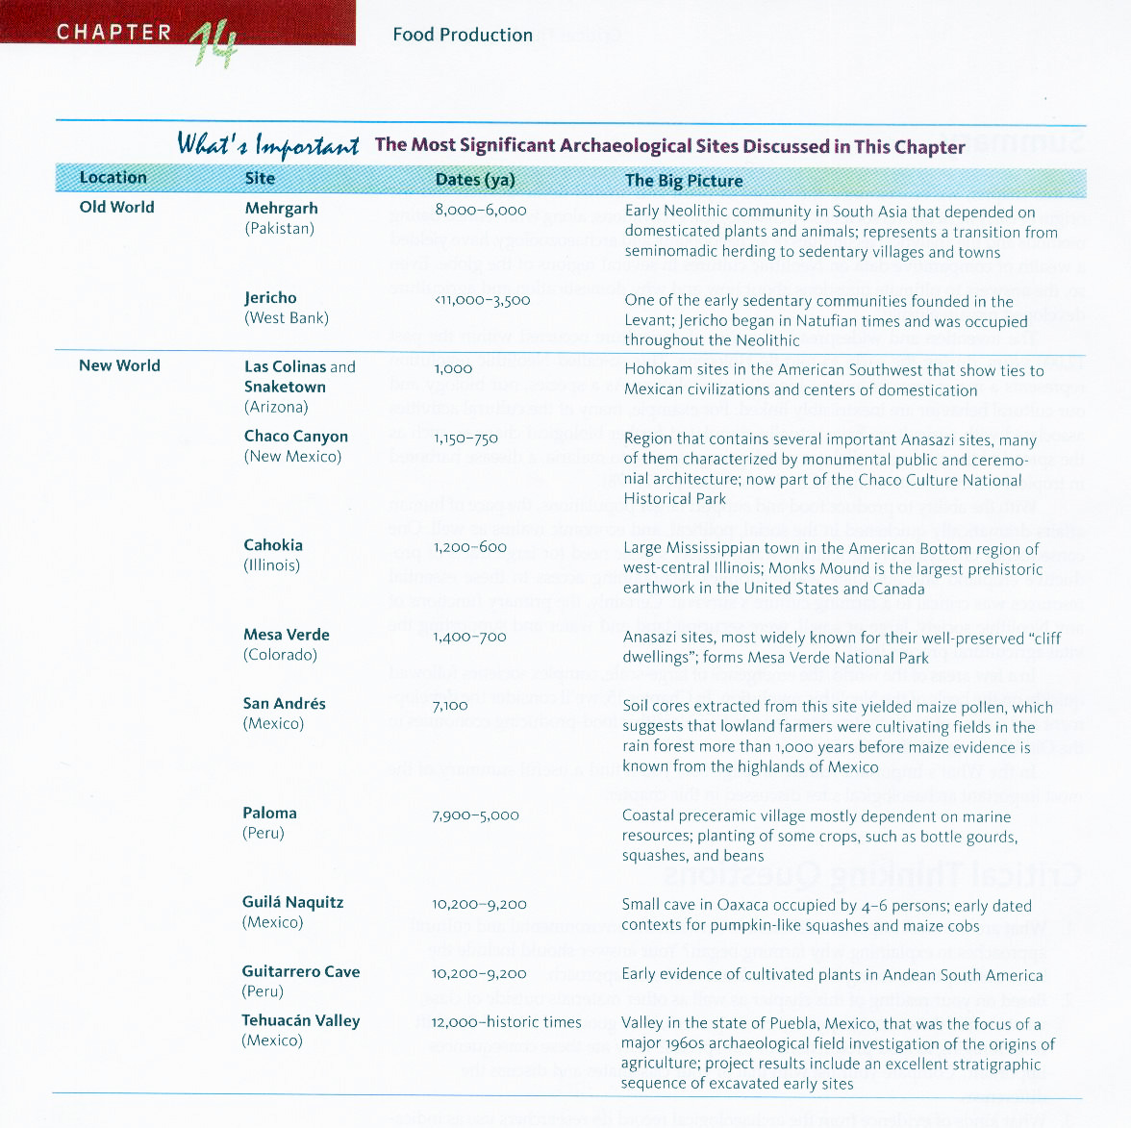
The Most Significant Archaeological Sites Discussed in Ch. 14
Understanding Humans,10th Ed., p. 386

Slide 33
The Most Significant Archaeological Sites Discussed in Ch. 14
Mehrgarth
(Pakistan)
Jericho
(West Bank)
Chaco Canyon
(New Mexico)
Cahokia
(Illinois)
Mesa Verde
(Colorado)
Tehuacán Valley
(Mexico)
Understanding Humans,10th Ed., p. 386

Slide 34
Time line for Ch.14 "Food Production”
Understanding Humans,10th Ed., p. 347

Slide 35
“Neolithic Revolution” V. Gordon Childe's term for the far-reaching
consequences of food production
Time line for Ch.14 "Food Production”
Understanding Humans,10th Ed., p. 347

Slide 36
Chapter 15 The First Civilizations:
Old World Civilizations
Time line for Ch.15 “Old World Civilizations”
Understanding Humans,10th Ed., p. 397

Slide 37
Ten Classic Characteristics
of
Early Civilization
After V. Gordon Childe
Man Makes Himself (Rev. Ed).
NY: New American Library, 1951
What Happened in History.
Baltimore: Pelican Books, 1957

Slide 38
Ten Classic Characteristics
of
Early Civilization
After V. Gordon Childe
Man Makes Himself (Rev. Ed).
NY: New American Library, 1951
What Happened in History.
Baltimore: Pelican Books, 1957

Slide 39
Ten Classic Characteristics
of
Early Civilization
After V. Gordon Childe
Great enlargement of an organized population
including a wider level of social integration

Slide 40
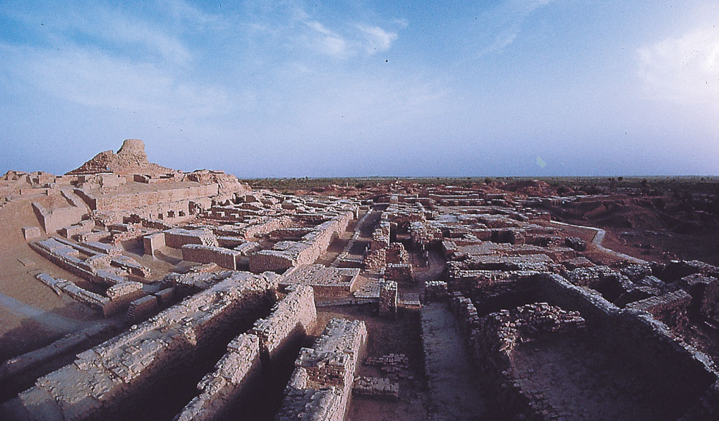
Great enlargement of an organized population
Indus Valley Civilization at Mohenjo-Daro, Pakistan
Understanding Humans,10th Ed., p. 405

Slide 41
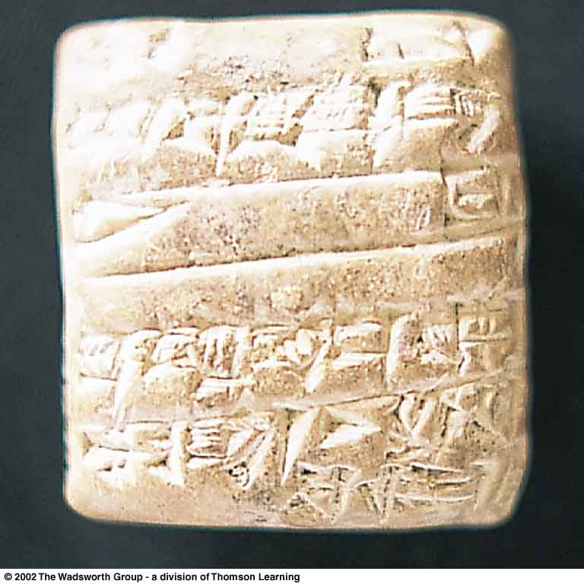
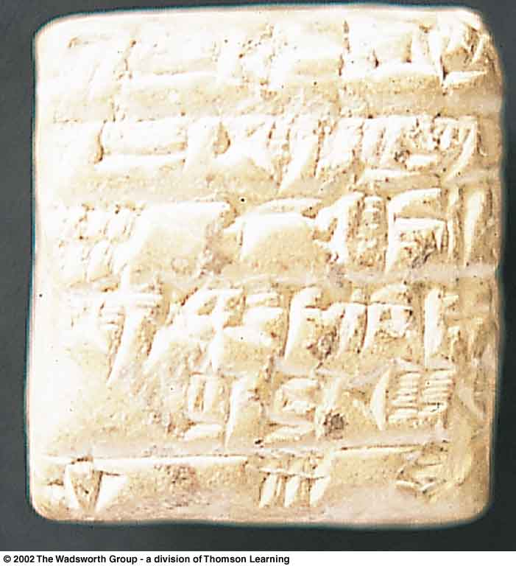
Ten Classic Characteristics of Early Civilization
Social means of collecting “surplus” production
Small Sumerian clay table is a 4,000-year-old tax receipt
with cuneiform impressions on both sides
Understanding Humans,10th Ed., p. 400

Slide 42
Ten Classic Characteristics of Early Civilization
Specialized production of goods, and development of systems of distribution and exchange of goods
economic system allows individuals to devote full time to certain occupations
“specialization”

Slide 43
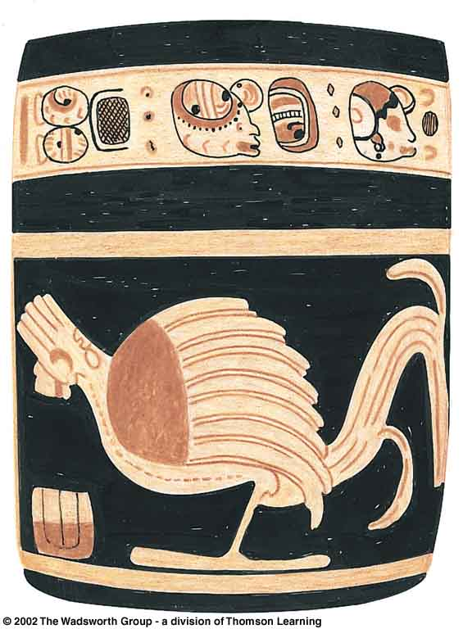
economic system allows individuals
to devote full time to occupations like . . .
pottery making
Classic Maya cylindrical jar
with bird motif and glyphs,
9th Ed., p. 411

Slide 44
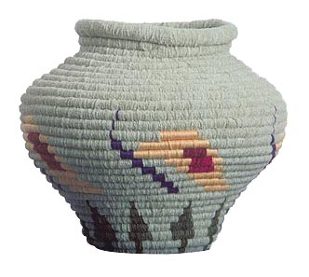
economic system allows individuals
to devote full time to occupations like . . .
basket making
Prehistoric basketry techniques
(Jean Connor)

Slide 45
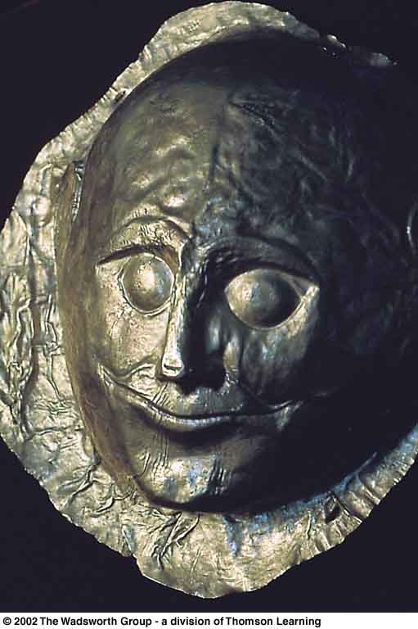
economic system allows individuals
to devote full time to occupations like . . .
metalworking
Mycenaean Royal death mask of hammered gold, 8th Ed., p. 472

Slide 46
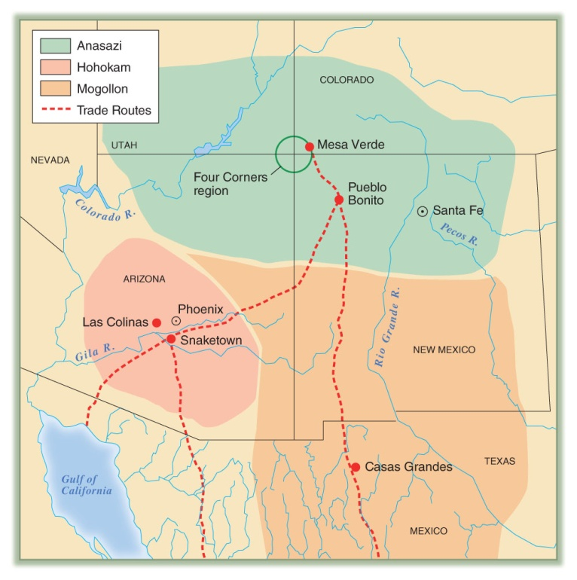
Ten Classic Characteristics of Early Civilization
Specialization and exchange expanded beyond the city
far-reaching trade developed
Trade routes (in red) of
village farming cultures
of the American Southwest,
10th Ed., p. 375

Slide 47
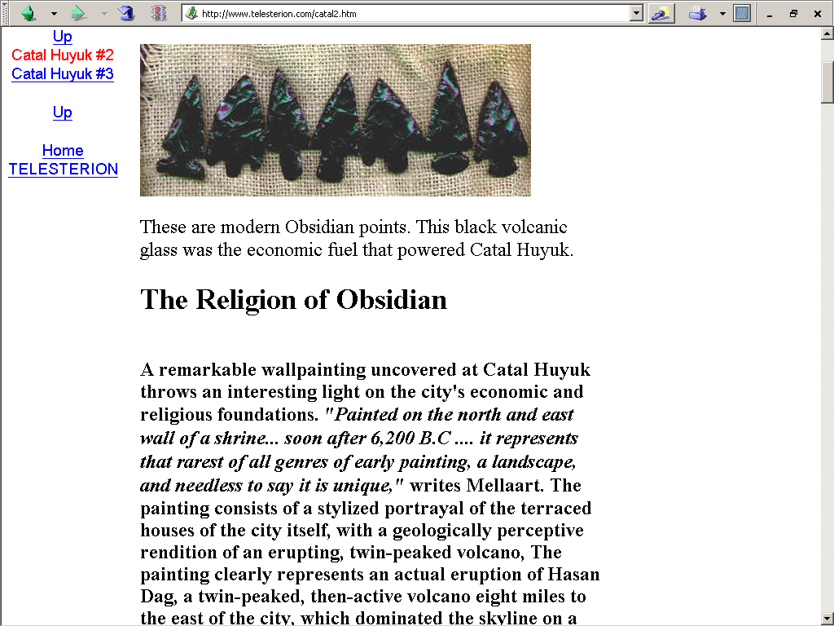
www.telesterion.com/catal2.htm

Slide 48
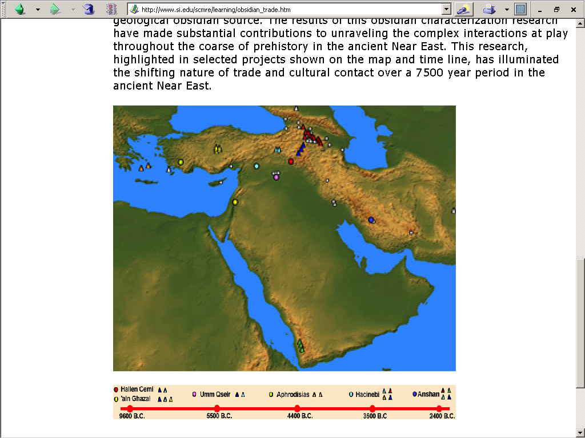
www.si.edu/scmre/learning/obsidian_trade.htm

Slide 49
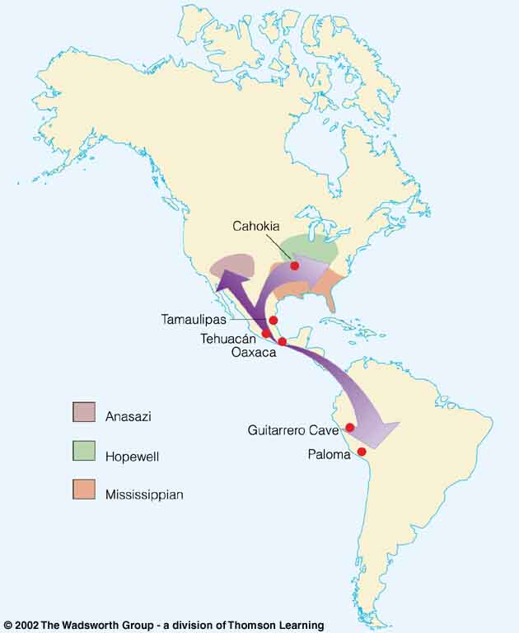
diffusion
the spread of something from one group to another through contact or exchange
Early farming
in the Americas,
showing the spread
of maize agriculture
(purple).
Understanding Physical Anthropology and Archaeology, cf. 9th Ed., p. 358

Slide 50
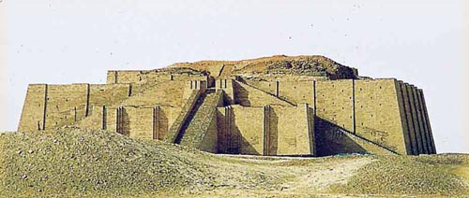
Ten Classic Characteristics of Early Civilization
Construction of monumental public works
Reconstructed lower stage of the late Sumerian ziggurat at Ur, Iraq
Understanding Humans,10th Ed., p. 400

Slide 51
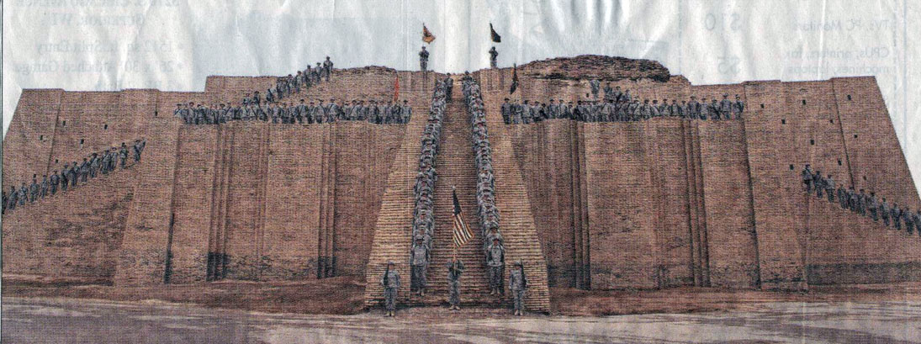
SPC. Deb Fideldy for the News Tribune
Duluth News Tribune, Sunday, 03 December 2006, p. A7

Slide 52
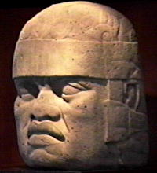
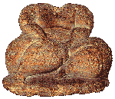
Ten Classic Characteristics of Early Civilization
Highly developed art forms begin
people symbolically identify with art forms
Mother Goddess Hagar Qim, Malta
Olmec Head, La Venta, Mexico
10th Ed., p. 411

Slide 53
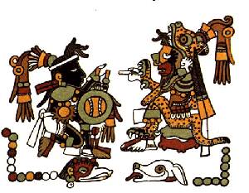
Ten Classic Characteristics of Early Civilization
Writing develops
initially to facilitate state organization and management
Sumerian tax receipt 10th Ed., p. 400
Mixtec Codex, Mitla, Mexico

Slide 54
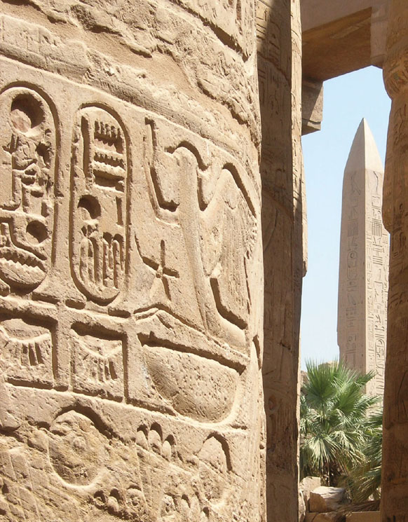
Ten Classic Characteristics of Early Civilization
Writing develops
Egyptian hieroglyphic inscriptions on a pillar in the Karnak Temple complex at Thebes (modern Luxor)
Understanding Humans,10th Ed., p. 404

Slide 55
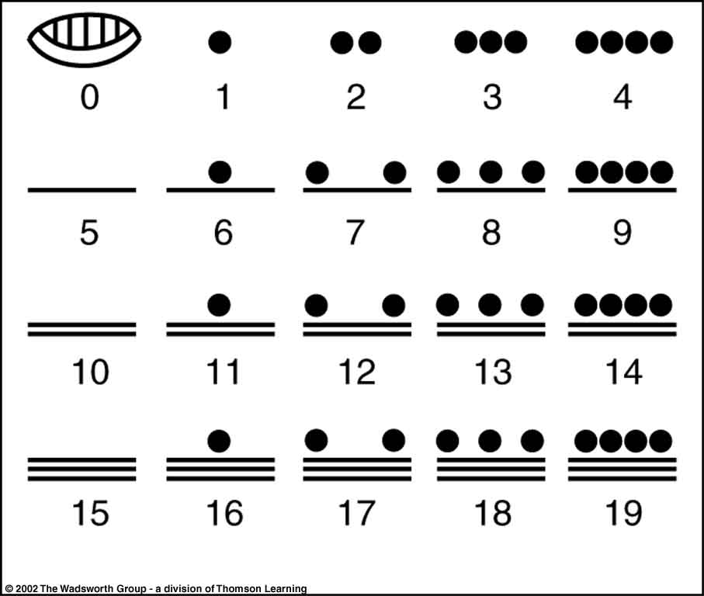
Ten Classic Characteristics of Early Civilization
Arithmetic, geometry and astronomy develop as rational thinking techniques
Mayan Mathematics 9th Ed., p. 412

Slide 56
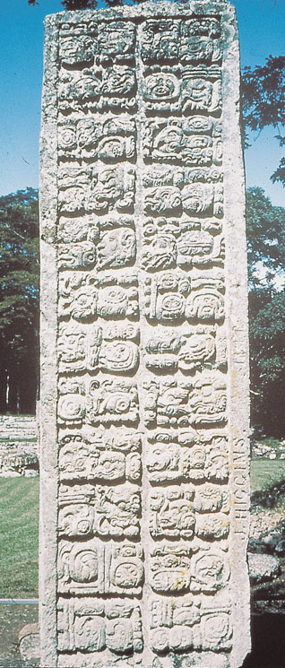
Ten Classic Characteristics of Early Civilization
Arithmetic, geometry and astronomy develop as rational thinking techniques
Understanding Humans,10th Ed., p. 415

Slide 57
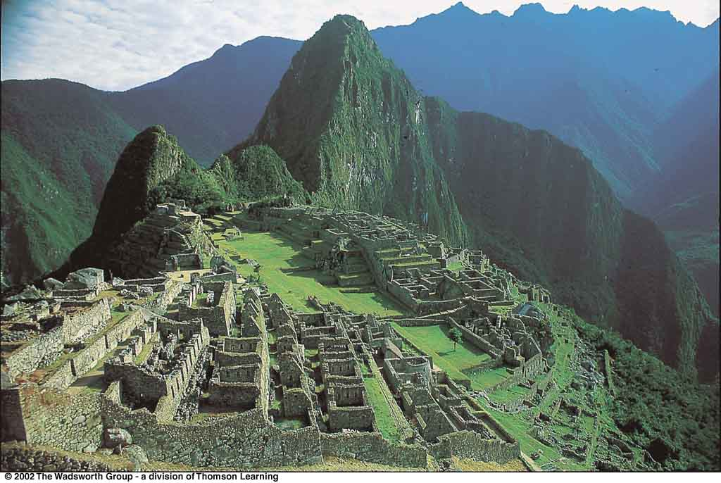
Ten Classic Characteristics of Early Civilization
Well-structured political organization, with membership based on residence, replaces political identification based on kinship
Machu Picchu, Peru 9th Ed., p. 425

Slide 58
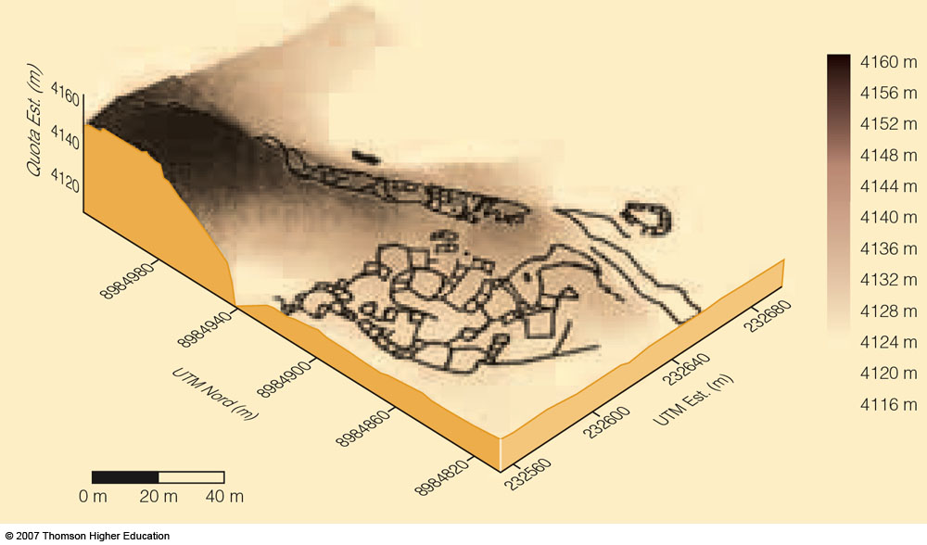
The use of GPS technology in the Peruvian Andes
Enabled archaeologists to construct a digital model of the local terrain,
On which they could drape a measured plan of the site of Huacramarca for interpretation
Understanding Physical Anthropology and Archaeology, 9th Ed., p. 372

Slide 59
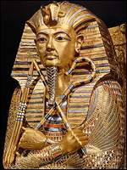
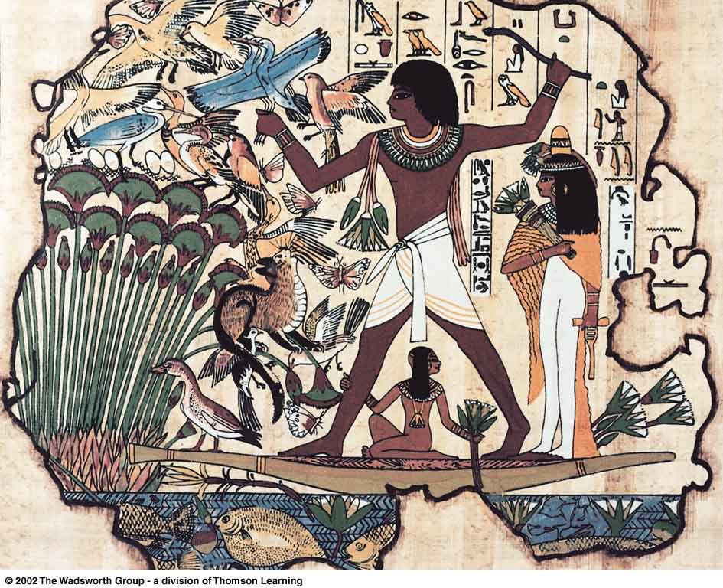
Ten Classic Characteristics of Early Civilization
A privileged ruling class of religious, political, and military leaders organizes and directs the entire system
Hieroglyphic inscription of a royal Egyptian hunting marsh birds from a papyrus boat,
9th ed. p. 393
King Tut

Slide 60
Ten Classic Characteristics
of
Early Civilization
criticisms
A. “. . . Childe’s recitation of material cultural inventions and equipment somehow failed to capture this central reality: A civilization is more than the sum of its parts.”

Slide 61
Ten Classic Characteristics
of
Early Civilization
functionalists
structuralists
configurationalists

Slide 62
Ten Classic Characteristics
of
Early Civilization
B. “. . . Childe’s trait list was not universally applicable. Though characterizing the Near-Eastern civilizations with which he was most familiar, it did not describe American Indian societies such as the Maya and the Inka, which were clearly civilizations, but had no use of sailing boats, animal traction, wheeled carts, and so on.”

Slide 63
Ten Classic Characteristics
of
Early Civilization
B. “. . . Childe’s trait list was not universally applicable. Though characterizing the Near-Eastern civilizations with which he was most familiar, it did not describe American Indian societies such as the Maya and the Inka, which were clearly civilizations, but had no use of sailing boats, animal traction, wheeled carts, and so on.”

Slide 64
Neolithic Revolution
Consequences of Neolithic activities
new settlement patterns
new technologies
profound biocultural effects

Slide 65
Ch. 14 Food Production: A Biocultural Revolution
Why and how did domestication and agriculture occur ?

Slide 66
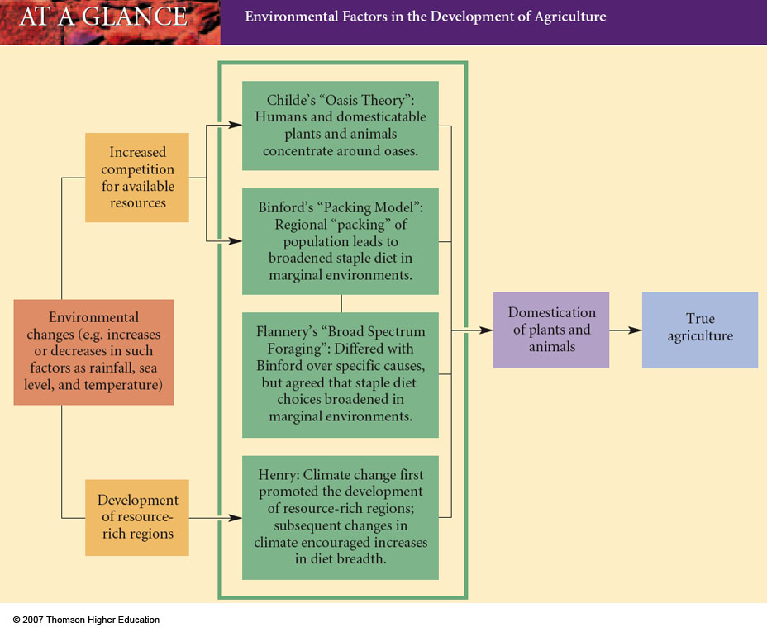
Environmental Factors in the Development of Agriculture
Understanding Humans,10th Ed., p. 352

Slide 67
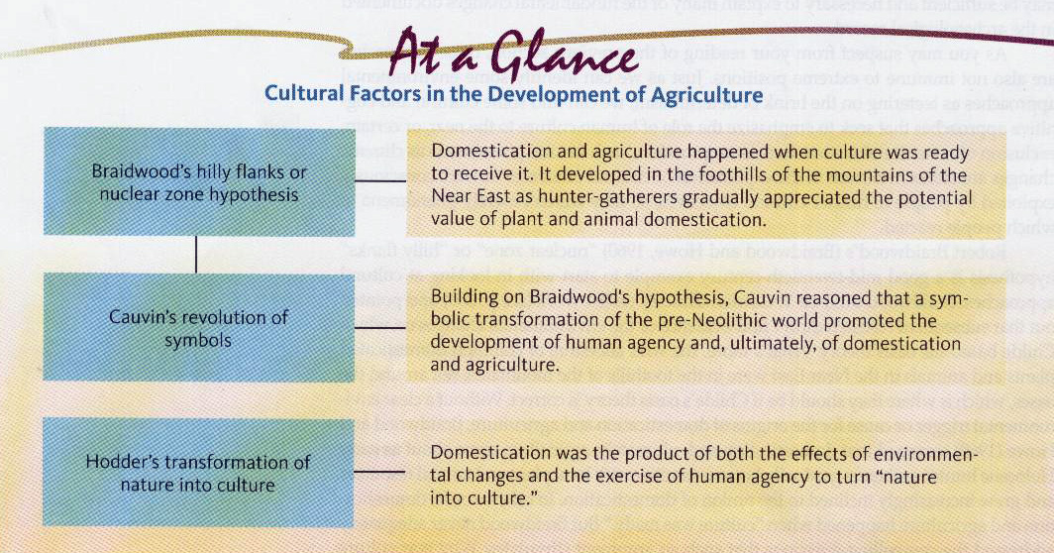
Environmental Factors in the Development of Agriculture
Understanding Humans,10th Ed., p. 354

Slide 68
Domestication and Agriculture
agriculture
the propagation and exploitation of domesticated plants and/or animals by humans

Slide 69
Domestication and Agriculture
agriculture
a cultural activity
a cultural activity associated with planting, herding, and processing domesticated species

Slide 70
Class Slides Set 32
The Neolithic
Ch. 14 Food Production: A Biocultural Revolution
Understanding Humans,10th Ed., pp. 366 and 361

Slide 71
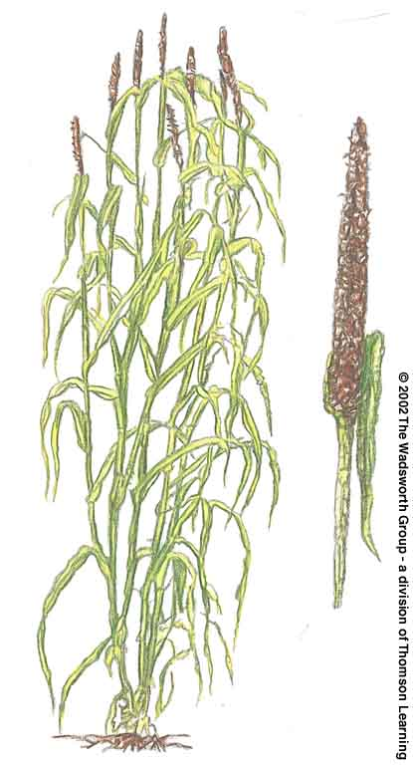
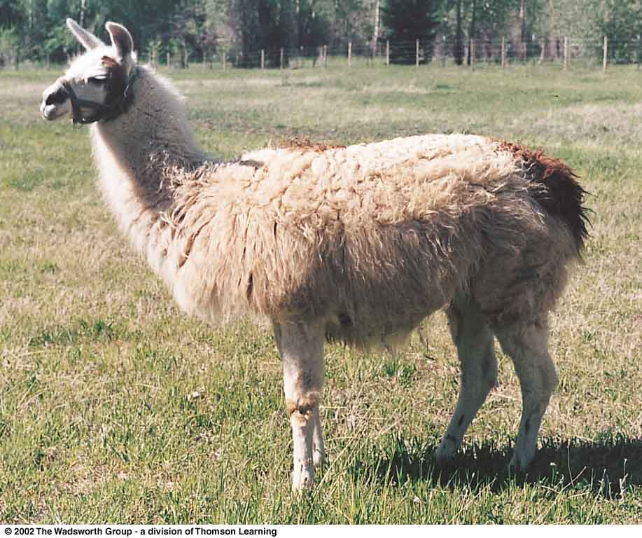
domestication
a state of interdependence between humans and selected plant or animal species
pearl millet
South American llama
Understanding Physical Anthropology and Archaeology, 8th Ed., pp. 421, 10th Ed., p. 361

Slide 72
Domestication and Agriculture
domestication
an evolutionary process that requires genetic transformation of a wild species

Slide 73
Domestication: Dogs
dogs were the first domesticated animals
first role was to help with hunting
as other animals were domesticated, dogs were used to herd, as working dogs
and possibly they acted as camp watch dogs . . .

Slide 74
Domestication: Dogs
dogs were the first domesticated animals
first role was to help with hunting
as other animals were domesticated, dogs were used to herd, as working dogs
and possibly they acted as camp watch dogs . . .

Slide 75
Domestication: Dogs
and “garbage disposals”
and as food
Dakota
Aztecs
China
formerly Germany
some parts of India
and elsewhere
the burial of a puppy with a Natufian who died 10,000 y.a. suggests dogs earned the role of pet very early

Slide 76
Domestication: Dogs
and “garbage disposals”
and as food
Dakota
Aztecs
China
formerly Germany
some parts of India
and elsewhere
the burial of a puppy with a Natufian who died 10,000 y.a. suggests dogs earned the role of pet very early

Slide 77
Reconstruction of a Natufian gazelle horn reaping knife,
^{with inset flint blades}
Understanding Physical Anthropology and Archaeology (9th Ed), p. 328

Slide 78
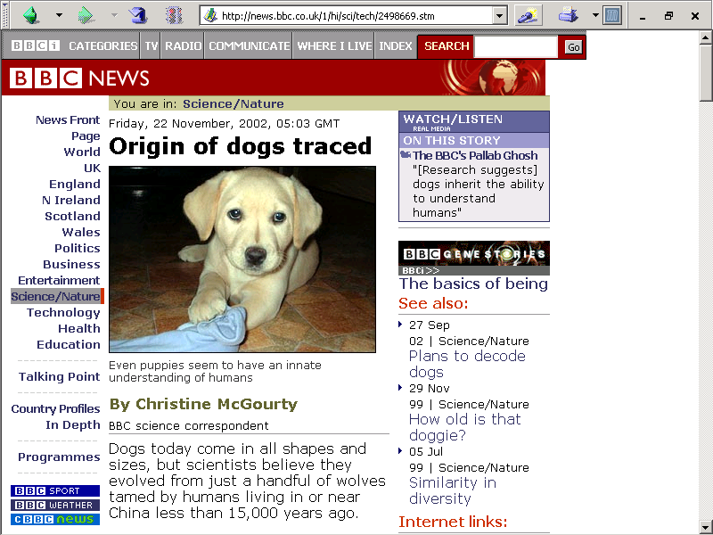
http://news.bbc.co.uk/1/hi/sci/tech/2498669.stm

Slide 79
www.msnbc.msn.com/id/30519834/
Notes:
79

Slide 80
From Collecting to Cultivating
as favorable plant traits developed, foragers would collect more of the plants with the favorable traits
this stimulated genetic changes in the plants and eventually produced a cultigen

Slide 81
From Collecting to Cultivating
as favorable plant traits developed, foragers would collect more of the plants with the favorable traits
this stimulated genetic changes in the plants and eventually produced a cultigen

Slide 82
cultigen
a plant that is wholly dependent on humans
a domesticate
cultivars
wild plants fostered by human efforts to make them more productive

Slide 83
cultigen
a plant that is wholly dependent on humans
a domesticate
cultivars
wild plants fostered by human efforts to make them more productive

Slide 84
From Collecting to Cultivating
as favorable plant traits developed, foragers would collect more of them
stimulated genetic changes in the plants and eventually produced a cultigen
as selection and isolation from other plants continued, plants became dependent on humans to disperse seeds

Slide 85
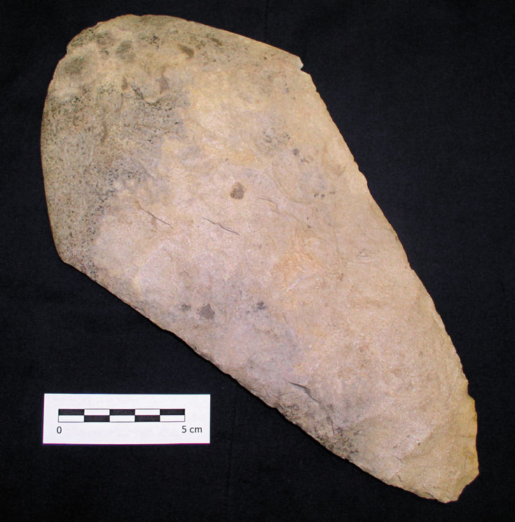
horticulture
farming method in which only
hand tools are used
typical of most early
Neolithic societies
flint hoe blade
Understanding Humans,10th Ed., p. 378

Slide 86
horticulture
farming method in which only
hand tools are used
typical of most early
Neolithic societies
flint hoe blade
Understanding Humans,10th Ed., p. 378

Slide 87
The Evidence
Ch. 14 Food Production: A Biocultural Revolution
Archaeological Evidence for Domestication and Agriculture

Slide 88
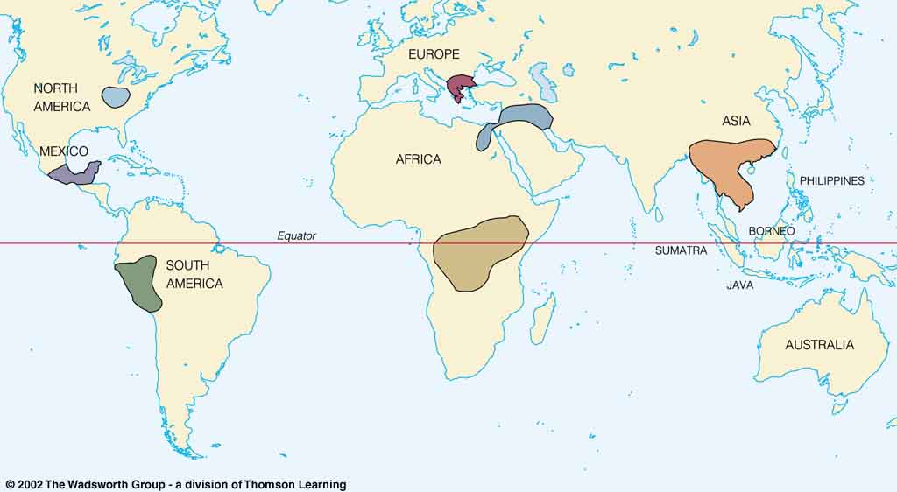
Origin of Domestication for Selected Plants
wheat
10,500 ybp
rice
7,000 ybp
maize
4,500 ybp
millet
4,000 ybp
manioc
4,200 ybp
Understanding Physical Anthropology and Archaeology, 8th Ed., p. 417

Slide 89
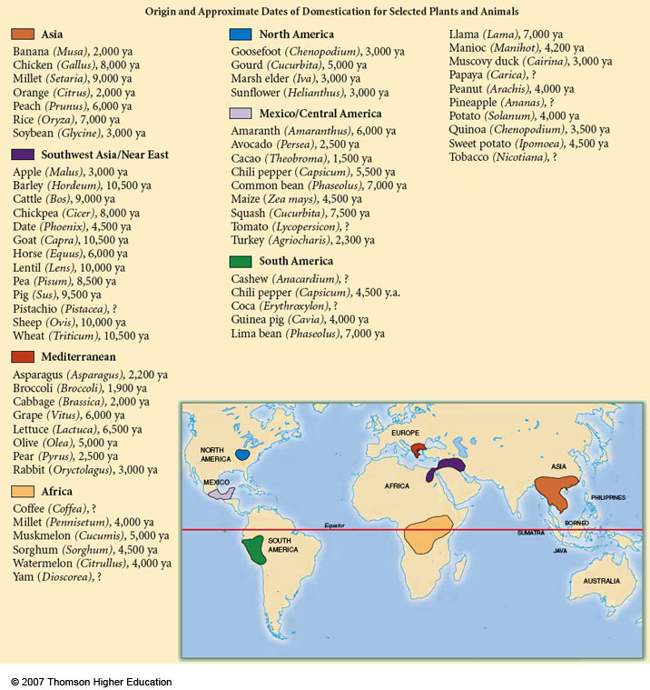
Origin and Approximate Dates of Domestication for Selected Plants and Animals
Understanding Physical Anthropology and Archaeology, 9th Ed., p. 417

Slide 90
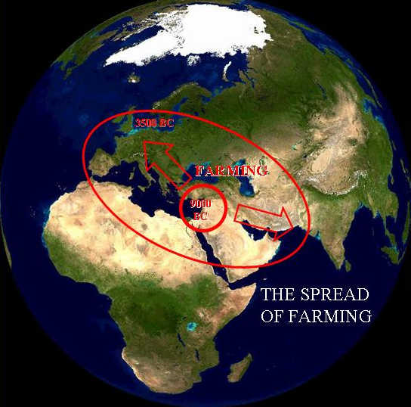
“A dialectical model of Neolithic Origins”
www.archatlas.dept.shef.ac.uk/OriginsFarming/Farming.php

Slide 91
The Evidence
Ch. 14 Food Production: A Biocultural Revolution
Archaeological Evidence for Domestication and Agriculture
excellent example: Tehuacán, Puebla, Mexico

Slide 92
Tehuacán
Valley,
Puebla,
Mexico
maize
4,500 ybp
Early farming in the Americas
Understanding Humans,10th Ed., p. 374

Slide 93
Important Mexican and South American Sites and Regions
Understanding Humans,10th Ed., p. 374

Slide 94
The Most Significant Archaeological Sites Discussed in Ch. 14
Tehuacán Valley
(Mexico)
Understanding Humans,10th Ed., p. 386

Slide 95
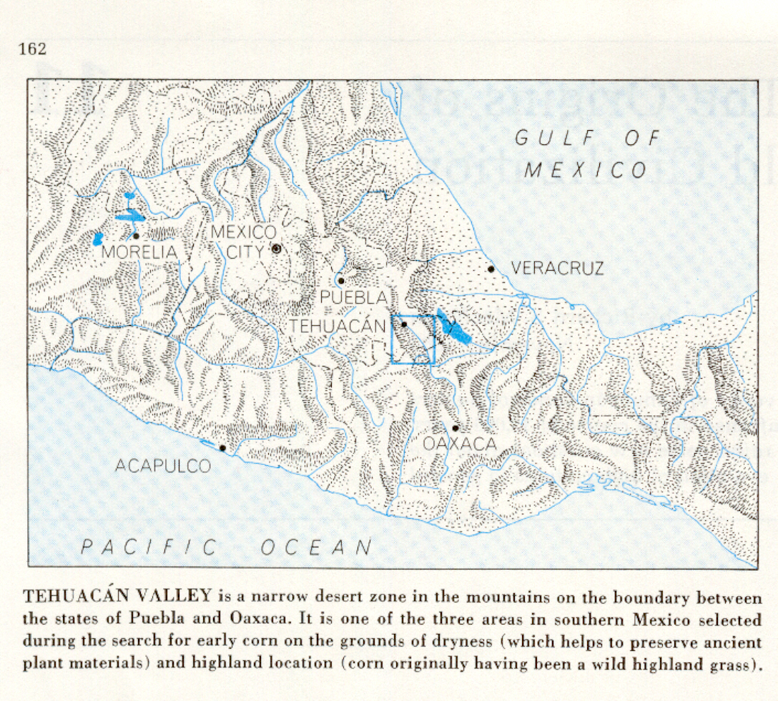
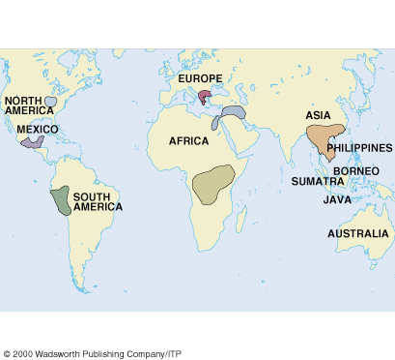
Richard S. Mac Neish, Scientific American, 1964.
Understanding Physical Anthropology and Archaeology (8th ed), p. 417.

Slide 96
Richard S. Mac Neish, Scientific American, 1964
Understanding Physical Anthropology and Archaeology (8th Ed), p. 417

Slide 97
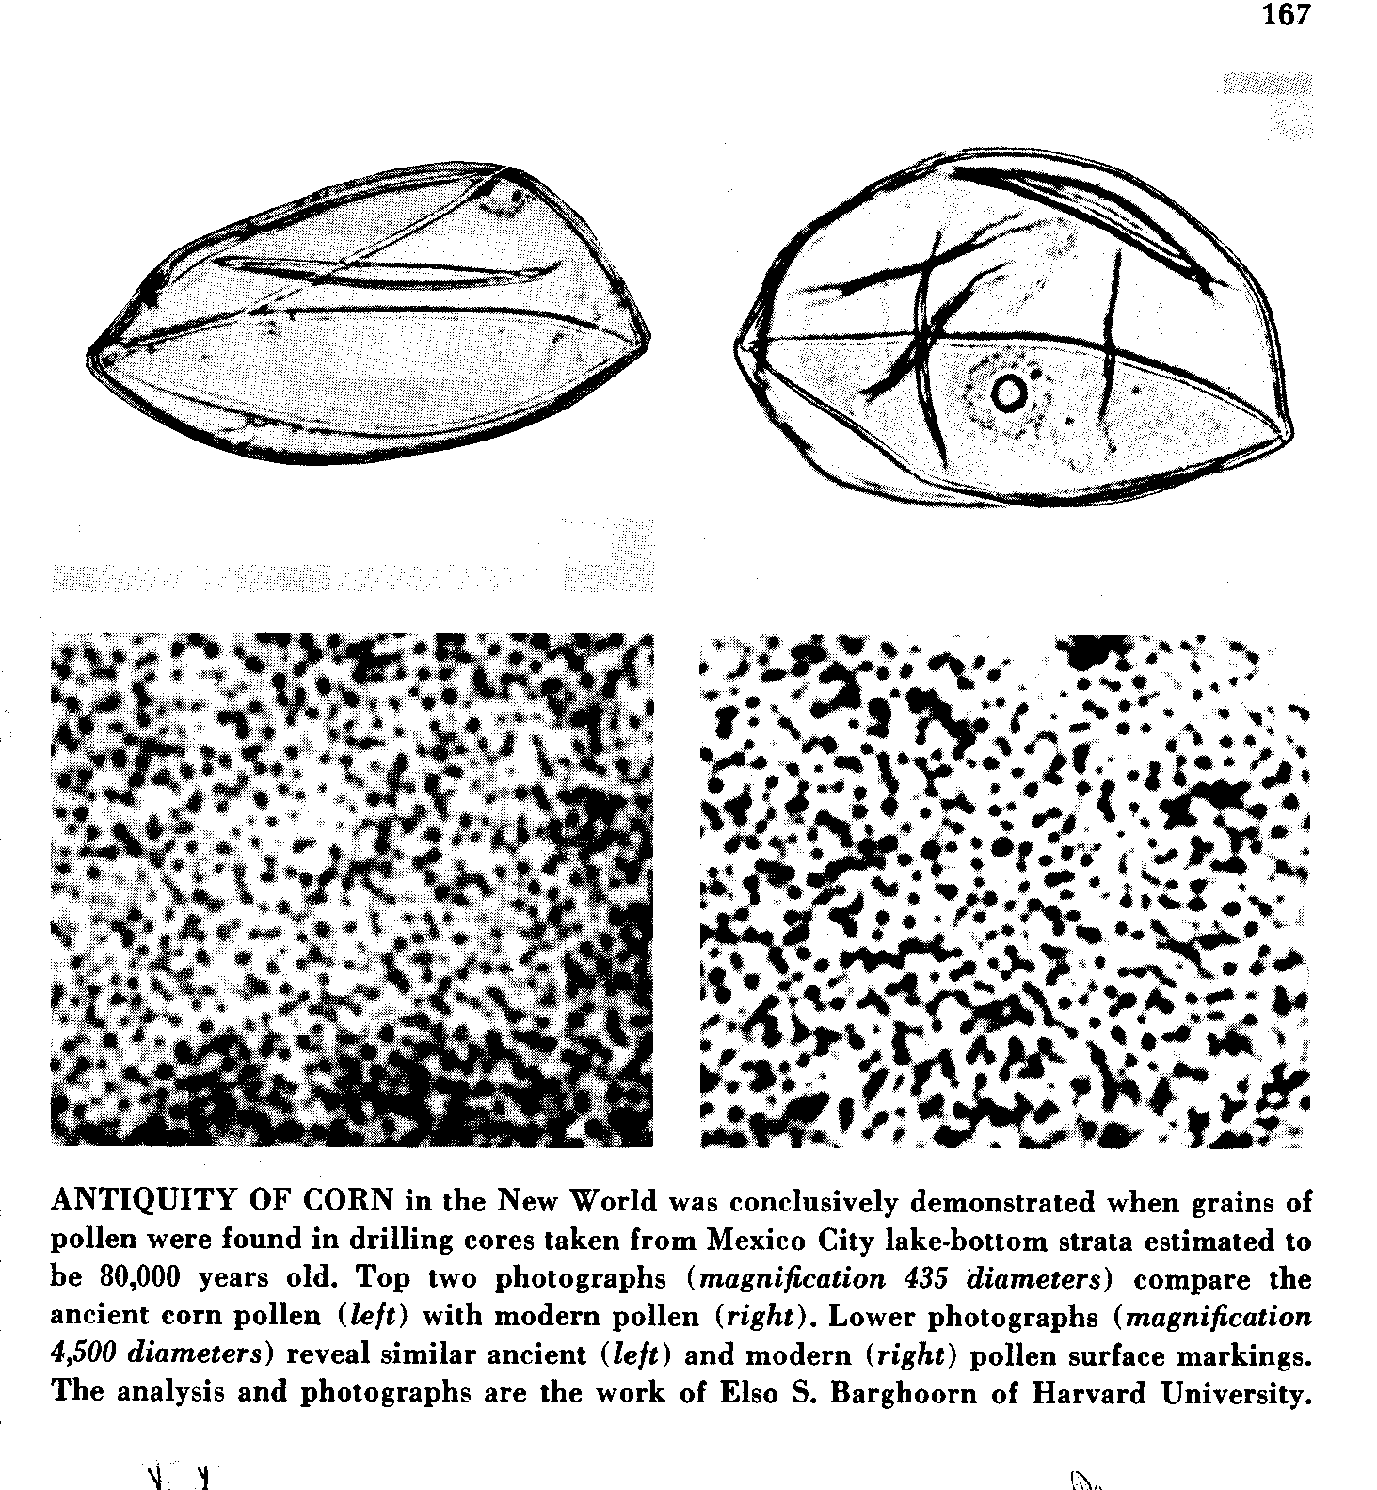
Pollen
microscopic
male gametes
produced by
flowering
plants.
Richard S. Maac Neish, Scientific American, 1964

Slide 98
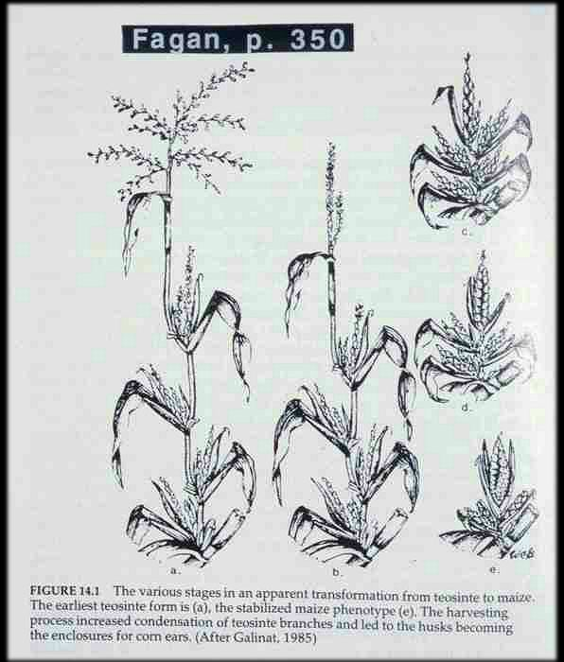

Slide 99
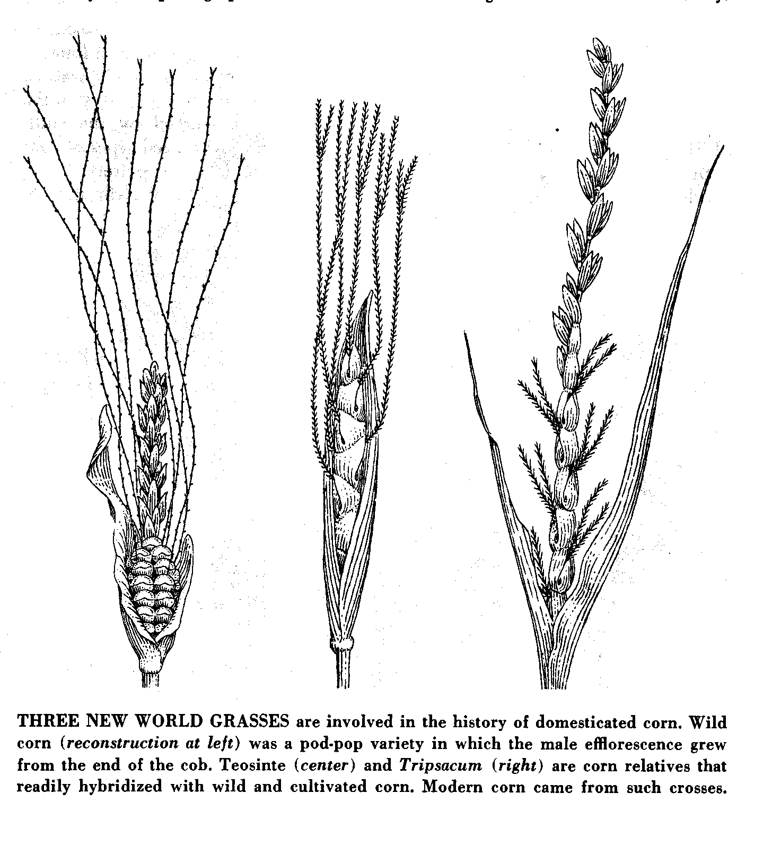
Wild corn
Teosinte
Tripsacum
wild
pod-pop variety
Richard S. Mac Neish, Scientific American, 1964

Slide 100
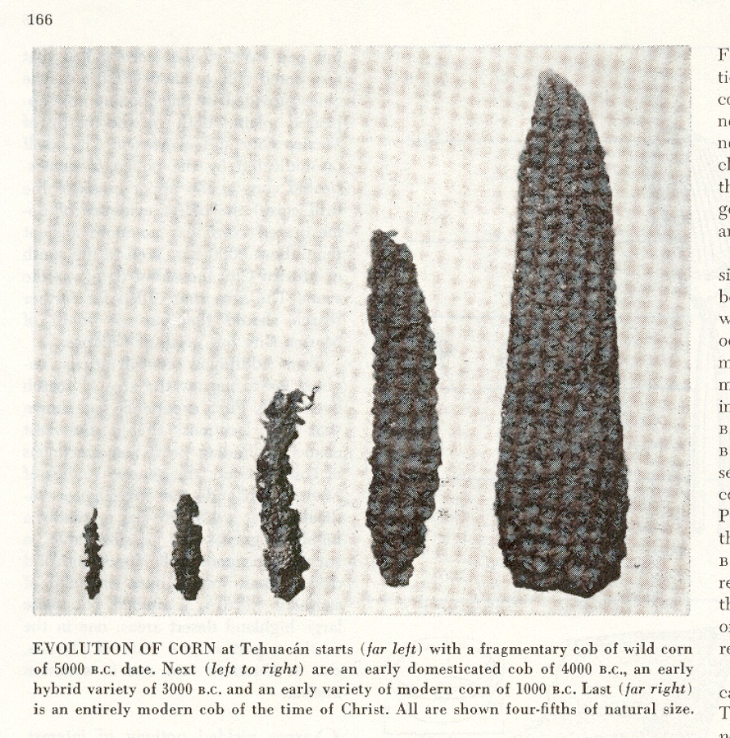
A.D. 0
1,000 B.C.
3,000 B.C.
5,000 B.C.
4,000 B.C.
Richard S. Mac Neish, Scientific American, 1964

Slide 101
= 100%
= 100%
= 100%
“seriation”
Richard S. Mac Neish, Scientific American, 1964

Slide 102
Richard S. Mac Neish, Scientific American, 1964

Slide 103
Richard S. Mac Neish, Scientific American, 1964

Slide 104
Richard S. Mac Neish, Scientific American, 1964

Slide 105
Richard S. Mac Neish, Scientific American, 1964

Slide 106
Richard S. Mac Neish, Scientific American, 1964

Slide 109
What Archaeologists can
Learn from Dead Plants
(Archaeobotany)
Plant remains
from a pit feature
in an Illinois
archaeological site.
Clockwise from
the top are
pieces of charred wood,
nutshell fragments,
and seeds.
Understanding Humans,10th Ed., p. 358

Slide 110
What Archaeologists can
Learn from Dead Plants
(Archaeobotany)
Pollen grains
from common
flowering plants.
75 µm
(micrometers)
0.003 in.
Understanding Humans,10th Ed., p. 359

Slide 111
What Archaeologists can
Learn from Dead Plants
(Archaeobotany)
Squash phytoliths
120 µm
(micrometers)
Understanding Humans,10th Ed., p. 359

Slide 112
What Archaeologists can
Learn from Dead Plants
(Archaeobotany)
carbonized grain of
domesticated barley
from the Nile valley
Understanding Physical Anthropology and Archaeology, 8th Ed., p. 419

Slide 113
Early farming in the Americas, showing
the spread of maize agriculture (purple)
Understanding Physical Anthropology and Archaeology, 8th Ed., p. 432

Slide 114
Tehuacán
Valley,
Puebla,
Mexico
maize
4,500 ybp
Early farming in the Americas
Understanding Humans,10th Ed., p. 374

Slide 115
Ch. 14 Food Production: A Biocultural Revolution
Other Early Farmers in the Americas
Pueblos

Slide 116
http://www.d.umn.edu/cla/faculty/troufs/anth3618/video/Collapse.html#title

Slide 117
The Most Significant Archaeological Sites Discussed in Ch. 14
Chaco Canyon
(New Mexico)
Understanding Humans,10th Ed., p. 386

Slide 118
Understanding Humans,10th Ed., p. 377

Slide 119
Village farming cultures of the American Southwest, showing trade routes (red)
Understanding Humans,10th Ed., p. 375

Slide 120
Pueblos
Spanish term for "town" referring to multiroom residence structures built by village farmers in the American Southwest
Pueblo Bonito,
Chaco Canyon,
New Mexico
Understanding Physical Anthropology and Archaeology, 9th Ed., p. 360

Slide 121
Pueblo Bonito is the largest prehistoric structure
in Chaco Canyon National Historic Park, New Mexico
Understanding Humans,10th Ed., p. 376

Slide 122
Cliff Palace was the largest of the pueblos built by Anasazi farmers living at Mesa Verde, Colorado, about 800 ya
Understanding Humans,10th Ed., p. 376

Slide 123
Chaco Canyon,
New Mexico
maize
4,500 ybp
Early farming in the Americas
Understanding Humans,10th Ed., p. 374

Slide 124
The Most Significant Archaeological Sites Discussed in Ch. 14
Chaco Canyon
(New Mexico)
Mesa Verde
(Colorado)
Understanding Humans,10th Ed., p. 386

Slide 125
Understanding Humans,10th Ed., p. 377

Slide 126
Ch. 14 Food Production: A Biocultural Revolution
Other Early Farmers in the Americas
Hopewell
Mississippian

Slide 127
Mississippian
maize
4,500 ybp
Early farming in the Americas
Understanding Humans,10th Ed., p. 374

Slide 128
Reconstructed Mississippian village huts at
Angel Mounds State Historic Site, near Evansville, Indiana
Understanding Humans,10th Ed., p. 378

Slide 129
Hopewell A culture centered in southern Ohio between 2,100 and 1,700 ybp but influencing a much wider region through trade and the spread of a cult centered on burial ritualism
Understanding Physical Anthropology and Archaeology, 9th Ed., p. 362

Slide 130
Mississippian
maize
4,500 ybp
Early farming in the Americas
Understanding Humans,10th Ed., p. 374

Slide 131
Understanding Humans,10th Ed., p. 377

Slide 132
The Most Significant Archaeological Sites Discussed in Ch. 14
Cahokia
(Illinois)
Understanding Humans,10th Ed., p. 386

Slide 133
St. Louis on Mississippi River
http://commons.wikimedia.org/wiki/Category:Maps_of_the_history_of_Hungary

Slide 134
Cahokia Mounds State Historic Site Collinsville, Illinois

Slide 135
Mississippian A southeastern United States mound-building culture that flourished from 1,100 to 500 ybp
Monks Mound, Cahokia, East St. Louis, Illinois
Understanding Physical Anthropology and Archaeology, 9th Ed., see p. 363

Slide 136
Monks Mound at Cahokia Mounds Historic Center, near Collinsville, Illinois
Understanding Humans,10th Ed., p. 379

Slide 137
"Community Life" by Michael Hampshire
Courtesy of Cahokia Mounds State Historic Site Collinsville, Illinois

Slide 138
Mississippian
flint hoe blade used by Mississippian farmers
Understanding Humans,10th Ed., p. 378

Slide 139
Ch. 14 Food Production: A Biocultural Revolution
Agricultural Societies
of the
Old World

Slide 140
Ch. 14 Food Production: A Biocultural Revolution
Near Eastern Farmers
Çatalhöyük, Anatolia, Turkey
Jericho, Palestine
Jarmo, Iraq
Ali Kosh, Iran

Slide 141
Early Neolithic sites of the Fertile Crescent
Understanding Humans,10th Ed., p. 363

Slide 142
Jericho
early Neolithic community in Palestine

Slide 143
Early Neolithic sites of the Fertile Crescent
Understanding Humans,10th Ed., p. 363

Slide 144
The Most Significant Archaeological Sites Discussed in Ch. 14
Jericho
(West Bank)
Understanding Humans,10th Ed., p. 386

Slide 145
Important Near Eastern Sites and Regions
Understanding Humans,10th Ed., p. 364

Slide 146
Time line for Ch.14 "Food Production”
Understanding Humans,10th Ed., p. 347

Slide 147
Time line for Ch.15 “The First Civilizations”
Understanding Humans,10th Ed., p. 397

Slide 148
http://faculty.smu.edu/dbinder/jericho.html

Slide 149
Jericho
http://ancientneareast.tripod.com/Jericho_Tell_Sultan.html

Slide 150
Çatalhöyük
early Neolithic community in southern Anatolia, Turkey

Slide 151
More on Çatal Hüyük in the video
"Wisdom of the Stones: Life in the Neolithic Age"
Early Neolithic sites of the Fertile Crescent
Understanding Humans,10th Ed., p. 363

Slide 152
http://www.d.umn.edu/cla/faculty/troufs/anth1602/video/Secrets.html#Wisdom_of_the_Stones

Slide 153
Sites associated with early civilizations in Mesopotamia and the Nile Valley
Understanding Humans,10th Ed., p. 390

Slide 154
Early Neolithic sites of the Fertile Crescent
Understanding Humans,10th Ed., p. 363

Slide 155
Time line for Ch.14 "Food Production”
Understanding Humans,10th Ed., p. 347

Slide 156
Time line for Ch.15 “The First Civilizations”
Understanding Humans,10th Ed., p. 397

Slide 157
Çatalhöyük, Anatolia, or Turkey
Shane, Orrin C. III, and Mine Küçuk.
"The World's First City."
Archaeology 51.2 (1998): 43-47.

Slide 158
Çatalhöyük, Anatolia, or Turkey
www.ccny.cuny.edu/architecture/archprog/slide-232/pages/002%20Catal%20Huyuk%20Map.htm

Slide 159
Çatalhöyük, Anatolia, or Turkey
http://www.ccny.cuny.edu/architecture/archprog/slide-232/pages/001%20Catal%20Huyuk.htm

Slide 160
www.telesterion.com/catal2.htm

Slide 161
Jarmo
early Neolithic community in northern Iraq
the oldest known farming community in the world
ca. 7000 B.C.

Slide 162
Early Neolithic sites of the Fertile Crescent
Understanding Humans,10th Ed., p. 363

Slide 163
Jarmo, Iraq

Slide 164
Ali Kosh
early site in the Fertile Crescent

Slide 165
Early Neolithic sites of the Fertile Crescent
Understanding Humans,10th Ed., p. 363

Slide 166
= 100%
= 100%
= 100%
“seriation”
= 100%
Pottery types from Deh Luran, Iran
Hole, Flannery and Neely, “Prehistory and Human Ecology
Of the Deh Luran Plain: An Early Village Sequence from
Khuzistan, Iran.” Ann Arbor: 1969, fig. 69

Slide 167
Malta
Early Neolithic sites of Europe
Understanding Humans,10th Ed., p. 369

Slide 168
Malta
Early Neolithic sites of Europe
Understanding Humans,10th Ed., p. 369

Slide 169
Malta
Understanding Physical Anthropology and Archaeology, 8th Ed., p. 427.

Slide 170
Malta

Slide 171
Malta
Early Neolithic sites of Europe
Understanding Humans,10th Ed., p. 369

Slide 172
Malta
Mnjandra Neolithic Temple.
Video: "Wisdom of the Stones: Life in the Neolithic Age“
(The Oldest Buildings in Europe are found in Malta)

Slide 173
http://www.d.umn.edu/cla/faculty/troufs/anth1602/video/Secrets.html#Wisdom_of_the_Stones

Slide 174
Malta
Hagar Qim

Slide 175
Malta
Also note information on Malta in the video
"Wisdom of the Stones: Life in the Neolithic Age“
(The Oldest Buildings in Europe are found in Malta)

Slide 176
Ch. 14 Food Production: A Biocultural Revolution
Asian Farmers
Mehrgarh

Slide 177
Early Farming in Asia
Understanding Humans,10th Ed., p. 367

Slide 178
Mehrgarh
One of the earliest Neolithic settlements
of southern Asia, Pakistan
Early Farming in Asia
Understanding Humans,10th Ed., p. 367

Slide 179
Important Asian Sites and Regions
Understanding Humans,10th Ed., p. 368

Slide 180
The Most Significant Archaeological Sites Discussed in Ch. 14
Mehrgarth
(Pakistan)
Understanding Humans,10th Ed., p. 386

Slide 181
Mehrgarh One of the earliest Neolithic settlements of southern Asia, Pakistan
Understanding Physical Anthropology and Archaeology, 8th Ed., p. 426.

Slide 182
Mehrgarh includes one of the earliest
examples of dentistry
Time line for Ch.14 "Food Production”
Understanding Humans,10th Ed., p. 347

Slide 183
5,000-year-old figurine from Mehrgarh
Department of Archaeology and Museums, Pakistan

Slide 184
Early Farming in Asia
Understanding Humans,10th Ed., p. 367

Slide 185
South India
A mid-20th century archaeological thematic map
showing the distribution of megalithic burial cists
in relation to the presence of granite outcrops in South India
Understanding Physical Anthropology and Archaeology, 9th Ed., p. 371

Slide 186
Ch. 14 Food Production: A Biocultural Revolution
European Farmers
Stonehenge, England
Carnac, France

Slide 187
Early Neolithic sites of Europe
Understanding Humans,10th Ed., p. 369

Slide 188
Time line for Ch.14 "Food Production”
Understanding Humans,10th Ed., p. 347

Slide 189
megaliths
Stonehenge, England, was built in several stages
^{between 4,800 and 3,300 y.a.}
Understanding Physical Anthropology and Archaeology, 8th Ed., p. 428

Slide 190
megaliths
monumental structures made of very large stones, characteristic of western Europe during the early Neolithic
^{Stonehenge, England}
Understanding Physical Anthropology and Archaeology, 8th Ed., p. 429

Slide 191
Time line for Ch.14 "Food Production”
Understanding Humans,10th Ed., p. 347

Slide 192
Early Neolithic sites of Europe
Understanding Humans,10th Ed., p. 369

Slide 193
Menhir
Carnac, France
http://pages.infinit.net/celte/chateau.html

Slide 194
Newgrange,
Ireland

Slide 197
www.photo.net/photo/pcd3815/newgrange-87.tcl

Slide 198
Plan of Newgrange with interior passage aligned to Winter Solstice sunrise
www.photo.net/photo/pcd3815/newgrange-87.tcl

Slide 199
www.photo.net/photo/pcd3815/newgrange-87.tcl

Slide 200
www.photo.net/photo/pcd3815/newgrange-87.tcl

Slide 201
www.photo.net/photo/pcd3815/newgrange-87.tcl

Slide 202
Diagram of the passage
inside Newgrange
www.photo.net/photo/pcd3815/newgrange-87.tcl

Slide 203
Astronomy of Newgrange
www.mythicalireland.com/ancientsites/newgrange-facts/astronomy.php

Slide 204
http://homepage.univie.ac.at/franz.kerschbaum/analog/pages/newgrange.htm

Slide 205
A beam of sunlight spotlights 6,000 year-old solar symbol petroglyph Sunrise,
Autumn Equinox, Cairn T Loughcrew, Ireland
© 1999 Martin Byrne
http://www.global-vision.org/dream/dreamch4.html

Slide 207
Tri-spiral Etchings on Newgrange Entrance Stone
Newgrange, one of three passage tombs in Bru na Boinne, was built over 5,000 years ago

Slide 208
Newgrange
in County Meath, Ireland, is a large prehistoric passage grave, dated around 3500 BC. It has wonderful carvings of double spirals, which are not normally thought of as mazes. However Robert Graves in "The White Goddess" pointed out that if you trace with your finger a passage from the edge to the centre, you can also return to the outside again along a different path. He suggested that it was a symbol of Death and Rebirth. The coloured diagram shows the two paths.
http://www.gwydir.demon.co.uk/jo/maze/simple.htm

Slide 209
THE FIBONACCI SPIRAL
The Fibonacci Spiral is an outward growing spiral whose growth is regulated by a series of numbers that's known as the "Fibonacci Number Sequence". This important series of numbers is created by adding the last two numbers together in order to create the next...as in, 0, 1, 1, 2, 3, 5, 8, 13, 21, 34, & so forth. It's an attempt to replicate a spiral of divine proportions that has neither a beginning nor an end, that's commonly known as the "Golden Mean Ratio" (or phi ratio, 1.6180339). This unique spiral illustrates for us the perfect harmony and proportion of nature's natural growth pattern. But whilst It's quite difficult to get our heads round something that has no beginning, we find we can get quite close to this divine spiral by employing the Fibonacci analogue sequence, that offers very little difference between the two.
www.medwaycropcircle.co.uk/article6.htm

Slide 210
THE FIBONACCI SPIRAL
The Fibonacci Spiral is an outward growing spiral whose growth is regulated by a series of numbers that's known as the "Fibonacci Number Sequence". This important series of numbers is created by adding the last two numbers together in order to create the next...as in, 0, 1, 1, 2, 3, 5, 8, 13, 21, 34, & so forth. It's an attempt to replicate a spiral of divine proportions that has neither a beginning nor an end, that's commonly known as the "Golden Mean Ratio" (or phi ratio, 1.6180339). This unique spiral illustrates for us the perfect harmony and proportion of nature's natural growth pattern. But whilst It's quite difficult to get our heads round something that has no beginning, we find we can get quite close to this divine spiral by employing the Fibonacci analogue sequence, that offers very little difference between the two.
www.medwaycropcircle.co.uk/article6.htm

Slide 211
Glastonbury
home.hiwaay.net/~jalison/Art5.html

Slide 212
www.thefab.net/topics/culture_history/hg06_german-stonehenge_01.htm

Slide 213
www.dw-world.de/dw/article/0,1564,942824,00.html

Slide 214
www.thefab.net/topics/culture_history/hg06_german-stonehenge_01.htm

Slide 215
Early Farming in Asia
Understanding Humans,10th Ed., p. 367

Slide 216
South India
A mid-20th century archaeological thematic map
showing the distribution of megalithic burial cists
in relation to the presence of granite outcrops in South India
Understanding Physical Anthropology and Archaeology, 9th Ed., p. 371

Slide 217
Ch. 14 Food Production: A Biocultural Revolution
Biocultural Consequences of Food Production

Slide 218
Biocultural Consequences: Population
population size and density increased

Slide 219
Biocultural Consequences: Population
World Population Growth
Understanding Humans,10th Ed., p. 380

Slide 220
Biocultural Consequences: Population
demographic increase
pertaining to the size or rate of increase of human populations

Slide 221
Biocultural Consequences: Population
carrying capacity
population the environment can sustain

Slide 222
Biocultural Consequences: Population
people clustered into villages
women had more children
even early settlements quickly reached considerable size

Slide 223
Biocultural Consequences: Technology
basket and skin containers were replaced with ceramic vessels
pottery made it easier to boil grains into digestible foods

Slide 224
Pottery types from Deh Luran, Iran
Hole, Flannery and Neely, “Prehistory and Human Ecology
Of the Deh Luran Plain: An Early Village Sequence from
Khuzistan, Iran.” Ann Arbor: 1969, fig. 69

Slide 225
Important European Sites and Regions
Understanding Humans,10th Ed., p. 370

Slide 226
Time line for Ch.14 "Food Production”
Understanding Humans,10th Ed., p. 347

Slide 227
Bandkeramic vessel from Motzenstein, Germany
Understanding Humans,10th Ed., p. 369

Slide 228
bandkeramic
“lined pottery," referring to a Neolithic ceramic ware widely encountered in central Europe and to the culture that produced it
Understanding Physical Anthropology and Archaeology, 8th Ed., p. 427

Slide 229
Arizona (for example)
Early farming in the Americas
Understanding Humans,10th Ed., p. 374

Slide 230
prehistoric decorated pottery vessel from Arizona
Understanding Physical Anthropology and Archaeology, 9th Ed., p. 365

Slide 231
Understanding Humans,10th Ed., p. 377

Slide 232
Understanding Humans,10th Ed., p. 386

Slide 233
Time line for Ch.14 "Food Production”
Understanding Humans,10th Ed., p. 347

Slide 234
Biocultural Consequences: Technology
non-farmers could engage in
specialized crafts

Slide 235
economic system allows individuals
to devote full time to occupations like
pottery making
Classic Maya cylindrical jar
with bird motif and glyphs
9th Ed., p. 411

Slide 236
economic system allows individuals
to devote full time to occupations like
basket making
Prehistoric basketry techniques
(Jean Connor)

Slide 237
economic system allows individuals
to devote full time to occupations like
metalworking
Mycenaean Royal death mask of hammered gold 8thEd., p. 472

Slide 238
economic system allows individuals to devote full time to occupations like
pottery making basket making metalworking
Classic Maya cylindrical jar
with bird motif and glyphs
9th Ed., p. 411
Prehistoric basketry techniques
(Jean Connor)
Mycenaean Royal death mask of hammered gold 8thEd., p. 472

Slide 239
Biocultural Consequences:
Social Relations and Economics
food surplus could be used in times of shortages
excess production served as capital that fostered new socioeconomic transactions

Slide 240
Biocultural Consequences:
Social Relations and Economics
barter and exchange flourished
new social order distinguished landowners and tenant farmers

Slide 241
Biocultural Consequences: Environment
soil erosion due to plowing, terracing, clear-cutting of forests, and animal grazing
intensive agriculture depleted soil nutrients
many areas remain unproductive thousands of years later

Slide 242
Biocultural Consequences: Environment
in the Tigris-Euphrates valley, salts carried by irrigation waters slowly poisoned fields
in North Africa, herders allowed animals to overgraze the Sahara grasslands, furthering the development of the world's largest desert

Slide 243
Biocultural Consequences: Diversity
humans still rely on the seeds of a few grasses, several root crops and a few domesticated fowl and mammals
agricultural scientists are attempting to reestablish some genetic diversity through the introduction of "wild" strains

Slide 244
Biocultural Consequences: Diet and Health
early food producers faced health risks due to close proximity to domesticated animals
dogs carry rabies
horses carry tetanus
pigs and poultry carry influenza
AIDs was derived from chimpanzees

Slide 245
Other Important Terms . . .

Slide 246
symbiosis
mutually advantageous association of two different organisms
also known as “mutualism”

Slide 247
loess
fine-grained soil composed of glacially pulverized rock, deposited by the wind
http://members.tripod.com/IS335/loess.html

Slide 248
alluvial
deposited by streams, usually during flood stages
http://wrgis.wr.usgs.gov/docs/usgsnps/deva/galfan.html

Slide 249
El Niño
periodic climatic instability, related to temporary warming of Pacific Ocean waters, which may influence storm patterns and precipitation for several years

Slide 250
And in the end . . .

Slide 251
And in the end . . .
Royal Mycenaean Death Mask

Slide 252
Early farming in Africa and Bantu expansion
Understanding Humans,10th Ed., p. 365

