Slide 1
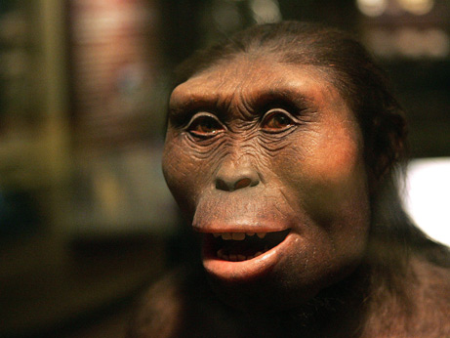
use your up/down arrow keys and/or
your space bar to advance the slides
Three Major
Perennial
Debates
Prehistoric Cultures
University of Minnesota Duluth
"Selam"
aka "Lucy's Baby”
Tim Roufs © 2010-2013
http://www.d.umn.edu/cla/faculty/troufs/anth3618/

Slide 2
Three Major
Perennial
Debates
Prehistoric Cultures
University of Minnesota Duluth
"Selam"
aka "Lucy's Baby”
Tim Roufs © 2010-2013
http://www.d.umn.edu/cla/faculty/troufs/anth3618/

Slide 3
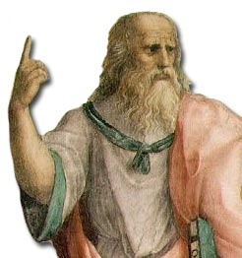
Some debates going on today have been going on since at least the days of Socrates, Plato, and Aristotle
Plato

Slide 4
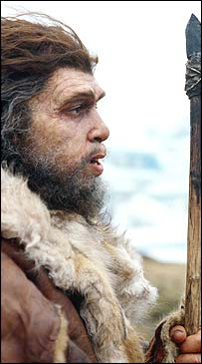
and probably even the Neandertals argued about the same sort of things
Neandertal

Slide 5
so let’s have a look at the big three debates . . .
Neandertal

Slide 6
these are one of the items you see listed in the Week 1 “Topics” . . .

Slide 7
three major contemporary debates
Biological Determinism vs. Cultural Constructionism (“nature” vs. “nurture”)
Ideationism vs. Cultural Materialism (ideas vs. things)
Individual Agency vs. Structuralism (“free will” vs. “power structures”)

Slide 8
three major contemporary debates
Biological Determinism vs. Cultural Constructionism (“nature” vs. “nurture”)
Ideationism vs. Cultural Materialism (ideas vs. things)
Individual Agency vs. Structuralism (“free will” vs. “power structures”)

Slide 9
three major contemporary debates
Biological Determinism vs. Cultural Constructionism (“nature” vs. “nurture”)
Ideationism vs. Cultural Materialism (ideas vs. things)
Individual Agency vs. Structuralism (“free will” vs. “power structures”)
this is the classical debate on whether something is so because it is inherited
or because it is learned
you know the argument
and it goes by different names . . .

Slide 10
three major contemporary debates
Biological Determinism vs. Cultural Constructionism (“nature vs. nurture”) (“inherited vs. learned”)
(“nativism” vs. “empiricism”)

Slide 11
three major contemporary debates
Biological Determinism vs. Cultural Constructionism (“nature vs. nurture”) (“inherited vs. learned”)
(“nativism” vs. “empiricism”)

Slide 12
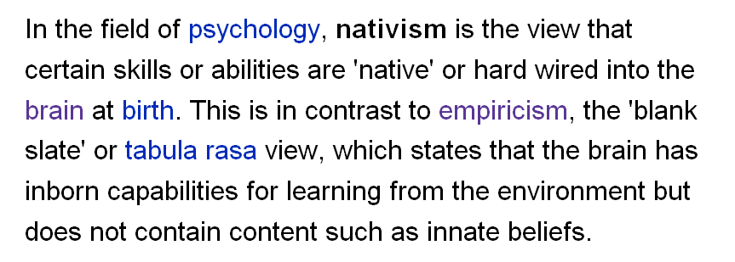
http://en.wikipedia.org/wiki/Psychological_nativism

Slide 13
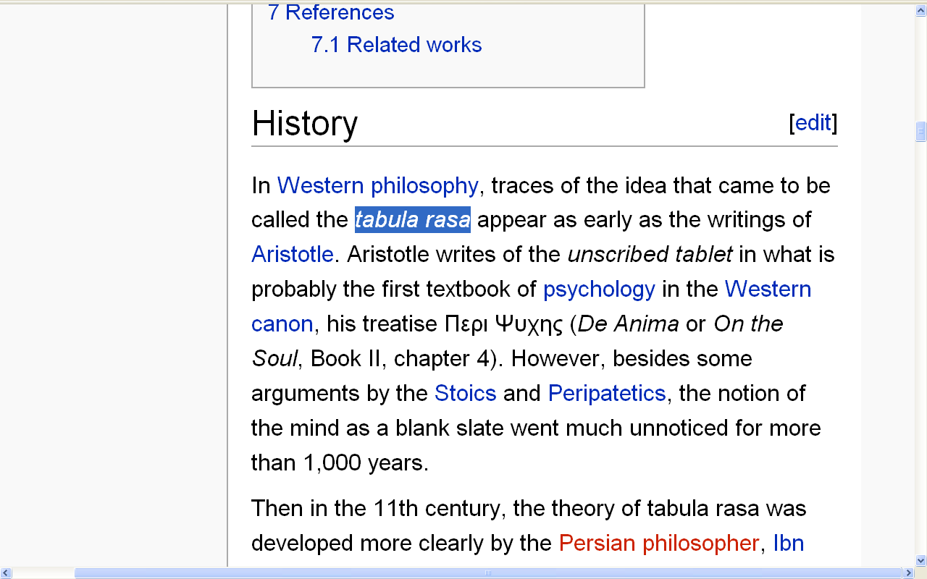
http://en.wikipedia.org/wiki/Tabula_rasa#History

Slide 14
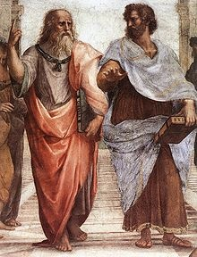
Aristotle
Plato
http://en.wikipedia.org/wiki/Tabula_rasa#History

Slide 15
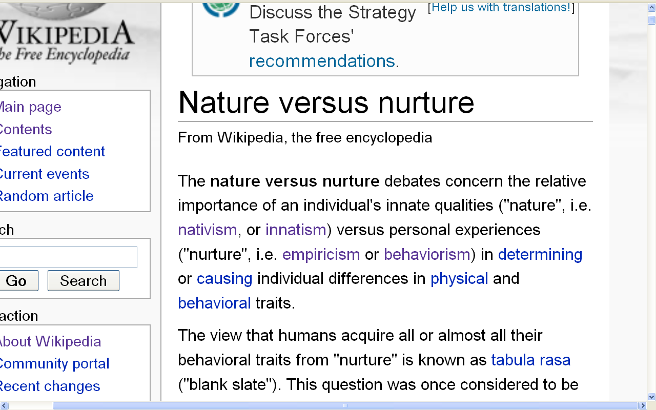
(“nature vs. nurture”)
(“inherited vs. learned”)
(“nativism” vs. “empiricism”)
http://en.wikipedia.org/wiki/Nature_versus_nurture

Slide 16
something else you will see often (and often repeated) in American Anthropology are discussions of the relationship between the physical and the cultural aspects of humans . . .
Here’s a good instance of that . . .

Slide 17
something else you will see often (and often repeated) in American Anthropology are discussions of the relationship between the physical and the cultural aspects of humans . . .
here’s a good instance of that . . .

Slide 18
three major contemporary debates
Biological Determinism vs. Cultural Constructionism (“nature vs. nurture”) (“inherited vs. learned”)
(“nativism” vs. “empiricism”)

Slide 19
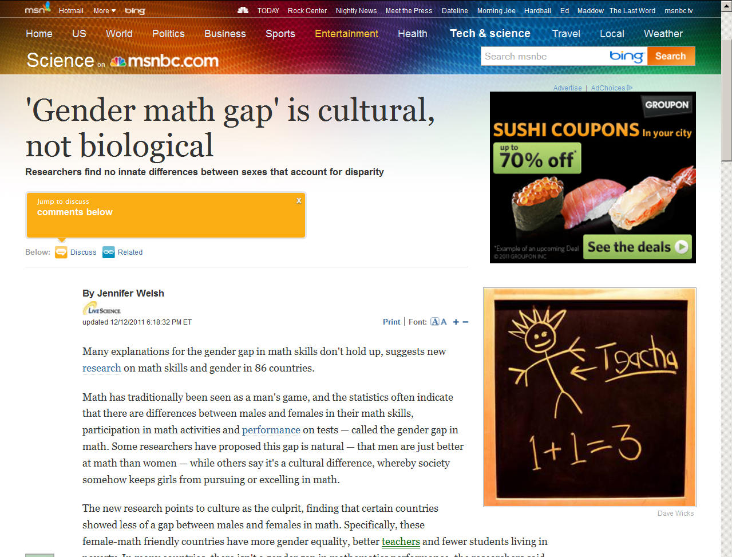
July 19, 2009
Notes:
19

Slide 20
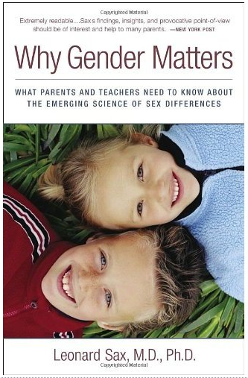
July 19, 2009
Three Rivers Press, 2006
Notes:
20

Slide 21
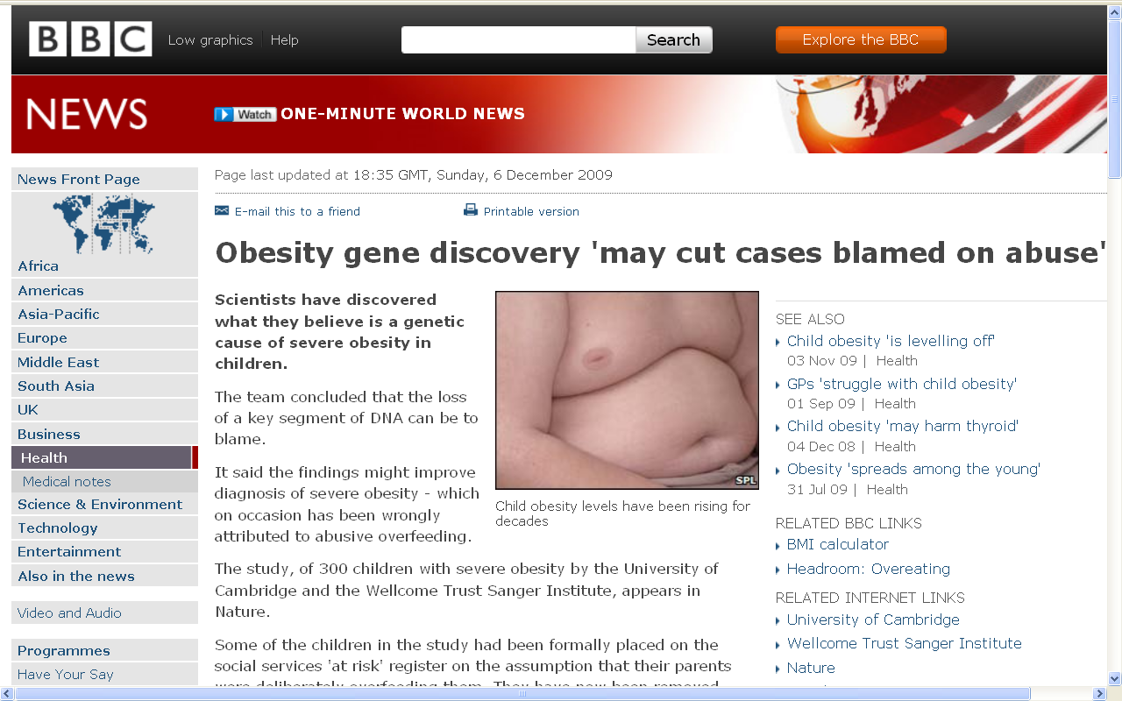
July 19, 2009
http://news.bbc.co.uk/2/hi/health/8394991.stm
Notes:
21

Slide 22
July 19, 2009
http://news.bbc.co.uk/2/hi/science/nature/8195762.stm
Notes:
22

Slide 23
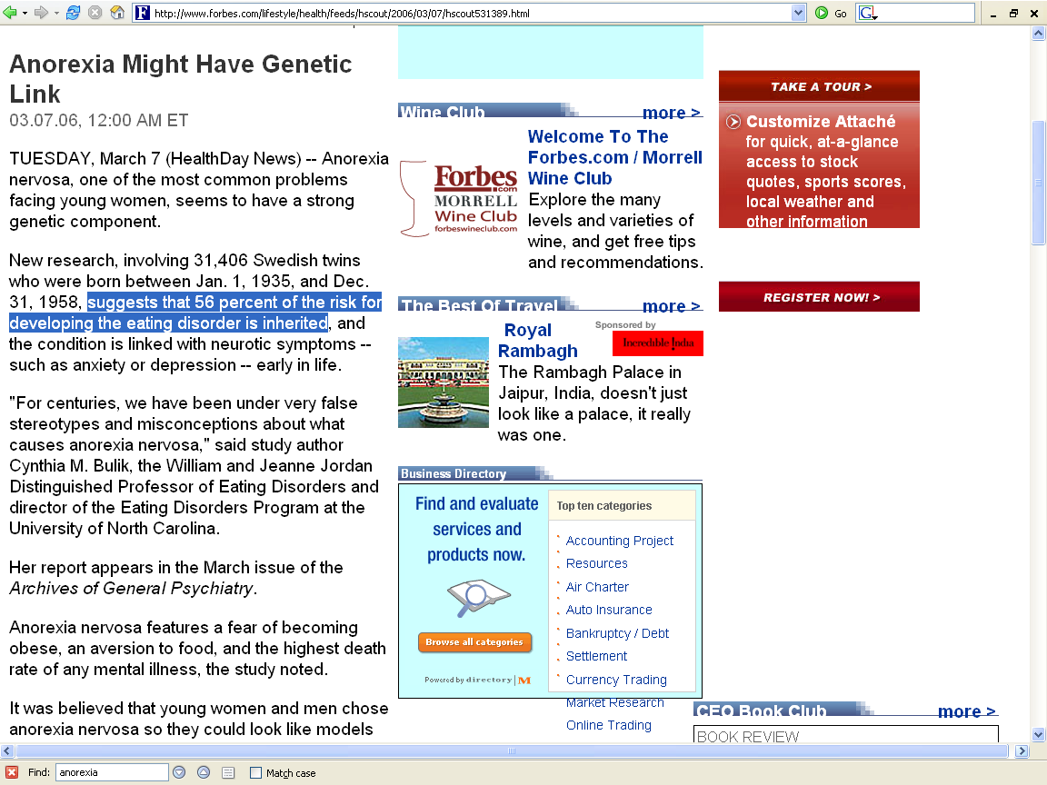
http://www.forbes.com/lifestyle/health/feeds/hscout/2006/03/07/hscout531389.html

Slide 24
three major contemporary debates
Biological Determinism vs. Cultural Constructionism (“nature vs. nurture”) (“inherited vs. learned”)
(“nativism” vs. “empiricism”)

Slide 25
and, of course, the question of how they relate to one another in causing or influencing something is at the root of many of the arguments . . .

Slide 26
the “correct” answer,
of course, is . . .
(at least to most serious observers)
that they both contribute.
So it’s . . .

Slide 27
the “correct” answer,
of course, is . . .
(at least to most serious observers)
that they both contribute
so it’s . . .

Slide 28
three major contemporary debates
Biological Determinism and Cultural Constructionism (“nature and nurture”) (“inherited and learned”)
(“nativism” and “empiricism”)

Slide 29
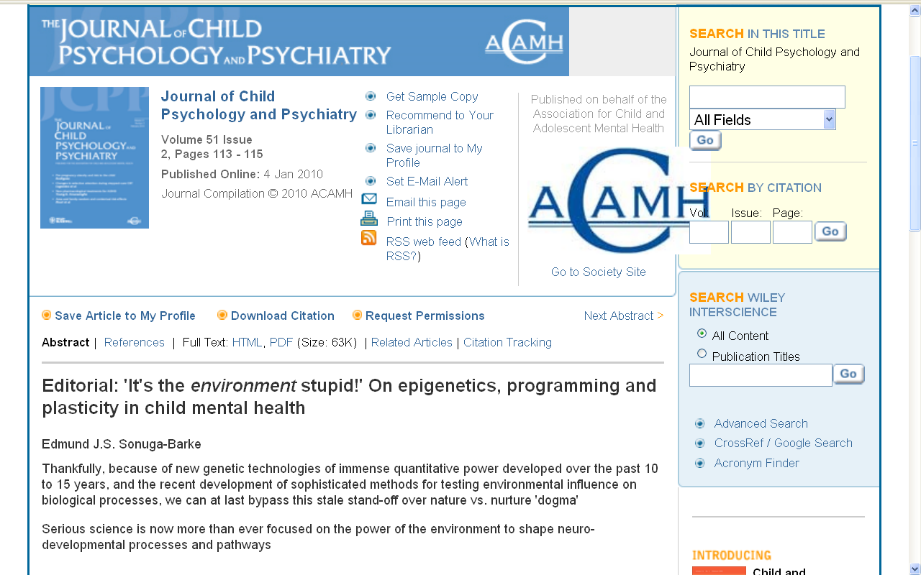
http://www3.interscience.wiley.com/journal/123232350/abstract

Slide 30
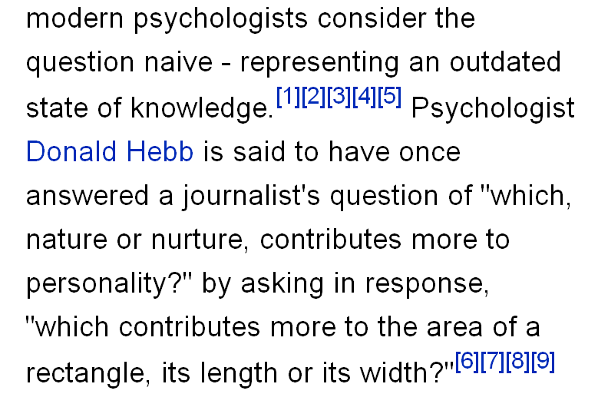
http://en.wikipedia.org/wiki/Nature_versus_nurture

Slide 31
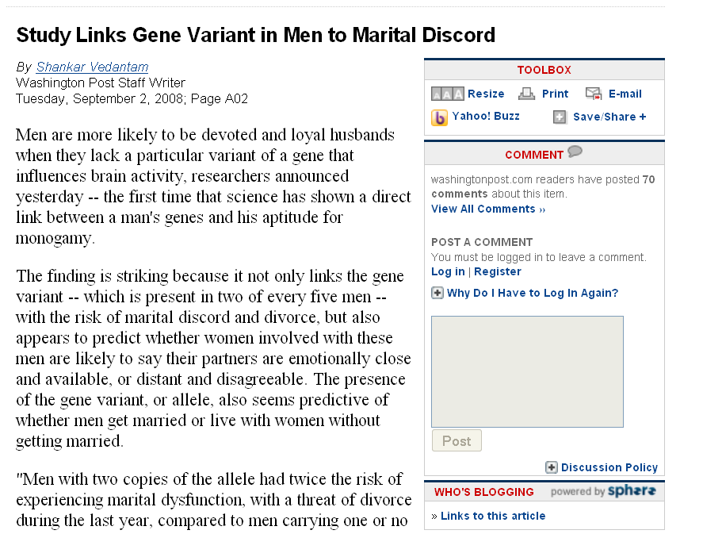
www.washingtonpost.com/wp-dyn/content/article/2008/09/01/AR2008090102087.html

Slide 32
three major contemporary debates
Biological Determinism vs. Cultural Constructionism
Ideationism vs. Cultural Materialism
Individual Agency vs. Structuralism (“free will” vs. “power structures”)

Slide 33
three major contemporary debates
Biological Determinism vs. Cultural Constructionism
Ideationism vs. Cultural Materialism
Individual Agency vs. Structuralism (“free will” vs. “power structures”)

Slide 34
three major contemporary debates
Biological Determinism vs. Cultural Constructionism
Ideationism vs. Cultural Materialism
Individual Agency vs. Structuralism (“free will” vs. “power structures”)
Ideationism vs. Cultural Materialism
e.g., Aztecs must sacrifice and eat humans
in order to please the gods
in order that the gods allow
the sun to rise each day,
so that the world doesn’t end

Slide 35
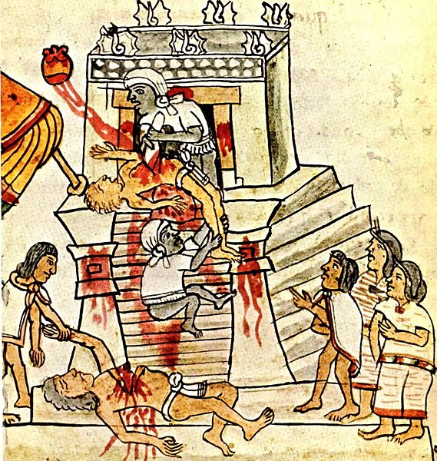
Aztec human sacrifice as shown in the Codex Magliabechiano
http://en.wikipedia.org/wiki/Image:Mendoza_HumanSacrifice.jpg

Slide 36
three major contemporary debates
Ideationism vs. Cultural Materialism
Biological Determinism vs. Cultural Constructionism
Ideationism vs. Cultural Materialism
Individual Agency vs. Structuralism (“free will” vs. “power structures”)
e.g., Aztecs sacrificed and ate humans
in order to control population size
in order to preserve their property,
to terrorize their neighbors
so they will continue to provide
goods and services as tribute,
and because they tasted good

Slide 37
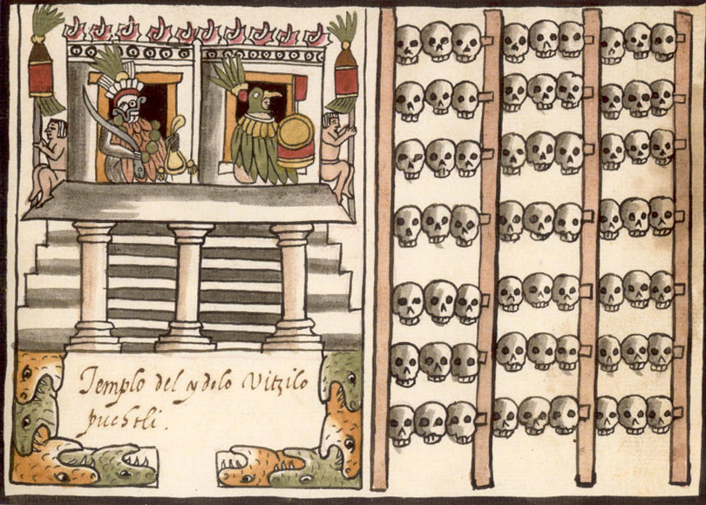
A tzompantli, or skull rack, as shown in the post-Conquest Ramirez Codex
http://en.wikipedia.org/wiki/Image:Mendoza_HumanSacrifice.jpg

Slide 38
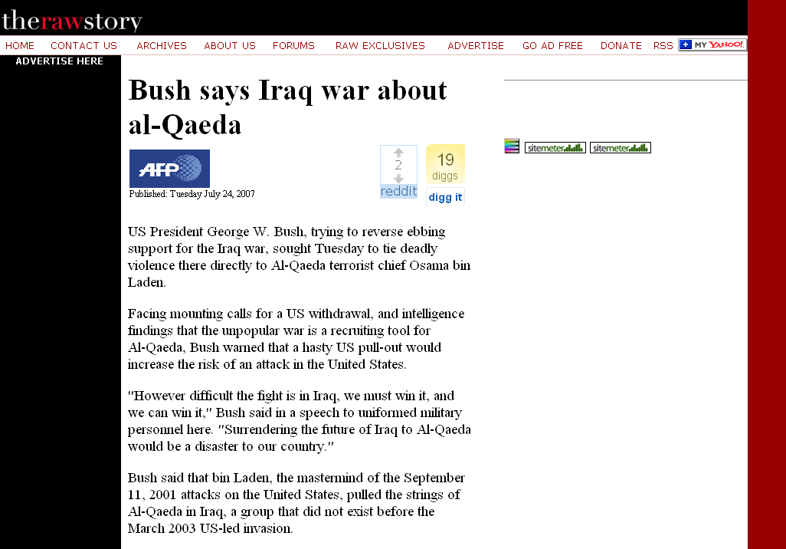
http://rawstory.com/news/afp/Bush_says_Iraq_war_about_al_Qaeda_07242007.html
Notes:
38

Slide 39
Peace
Justice
Security
Freedom
Honor
[God’s will / Allah’s will . . .]
http://rawstory.com/news/afp/Bush_says_Iraq_war_about_al_Qaeda_07242007.html
Notes:
39

Slide 40
Peace
Justice
Security
Freedom
Honor
[God’s will / Allah’s will . . .]
Ideationism vs. Cultural Materialism
http://rawstory.com/news/afp/Bush_says_Iraq_war_about_al_Qaeda_07242007.html
Notes:
40

Slide 41
three major contemporary debates
Biological Determinism vs. Cultural Constructionism
Ideationism vs. Cultural Materialism
Individual Agency vs. Structuralism (“free will” vs. “power structures”)
Peace
Justice
Security
Freedom
Honor
God’s will / Allah’s will . . .

Slide 42
http://news.aol.com/political-machine/2008/09/02/sarah-palin-iraq-war-gods-plan/
Notes:
42

Slide 43
Ideationism vs. Cultural Materialism
http://news.aol.com/political-machine/2008/09/02/sarah-palin-iraq-war-gods-plan/
Notes:
43

Slide 44
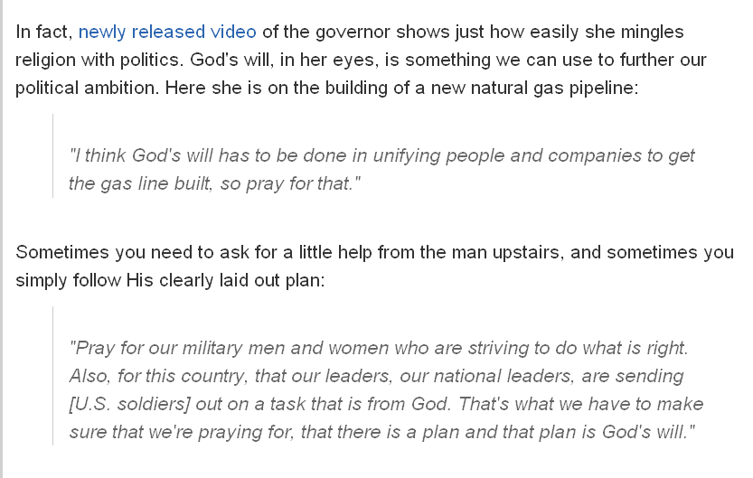
on building a new natural gas pipeline in Alaska . . .
http://news.aol.com/political-machine/2008/09/02/sarah-palin-iraq-war-gods-plan/
Notes:
44

Slide 45
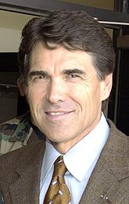
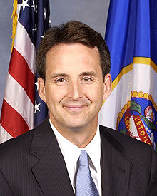
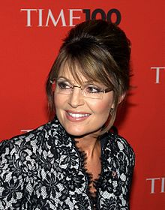
Tim Pawlenty
Rick Perry
Michele Bachmann
candidates called by
God
to run for
President of the United States
Sarah Palin
Notes:
45

Slide 46
and Ideationism has been around “forever”
take my Church, for e.g., the Holy Roman Catholic Church
they “fought“ the Crusades ideationally . . .

Slide 47
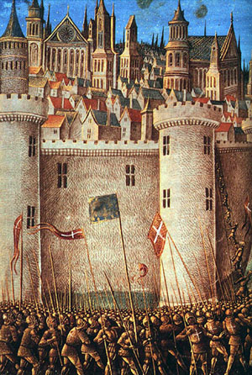
The Siege of Antioch, from a medieval miniature painting, during the First Crusade
http://en.wikipedia.org/wiki/Crusade
Notes:
47

Slide 48
Ideationism vs. Cultural Materialism
The Siege of Antioch, from a medieval miniature painting, during the First Crusade.
http://en.wikipedia.org/wiki/Crusade
Notes:
48

Slide 49
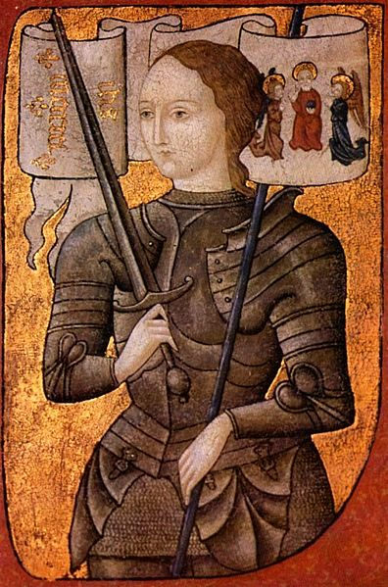
Saint Joan of Arc Burned at the stake by an ecclesiastical court
For leading the French Armey by divine guidance
During the Hundred Years’ War (1337 to 1453)
http://en.wikipedia.org/wiki/Joan_of_arc
Notes:
49

Slide 50
Ideationism vs. Cultural Materialism
Saint Joan of Arc Burned at the stake by an ecclesiastical court
For leading the French Armey by divine guidance
During the Hundred Years’ War (1337 to 1453)
http://en.wikipedia.org/wiki/Joan_of_arc
Notes:
50

Slide 51
and Ideationism will probably be around “forever” . . .

Slide 52
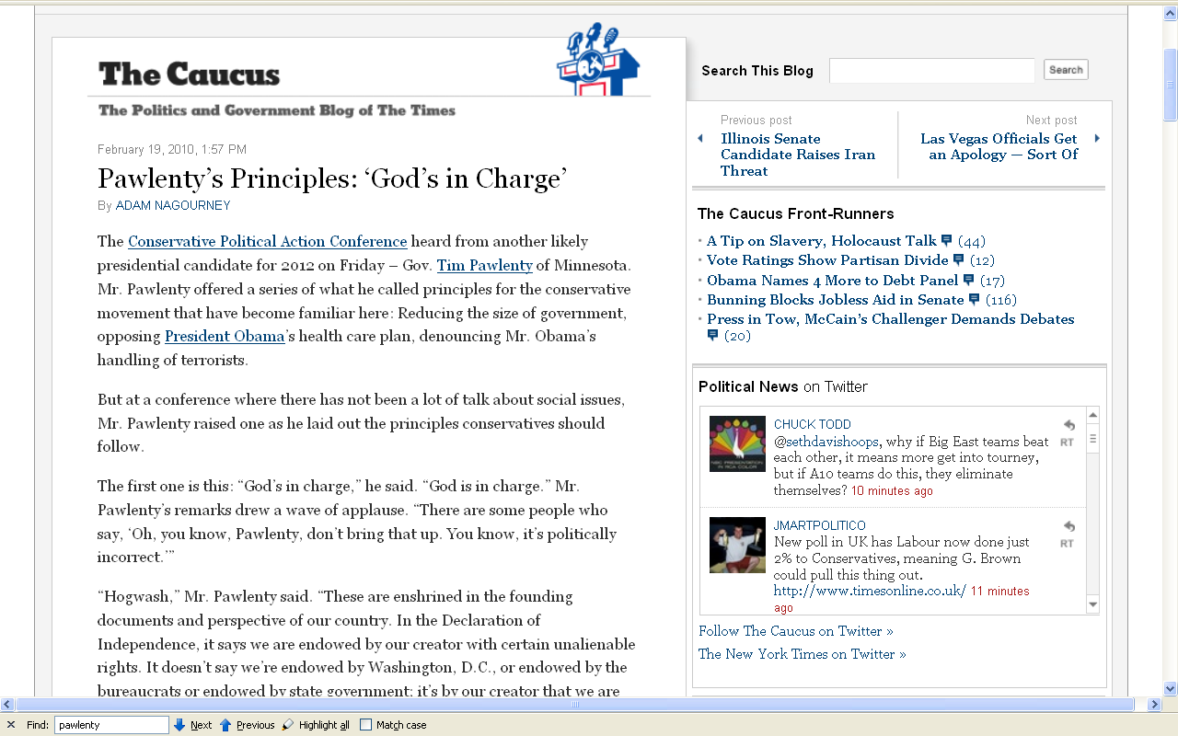
19 February 2010
Ideationism vs. Cultural Materialism
http://thecaucus.blogs.nytimes.com/2010/02/19/pawlentys-principles-gods-in-charge/
Notes:
52

Slide 53
but others say “no”
they say the real reasons for Aztec cannibalism lay in materialism (not ideas) . . .

Slide 54
three major contemporary debates
Biological Determinism vs. Cultural Constructionism
Ideationism vs. Cultural Materialism
Individual Agency vs. Structuralism (“free will” vs. “power structures”)

Slide 55
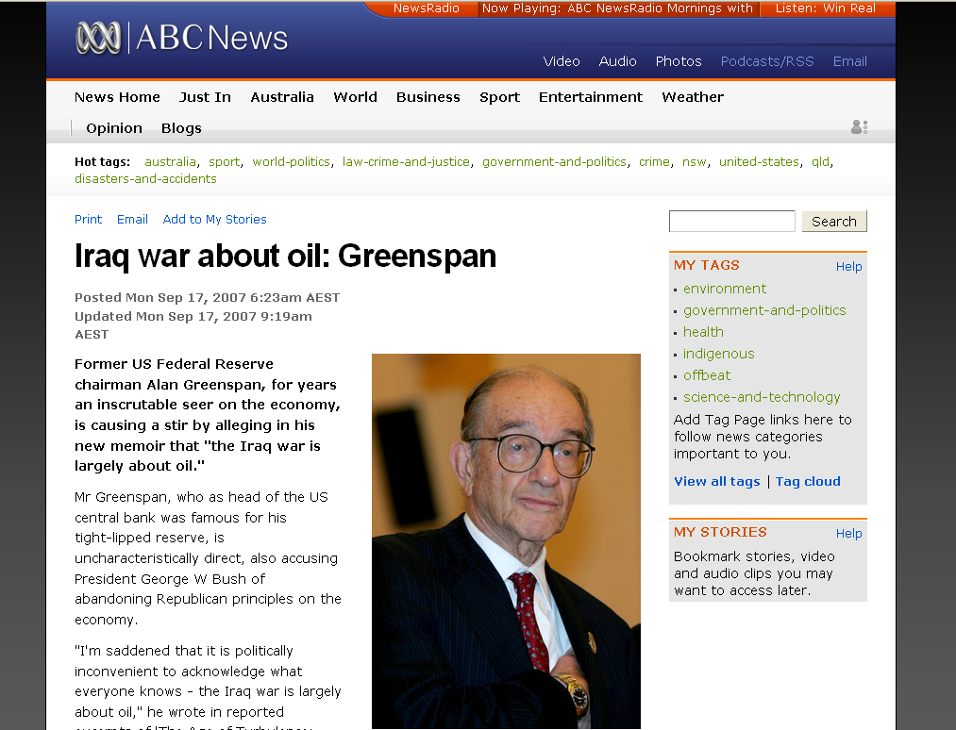
www.abc.net.au/news/stories/2007/09/17/2034283.htm
Notes:
55

Slide 56
Ideationism vs. Cultural Materialism
www.abc.net.au/news/stories/2007/09/17/2034283.htm
Notes:
56

Slide 57
three major contemporary debates
Biological Determinism vs. Cultural Constructionism
Ideationism vs. Cultural Materialism
Individual Agency vs. Structuralism (“free will” vs. “power structures”)
this debate is related in part to
“THE ‘TWO-CULTURE’ PROBLEM”
— C.P. Snow

Slide 58
Marion Nestle
Food Politics, Revsed Ed.
Ch. 10 “Science versus Supplements: ‘A Gulf of Mutual Incomprehension’”
“THE ‘TWO-CULTURE’ PROBLEM”
“belief-based” attitudes
vs.
“science-based” attitudes

Slide 59
I think the best recent discussion of this is in
Marion Nestle’s
Food Politics

Slide 60
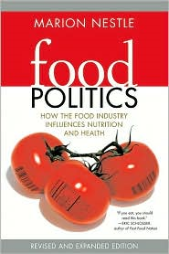

Slide 61
Marion Nestle
Food Politics, Revised Ed.
Ch. 10 “Science versus Supplements: ‘A Gulf of Mutual Incomprehension’”
“THE ‘TWO-CULTURE’ PROBLEM”
“belief-based” attitudes
vs.
“science-based” attitudes
Marion Nestle, Food Politics, Rev. Ed., 2007, pp. 230-233

Slide 62
this idea is based on C.P. Snow’s Classic Lecture . . .
C.P. Snow
“Two Cultures and the Scientific Revolution: The Rede Lecture”
London, Cambridge University Press
1959

Slide 63
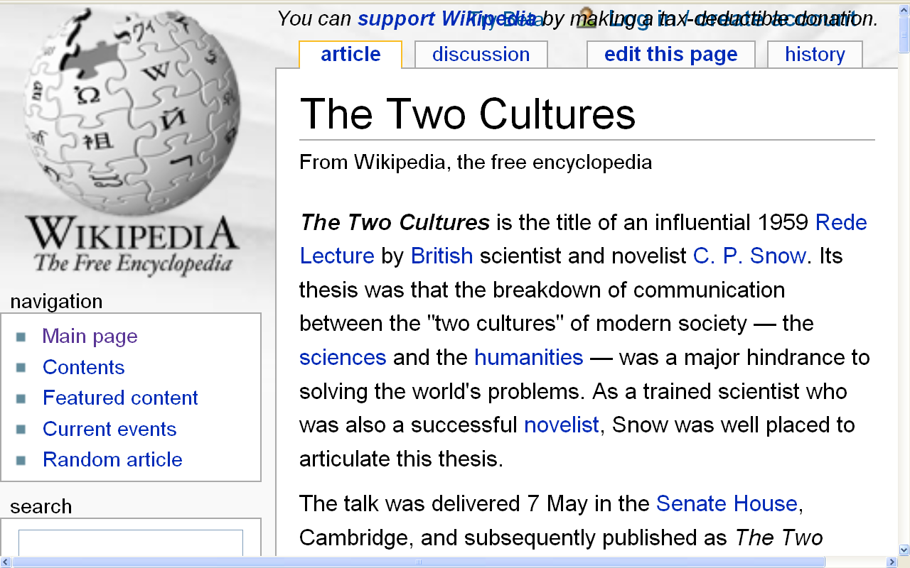
http://en.wikipedia.org/wiki/The_Two_Cultures
Notes:
63

Slide 64
take, for e.g., a question raised by Nestle in
Food Politics . . .

Slide 65
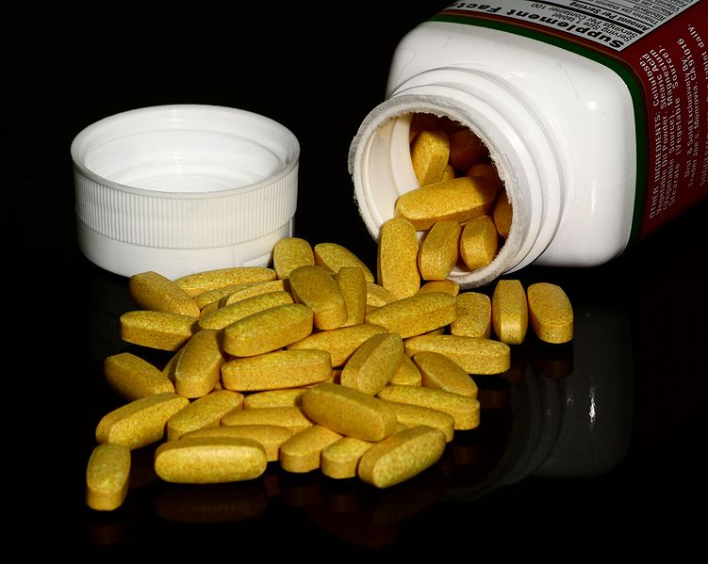
Are dietary supplements needed?
http://en.wikipedia.org/wiki/Multivitamin

Slide 66
Are dietary supplements needed?
A comparison of . . .
“belief-based” attitudes
vs.
“science-based” attitudes
(based on the criteria of)
Safety
Need
Efficacy
after Marion Nestle, Food Politics, Rev. Ed., 2007, pp. 232

Slide 67
Are dietary supplements needed ?
“science-based” attitudes
Safety
Excessive doses of many nutrients are demonstrably toxic
High levels of single nutrients interfere with the functions of other nutrients
The safety of many herbal products is untested and, therefore, unknown
Herbal supplements vary in composition, potency, and quality
after Marion Nestle, Food Politics, Rev. Ed., 2007, pp. 232

Slide 68
Are dietary supplements needed ?
“belief-based” attitudes
Safety
Supplements are safe within a broad range of intake; safety problems are rare
Herbal products have been used for thousands of years
Supplements cause less harm than many prescription drugs
after Marion Nestle, Food Politics, Rev. Ed., 2007, pp. 232

Slide 69
Are dietary supplements needed ?
“science-based” attitudes
Need
Food is sufficient to meet nutritional needs
Foods provide nutrients and other valuable substances not present in supplements
People who take supplements are better educated and wealthier
they are healthier whether or not they take supplements
after Marion Nestle, Food Politics, Rev. Ed., 2007, pp. 232

Slide 70
Are dietary supplements needed ?
“belief-based” attitudes
Need
Diets do not always follow dietary recommendations
Foods grown on depleted soils lack essential nutrients
Pollution and stressful living conditions increase nutrient requirements
Cooking destroys essential nutrients
after Marion Nestle, Food Politics, Rev. Ed., 2007, pp. 232

Slide 71
Are dietary supplements needed ?
“science-based” attitudes
Efficacy
Research demonstrates health benefits of diets and foods, not of single nutrients
Higher-than-recommended doses of few single nutrients improve health
Health claims for many supplements often address issues (such as “stress”) that are difficult to evaluate scientifically
The health benefits of most supplements are unproven
Many “benefits” of supplements can be explained as placebo or other self-healing effects
after Marion Nestle, Food Politics, Rev. Ed., 2007, pp. 232

Slide 72
Are dietary supplements needed ?
“belief-based” attitudes
Efficacy
People who take supplements are healthier
People feel better when they take supplements
Studies demonstrate the health benefits of supplements
Benefits are sometimes greater at amounts higher than can be obtained from food
after Marion Nestle, Food Politics, Rev. Ed., 2007, pp. 232

Slide 73
summary
DIETARY SUPPLEMENTS
“science-
based”
“faith-
based”
Safe No/ Yes
Unknown
Need No Yes
Efficacy No/ Yes
Unknown
Take No Yes
after Marion Nestle, Food Politics, Rev. Ed., 2007, pp. 232

Slide 74
in the end, Nestle essentially concludes that food supplements are basically a modern-day version of . . .

Slide 75
http://www.reverbnation.com/data_public/artist/userfiles/97034/shine04.09.jpg
Notes:
⁷⁵

Slide 76
DIETARY SUPPLEMENTS
Question:
What percentage of Americans
regularly take
dietary supplements?
after Marion Nestle, Food Politics, Rev. Ed., 2007, pp. 232

Slide 77
DIETARY SUPPLEMENTS
and the really good question is:
Why do the science-based “people” take them?
after Marion Nestle, Food Politics, Rev. Ed., 2007, pp. 232

Slide 78
in the end, some people accomplish the same thing without food supplements
they either eat a healthy, balanced meal, or . . .

Slide 79
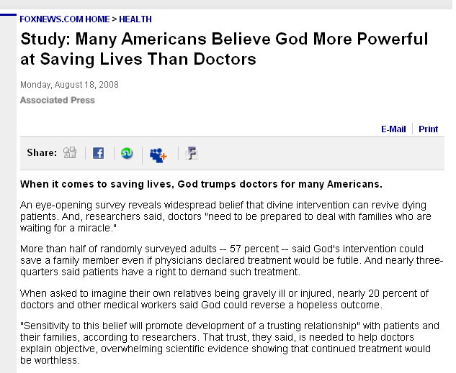
www.foxnews.com/story/0,2933,405765,00.html
Notes:
⁷⁹

Slide 80
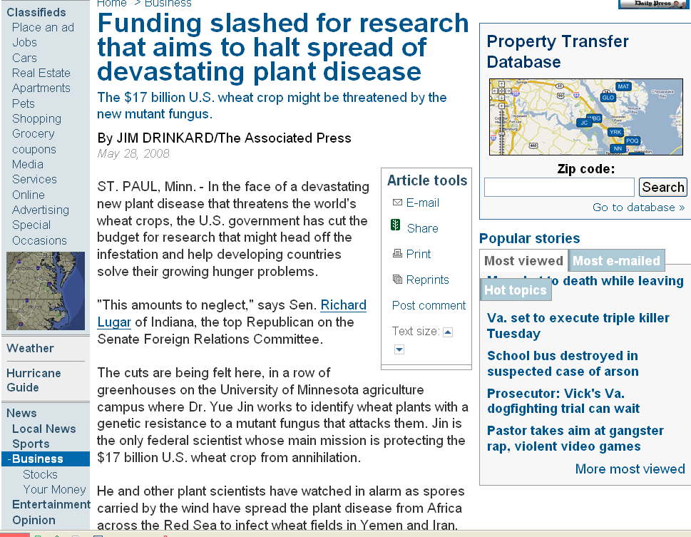
www.dailypress.com/business/dp-biz_endangered_wheat_0528may28,0,3094328.story
Notes:
80

Slide 81
according to Nestle, this is a really important work,
so make note of it . . .
C.P. Snow
“Two Cultures and the Scientific Revolution: The Rede Lecture”
London, Cambridge University Press
1959

Slide 82
and if you’re interested
in these kinds of questions
also have a look at . . .

Slide 83
Marion Nestle
Food Politics, Revised Ed.
Ch. 10 “Science versus Supplements: ‘A Gulf of Mutual Incomprehension’”
“THE ‘TWO-CULTURE’ PROBLEM”
“belief-based” attitudes
vs.
“science-based” attitudes

Slide 84
and in anthropology in general,
the guru
of cultural materialism is . . .

Slide 85
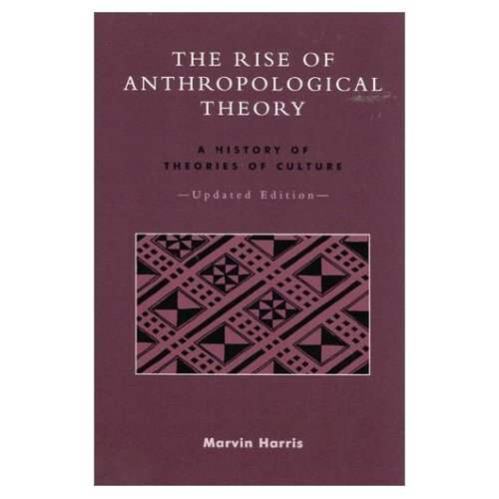
Cultural Materialism
Marvin Harris
The Rise of Anthropological Theory:
A History of Theories of Culture,
Updated Edition.
Lanham, MD: Altamira Press, 2000
Notes:
85

Slide 86
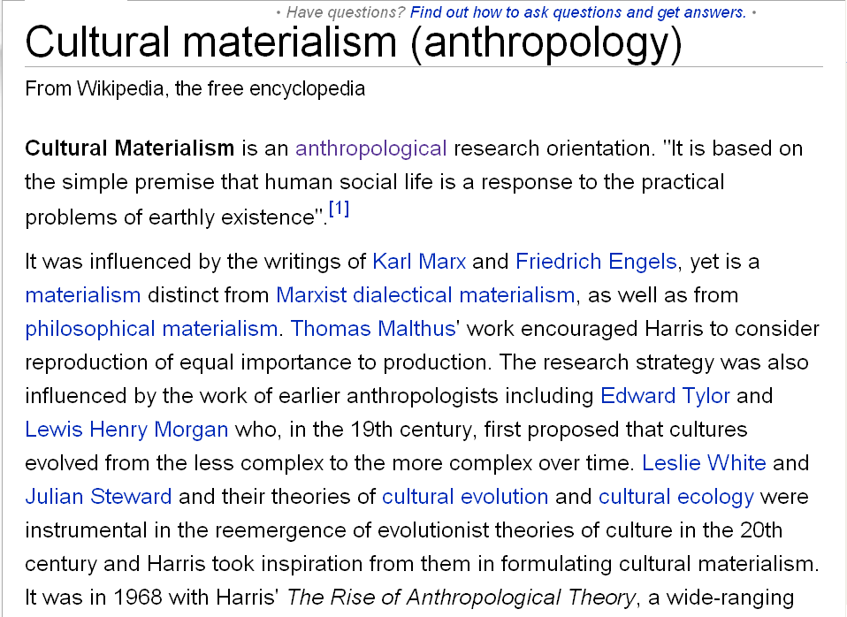
http://en.wikipedia.org/wiki/Cultural_materialism_%28anthropology%29
Notes:
86

Slide 87
www.cultural-materialism.org/cultural-materialism/
Notes:
87

Slide 88
three major contemporary debates
finally . . .
Biological Determinism vs. Cultural Constructionism
Ideationism vs. Cultural Materialism
Individual Agency vs. Structuralism (“free will” vs. “power structures”)

Slide 89
three major contemporary debates
Biological Determinism vs. Cultural Constructionism
Ideationism vs. Cultural Materialism
Individual Agency vs. Structuralism (“free will” vs. “power structures”)

Slide 90
three major contemporary debates
Biological Determinism vs. Cultural Constructionism
Ideationism vs. Cultural Materialism
Individual Agency vs. Structuralism (“free will” vs. “power structures”)

Slide 91
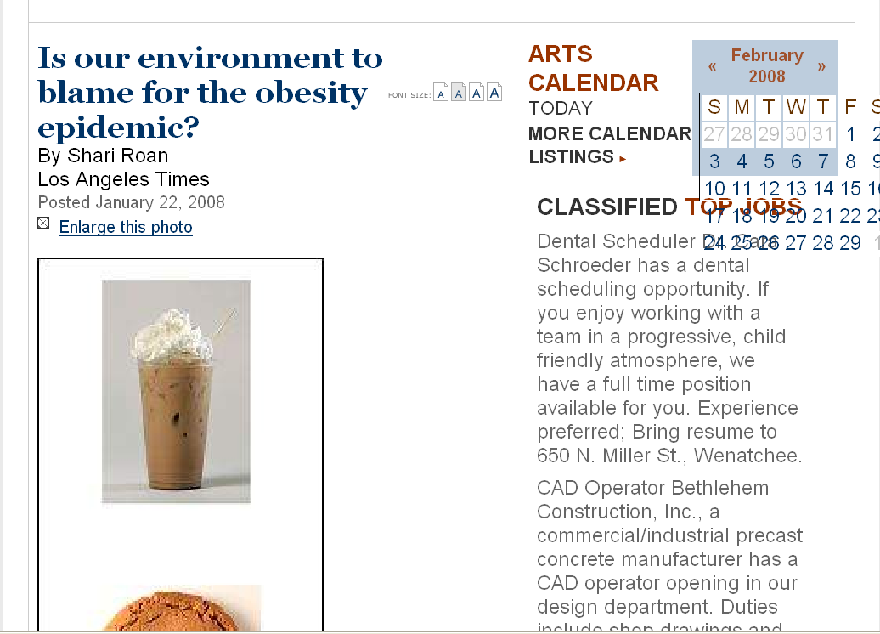
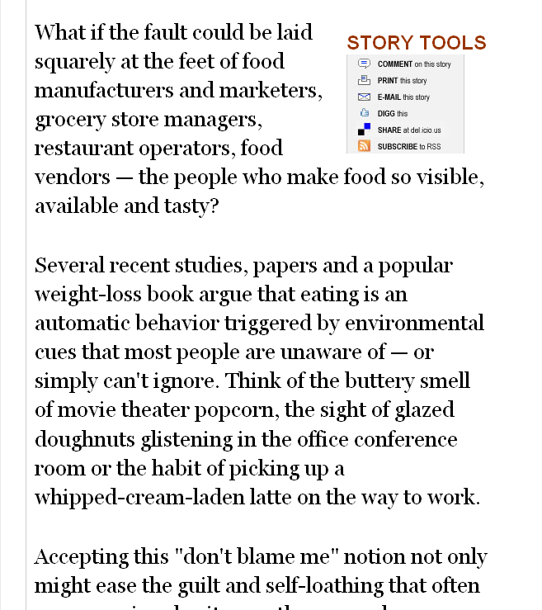
www.wenatcheeworld.com/apps/pbcs.dll/article?AID=/20080122/FOOD/373497927/1030/rss1030
Notes:
91

Slide 92
(“free will” vs. “power structures”)
www.wenatcheeworld.com/apps/pbcs.dll/article?AID=/20080122/FOOD/373497927/1030/rss1030
Notes:
92

Slide 93
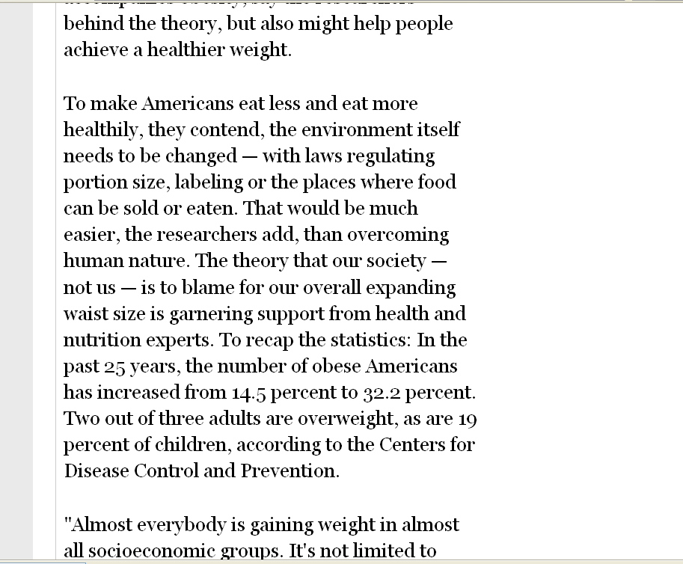
(“free will” vs. “power structures”)
www.wenatcheeworld.com/apps/pbcs.dll/article?AID=/20080122/FOOD/373497927/1030/rss1030
Notes:
93

Slide 94
www.cafepress.com/metalstar.71120928
Notes:
94

Slide 95
(“free will” vs.
[the ultimate] “power structure”)
www.cafepress.com/metalstar.71120928
Notes:
95

Slide 96
and, speaking of the devil,
Christians have been trying
to get rid of the devil since . . .
Notes:
96

Slide 97
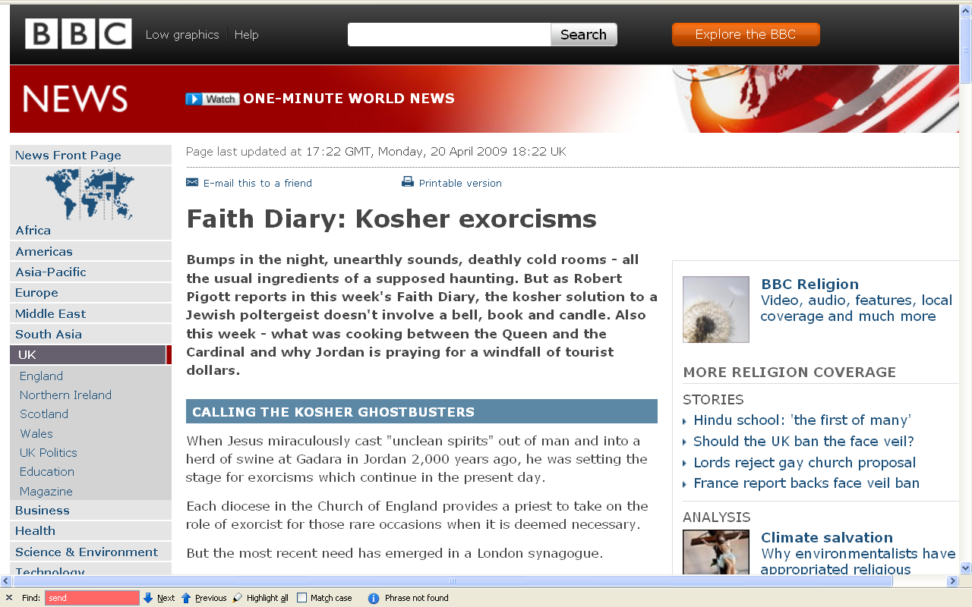
Christ chased “unclean spirits” out of a man and into a herd of swine 2,000 years ago . . .
http://news.bbc.co.uk/2/hi/uk_news/7999000.stm

Slide 98
http://news.bbc.co.uk/2/hi/uk_news/7999000.stm

Slide 99
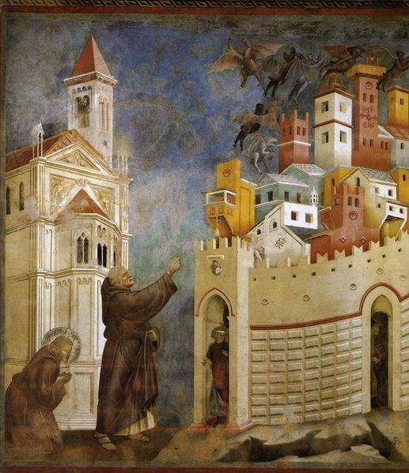
Saint Francis exorcised demons in Arezzo Giotto
http://en.wikipedia.org/wiki/Exorcism
Notes:
99

Slide 100
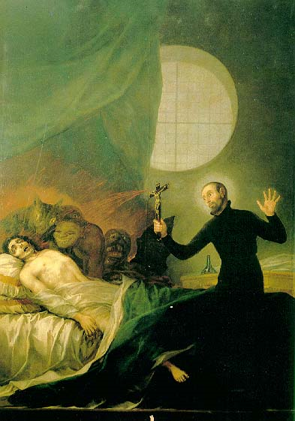
Saint Francis Borgia performing an exorcism
Francisco Goya
http://en.wikipedia.org/wiki/Exorcism
Notes:
100

Slide 101
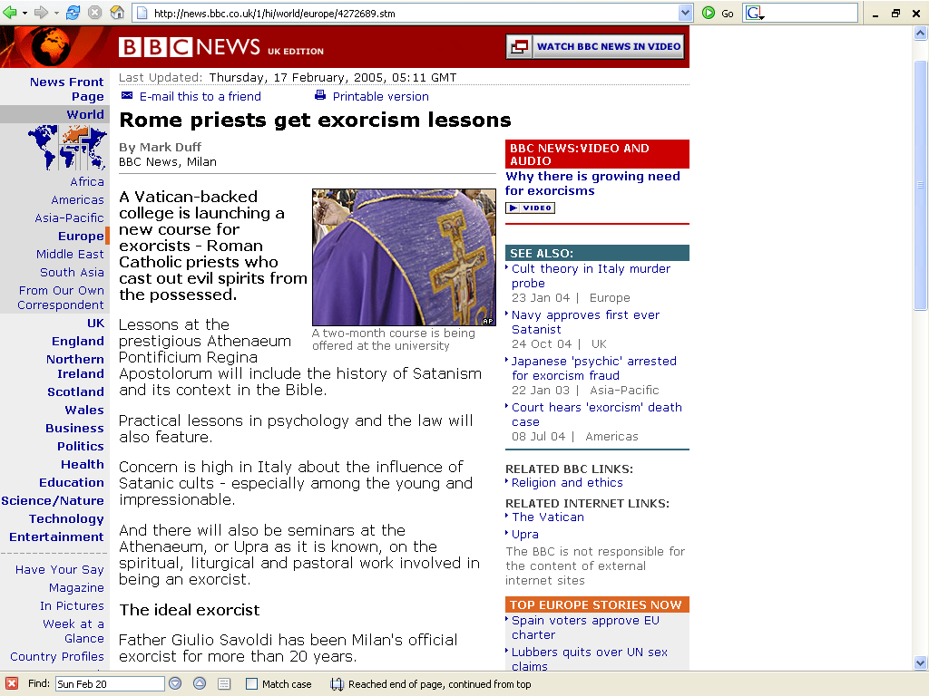
His Holiness the Pope recently increased efforts to train Roman Catholic priests
in exorcism . . .
http://news.bbc.co.uk/1/hi/world/europe/4272689.stm

Slide 102
http://news.bbc.co.uk/2/hi/uk_news/7999000.stm

Slide 103
each diocese in the Church of England provides a priest to exorcise demons . . .
http://news.bbc.co.uk/2/hi/uk_news/7999000.stm

Slide 104
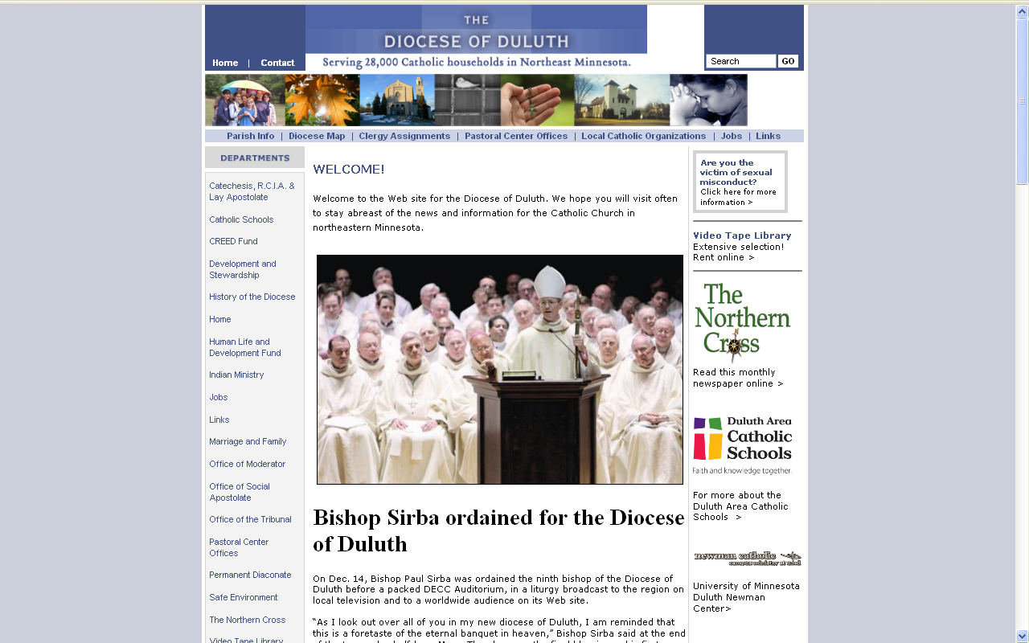
http://www.dioceseduluth.org/index.php

Slide 105
and even the Diocese of Duluth
has an exorcist . . .
although he’s not listed on the Diocesan web page . . .
http://www.dioceseduluth.org/index.php

Slide 106
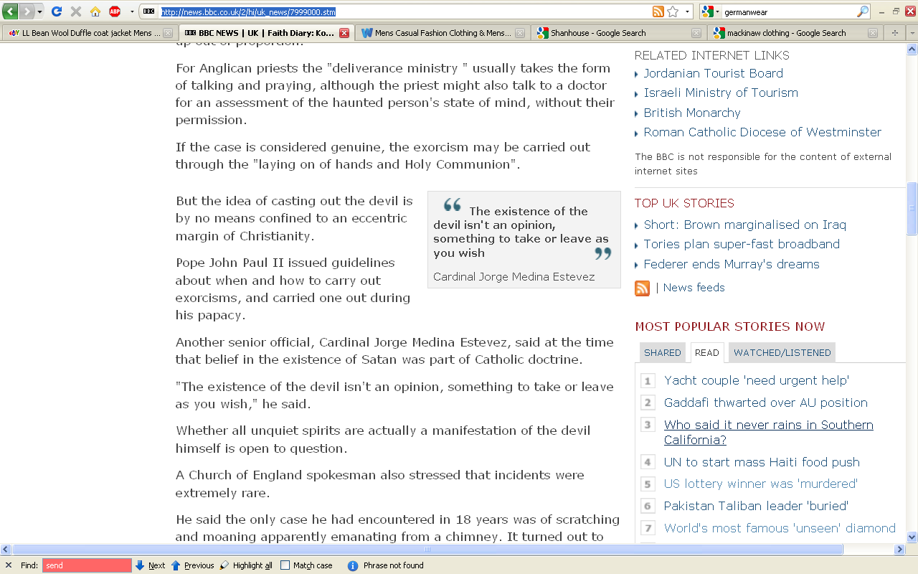
it’s Official Catholic doctrine . . .
http://news.bbc.co.uk/2/hi/uk_news/7999000.stm

Slide 107
the debates continue . . .
Plato

Slide 108
the debates continue . . .
they’re . . . well . . .
they’re “perennial”
Plato

Slide 109
so the
debates
go
on and on. . .
University of Minnesota Duluth
"Selam"
aka "Lucy's Baby”
Tim Roufs © 2010
http://www.d.umn.edu/cla/faculty/troufs/anth3618/

