Slide 1
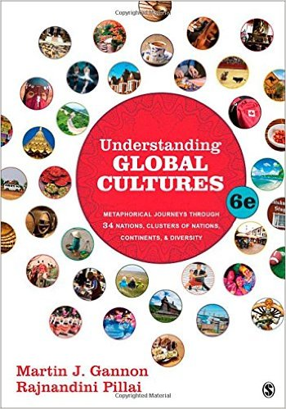
Start deck in “Slide Show” mode,
and use your up/down arrow keys and/or
your space bar to advance the slides
© 2010-2024 Timothy G. Roufs, University of Minnesota Duluth

Slide 2
REM
indicates that the materials
are a REMinder
and are thus being repeated . . .
REMinder

Slide 3
ANTH 1080
Global Cultures
Main
Characteristics of
Anthropology
© 2010-2024 Timothy G. Roufs, University of Minnesota Duluth

Slide 4
American
Main Characteristics of˄Anthropology
1. the four fields of general anthropology
culture as a primary concept
comparative method as major approach
holism as a primary theoretical goal
fieldwork as a primary research technique

Slide 5
American
Main Characteristics of˄Anthropology
1. the four fields of general anthropology
culture as a primary concept
comparative method as major approach
holism as a primary theoretical goal
fieldwork as a primary research technique

Slide 6
Main Characteristics
“cultures”
are groups of people sharing a common heritage (and usually a common language)

Slide 7
Main Characteristics
“cultures”
are groups of people sharing a common heritage (and usually a common language)
cultures generally strive to preserve their cultural identity

Slide 8
The Concept of Culture
cultures
generally strive to preserve their identity with . . .
food clothing
religion
ritual
music, dance, and other arts
language
cultural symbols . . .

Slide 9
The Concept of Culture
cultures
generally strive to preserve their identity with . . .
food clothing
religion
ritual
music, dance, and other arts
language
cultural symbols . . .

Slide 10
The Concept of Culture
local groups (microcultures)
generally strive to preserve their cultural identity with . . .
food clothing
religion
ritual
music, dance, and other arts
language
cultural symbols . . .

Slide 11
The Concept of Culture
microcultures can include ethnic groups within nations
e.g., Anishinabe (Chippewa; Ojibwa)
e.g., Irish “Travellers”
sometimes incorrectly called “Gypsies”
e.g., Australian Aboriginals
e.g., Cajan
e.g., Rom (Gypsies)
e.g., Basques
e.g., Kurds
. . . most often
cultures and microcultures are associated with their cuisine . . .
and can sometimes even be defined by their cuisine …

Slide 12
The Concept of Culture
microcultures can include ethnic groups within nations
e.g., Anishinabe (Chippewa; Ojibwa)
e.g., Irish “Travellers”
sometimes incorrectly called “Gypsies”
e.g., Australian Aboriginals
e.g., Cajan
e.g., Rom (Gypsies)
e.g., Basques
e.g., Kurds
. . . most often
these cultures are associated with their cuisine . . .
and can sometimes even be defined by their cuisine …
and they sometimes can even be defined by their cuisine . . .

Slide 13
The Concept of Culture
microcultures can include ethnic groups within nations
e.g., Anishinabe (Chippewa; Ojibwa)
e.g., Irish “Travellers”
sometimes incorrectly called “Gypsies”
e.g., Australian Aboriginals
e.g., Cajan
e.g., Rom (Gypsies)
e.g., Basques
e.g., Kurds
. . . and one’s cuisine is often a key factor in one’s own individual and collective identity . . .

Slide 14
How about a little game of . . .

Slide 15
How about a little game of
Jeopardy?

Slide 16
How about a little game of . . .
RIP Alex Trebek 1940 - 2020
https://www.usatoday.com/story/entertainment/celebrities/2020/11/08/alex-trebek-dies-ken-jennings-james-holzhauer-more-pay-tribute/6214106002/

Slide 17
How about a little game of . . .
Mike Richards 2021
https://www.nytimes.com/2021/08/11/arts/television/jeopardy-mike-richards-mayim-bialik-new-hosts.html

Slide 18
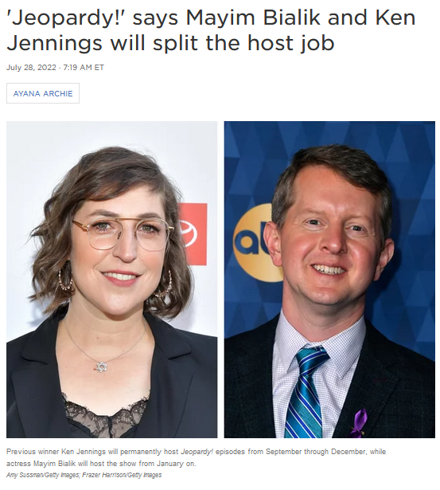
How about a little game of . . .
28 July 2022
15 Dec 2023
https://www.nytimes.com/2021/08/23/business/mayim-bialik-jeopardy-host.html

Slide 19
ANTH 1080
GLOBAL CULTURES

Slide 20
answer:
haggis
Finnan Haddie
spurtle (theevil)

Slide 21
How about a clue?

Slide 22
answers:
haggis
Finnan Haddie
spurtle (theevil)

Slide 23
How about one more clue?

Slide 24
answers:
haggis
Finnan Haddie
spurtle ( a.k.a. theevil)

Slide 25
How about a final clue?

Slide 26
answers:
haggis
Finnan Haddie
spurtle ( a.k.a. theevil)
cullen skink

Slide 27
question:
What do you think of
when someone says . . .

Slide 28
question:
What do you think of
when someone says . . .
“Scotland”?
or “Scot”?

Slide 29
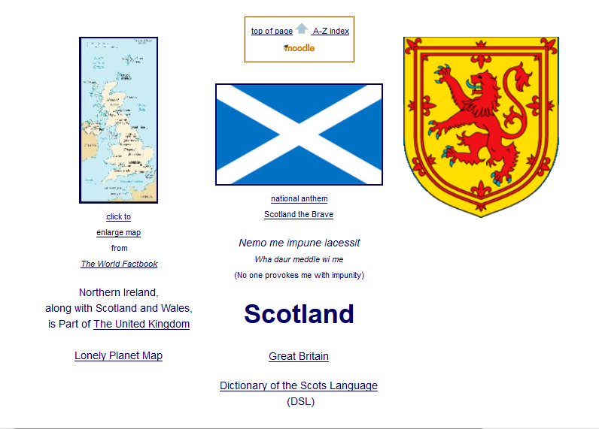

Slide 30
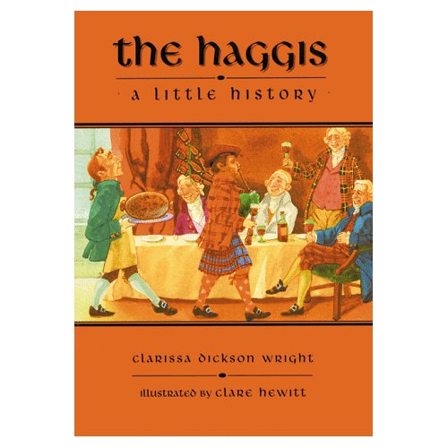
The Haggis: A Little History, Pelican, 1998

Slide 31
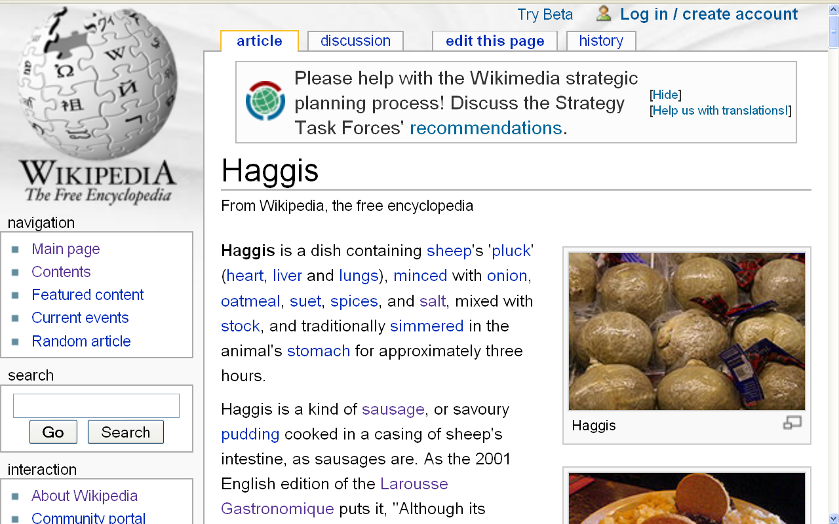
http://en.wikipedia.org/wiki/Haggis

Slide 32
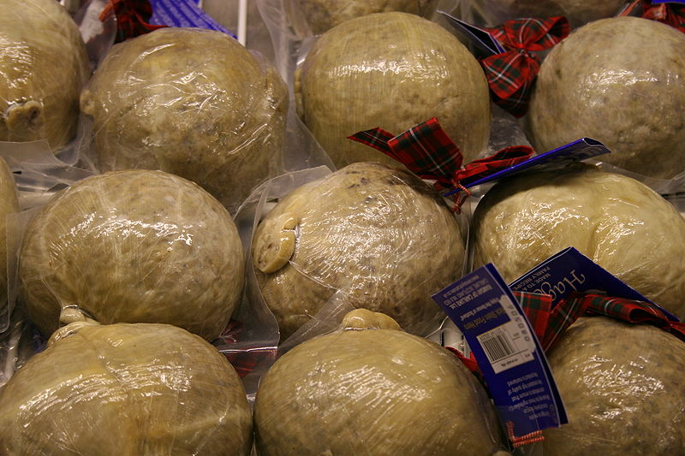
haggis
http://en.wikipedia.org/wiki/Spurtle

Slide 33
Food Trivia: The United State Government agencies does not allow “real” haggis to be sold in the United States
haggis
http://en.wikipedia.org/wiki/Spurtle

Slide 34
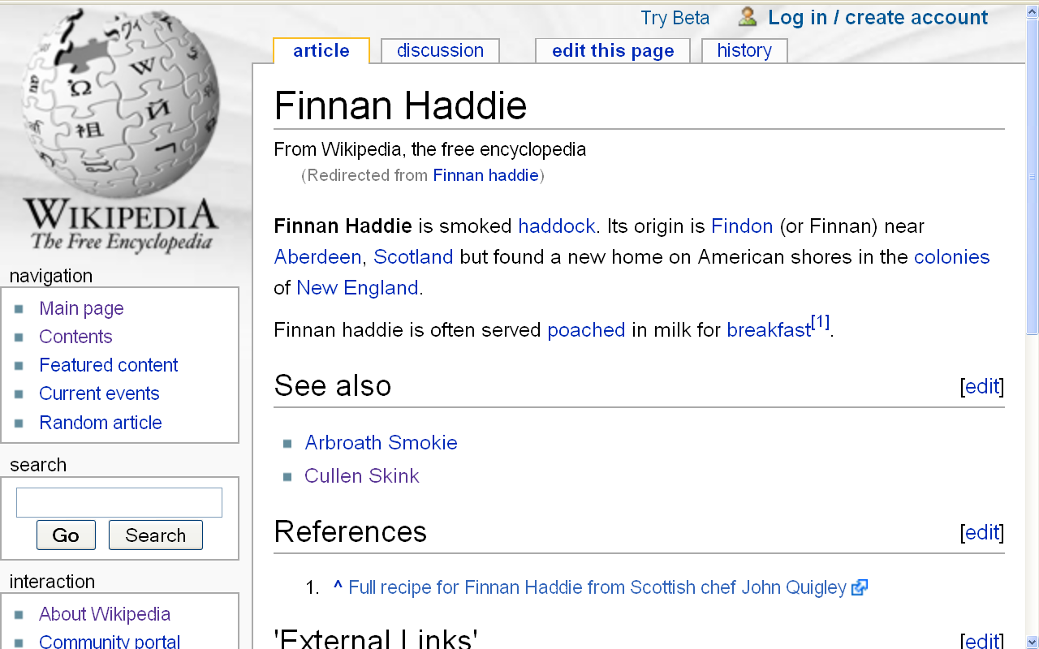
Finnan Haddie is smoked haddock
http://en.wikipedia.org/wiki/Finnan_haddie

Slide 35
Food Trivia: Its origin is Findon (or Finnan) near Aberdeen, Scotland, but found a new home on American shores in the colonies of New England
http://en.wikipedia.org/wiki/Finnan_haddie

Slide 36
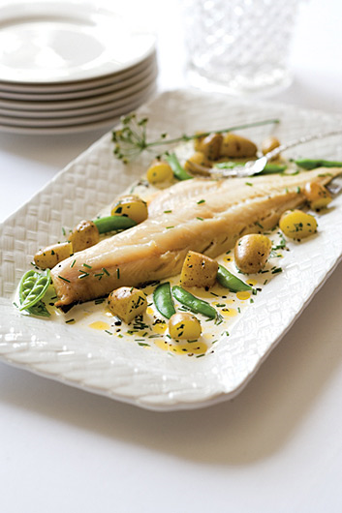
Finnan Haddie
http://en.wikipedia.org/wiki/Finnan_haddie

Slide 37
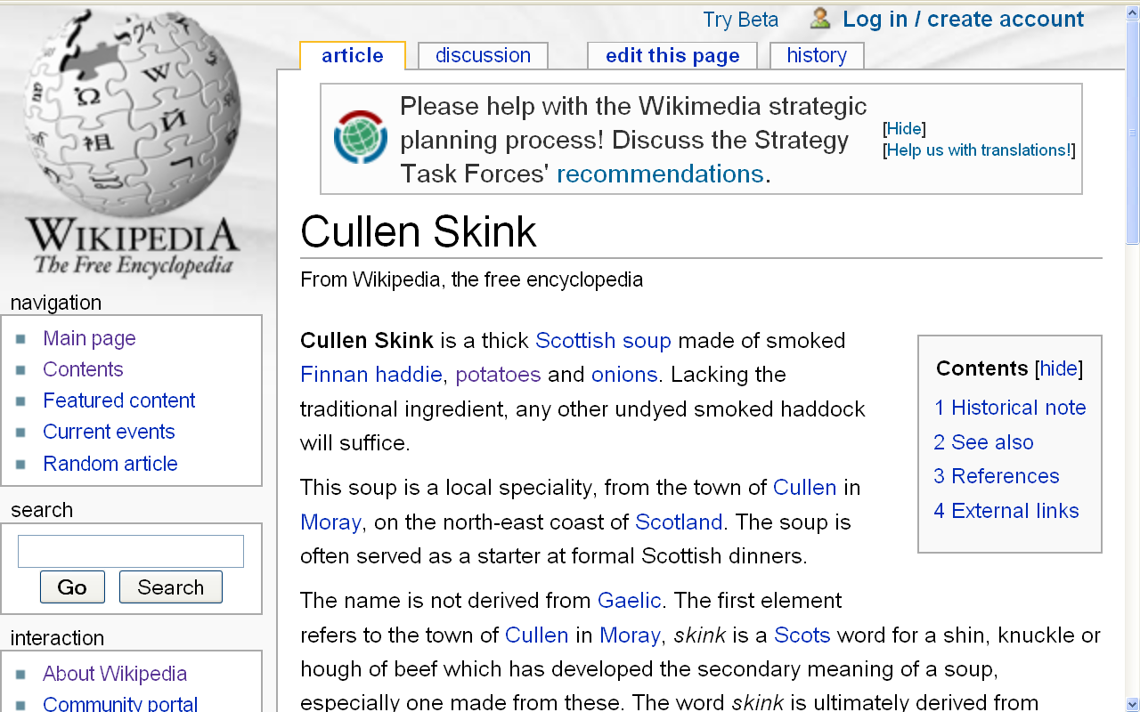
http://en.wikipedia.org/wiki/Cullen_Skink

Slide 38
Cullen Skink is a thick Scottish soup made of smoked Finnan Haddie, potatoes and onions
http://en.wikipedia.org/wiki/Cullen_Skink

Slide 39
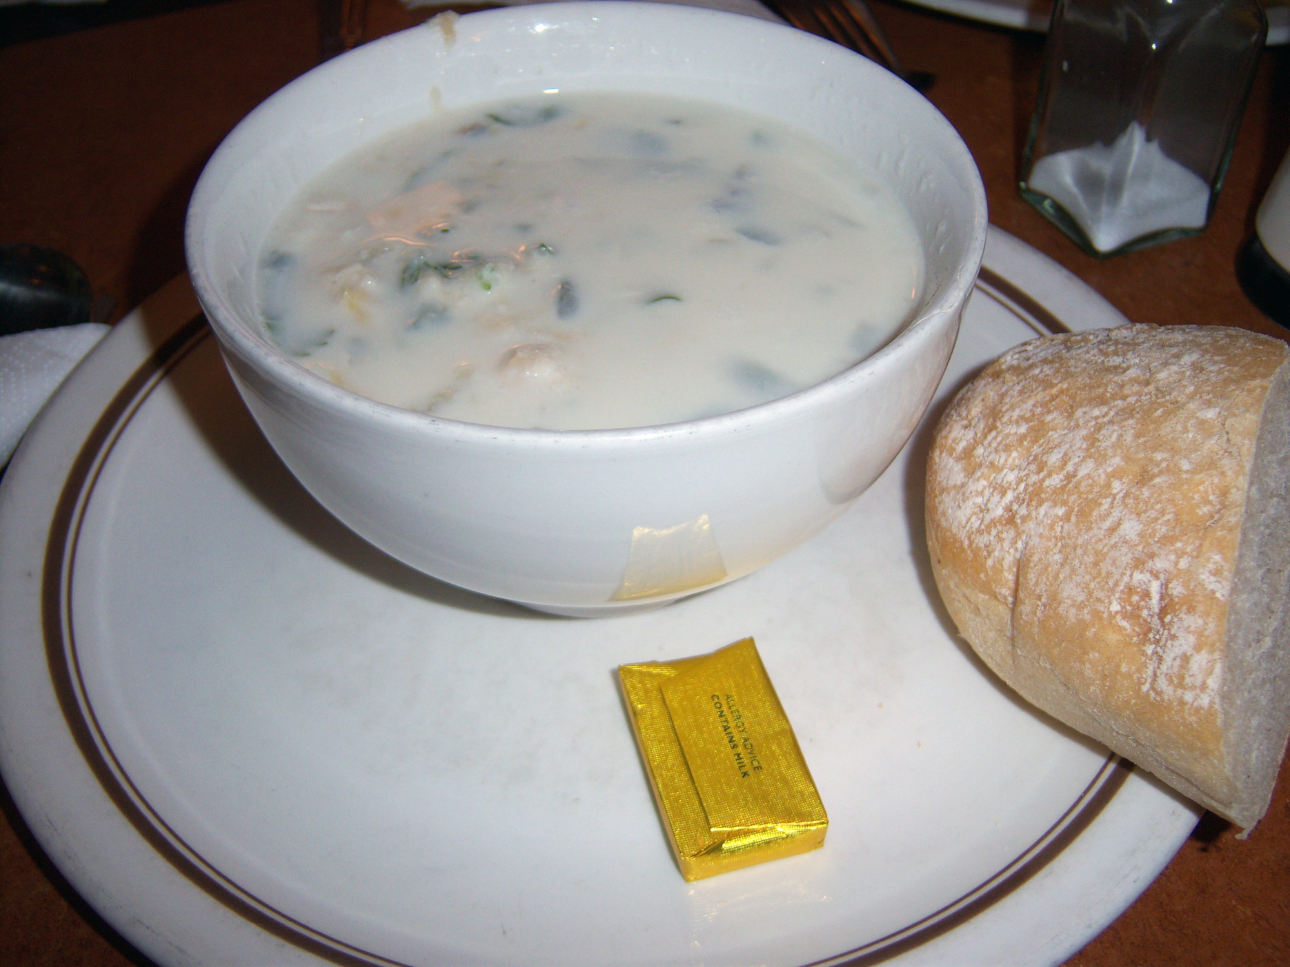
Cullen Skink
http://marthaandme.wordpress.com/2009/08/07/eating-our-way-across-the-uk/

Slide 40
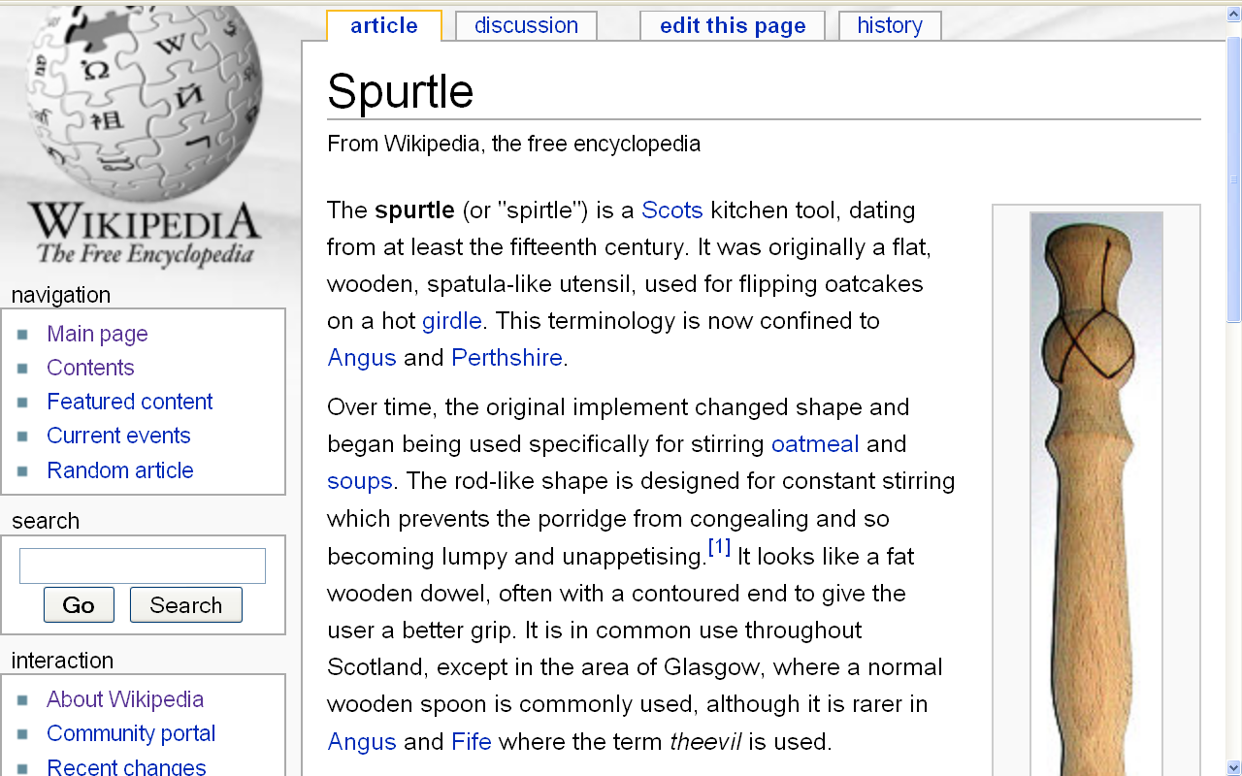
http://en.wikipedia.org/wiki/Spurtle

Slide 41
The spurtle (or "spirtle") is a Scots kitchen tool, dating from at least the fifteenth century. It was originally a flat, wooden, spatula-like utensil, used for flipping oatcakes on a hot griddle.
This terminology is now confined to
Angus and Perthshire.
http://en.wikipedia.org/wiki/Spurtle

Slide 42
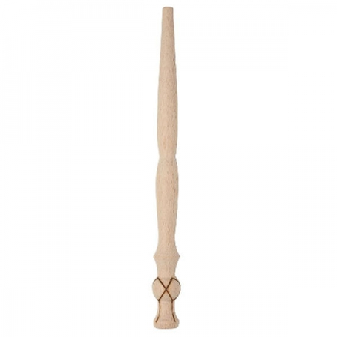
What famous person’s mother probably used one of these to cook him oatmeal?
spurtle ( a.k.a. theevil)

Slide 43
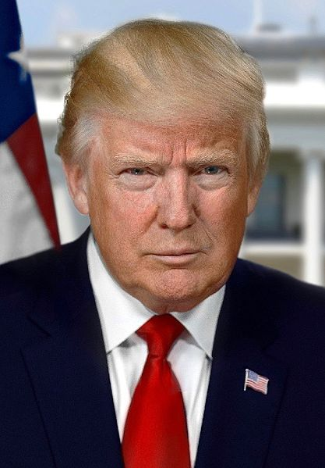
https://en.wikipedia.org/wiki/Donald_Trump

Slide 44
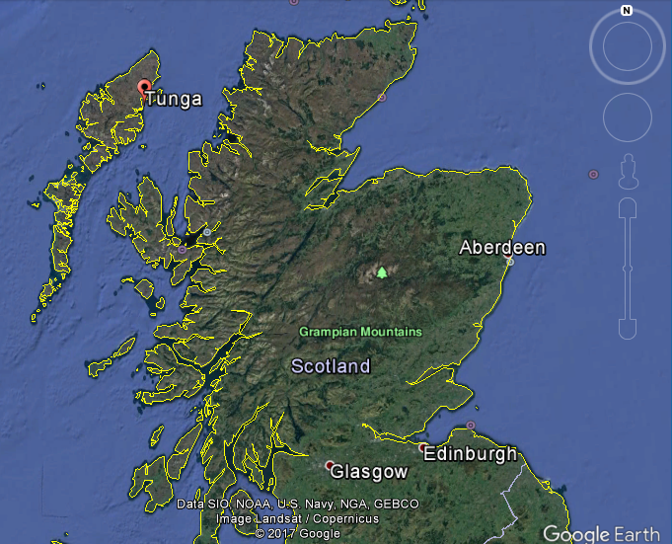
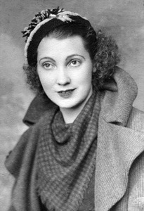
Mary Anne MacLeod Trump

Slide 46
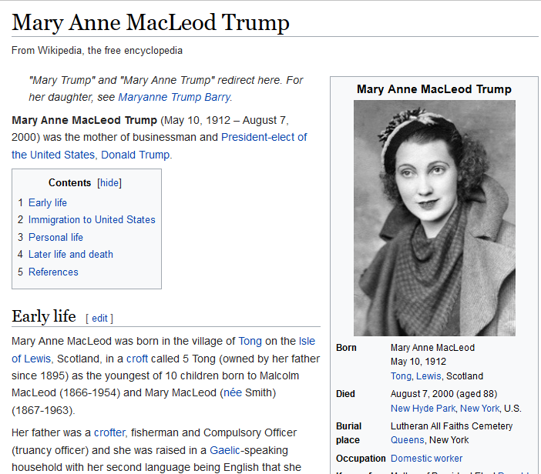
https://en.wikipedia.org/wiki/Mary_Anne_MacLeod_Trump

Slide 47
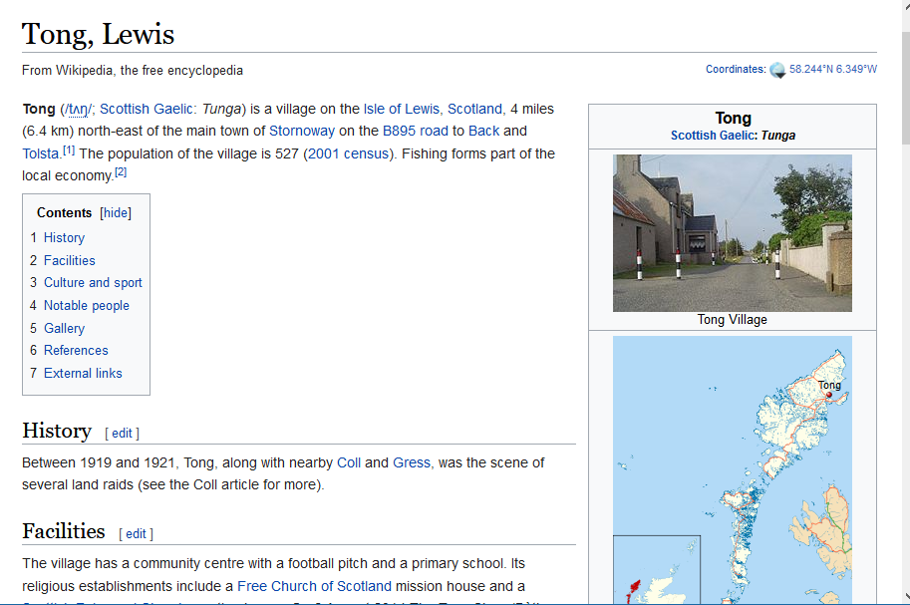

Slide 48
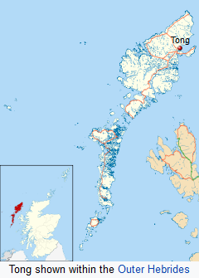
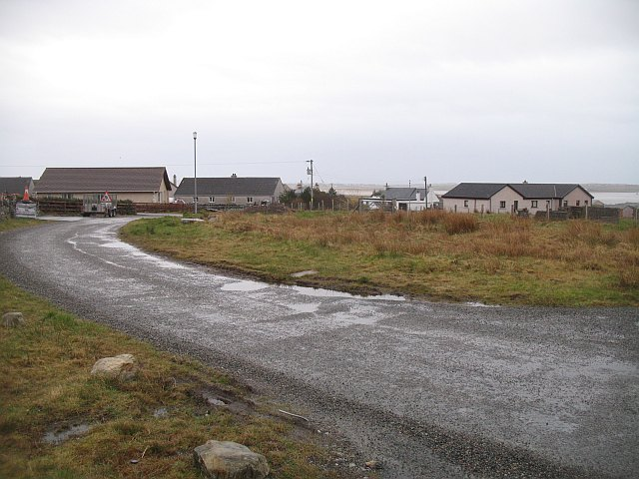
Tong, Lewis, Scotland
https://en.wikipedia.org/wiki/Tong,_Lewis

Slide 49
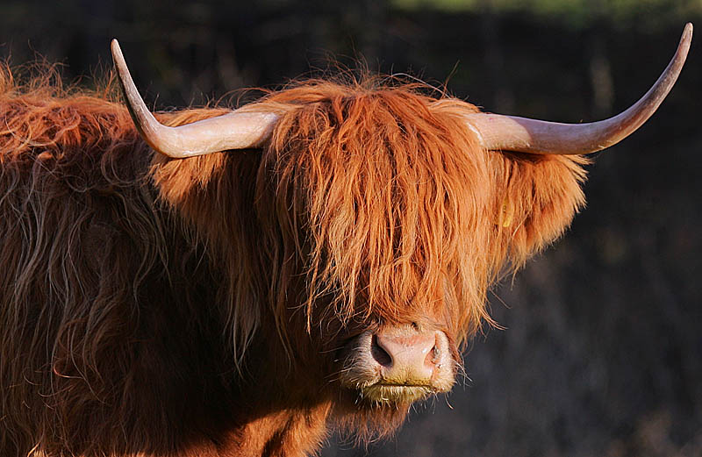
Scotland is also known for its highland cattle
http://en.wikipedia.org/wiki/Highland_cattle

Slide 50
A little more
JEOPARDY . . .

Slide 51
answer:
gulas
paprikas
kolbász
tokaji
Egri Bikavér

Slide 52
more clues . . .

Slide 53
answers:
gulas
paprikas
kolbász
tokaji
Egri Bikavér

Slide 54
question:
What do you think of
when someone says . . .
“Hungary”?
or “Hungarian”?

Slide 55
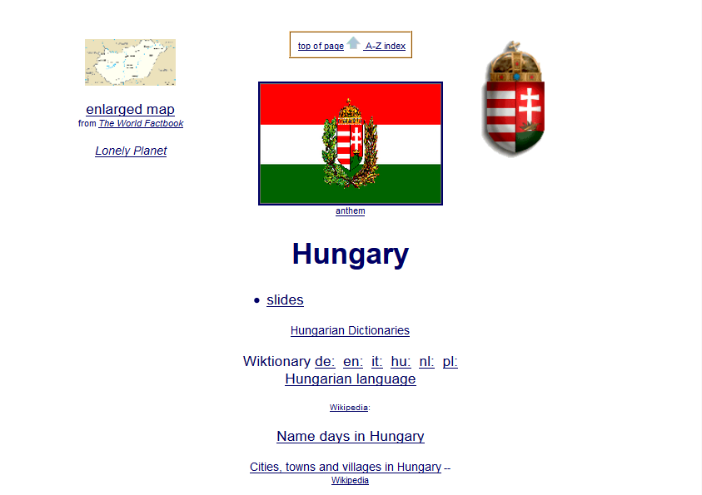

Slide 56
What do you think of
when someone says . . .
“Hungary” or Hungarian”?
these are Hungarikum, terms used to refer to uniquely Hungarian products, especially cuisine
http://en.wikipedia.org/wiki/Tokaji

Slide 57
What do you think of
when someone says . . .
“Hungary” or Hungarian”?
goulash
(gulas)

Slide 58
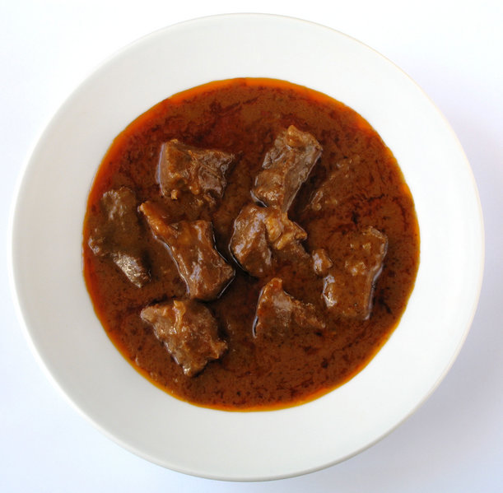
Gulas
http://en.wikipedia.org/wiki/Hungary

Slide 59
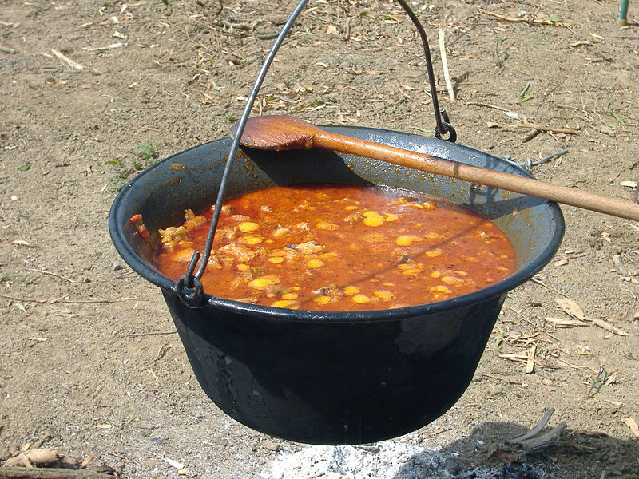
Gulas
http://en.wikipedia.org/wiki/Hungary

Slide 60
What do you think of
when someone says . . .
“Hungary” or Hungarian”?
and
Paprika
(paprikas)

Slide 61
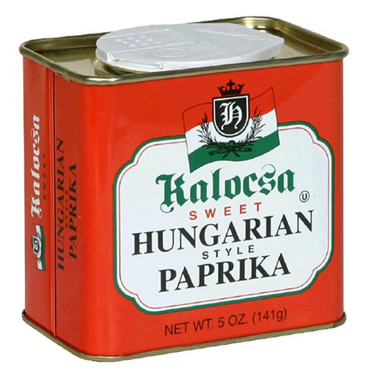
http://en.wikipedia.org/wiki/Hungary

Slide 62
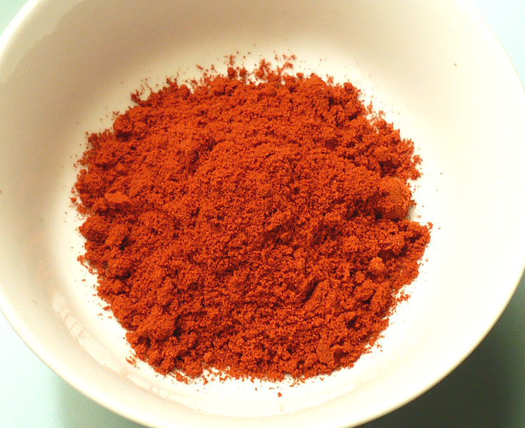
Hot Smoked Paprika
http://en.wikipedia.org/wiki/Hungary

Slide 63
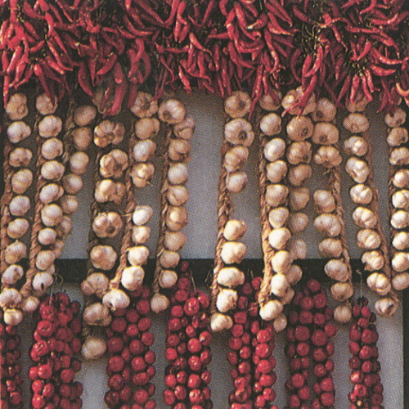
www.fsz.bme.hu/hungary/cuisine/cuisine.html

Slide 64
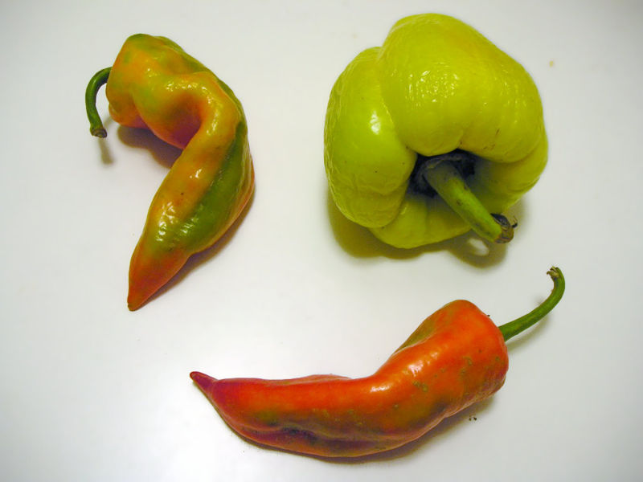
Capsicum Fruit Used to Make Paprika
http://en.wikipedia.org/wiki/Hungary

Slide 65
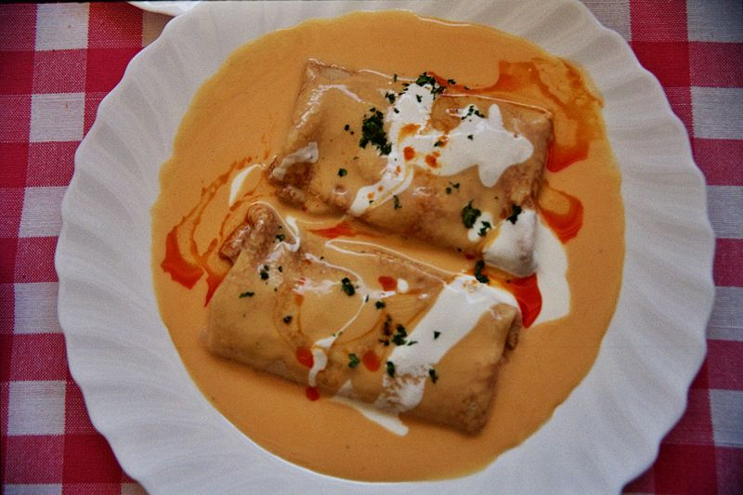
Hortobágyi palacsinta
http://en.wikipedia.org/wiki/Hungary

Slide 66
What do you think of
when someone says . . .
“Hungary” or Hungarian”?
and
sausages . . .
(kolbász)

Slide 67
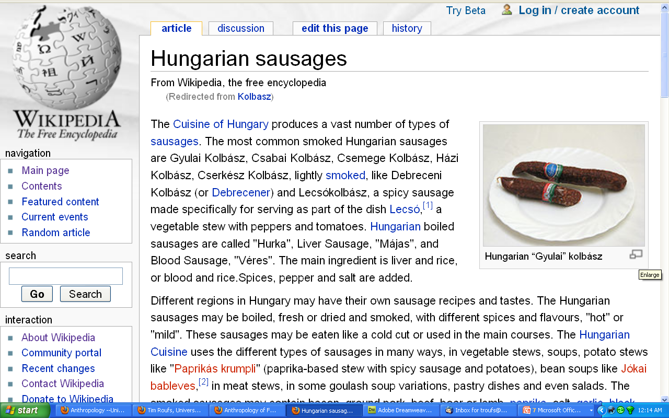
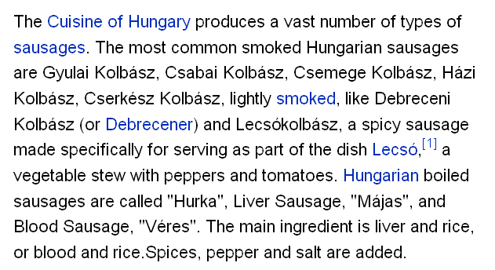
http://en.wikipedia.org/wiki/Kolbasz

Slide 68
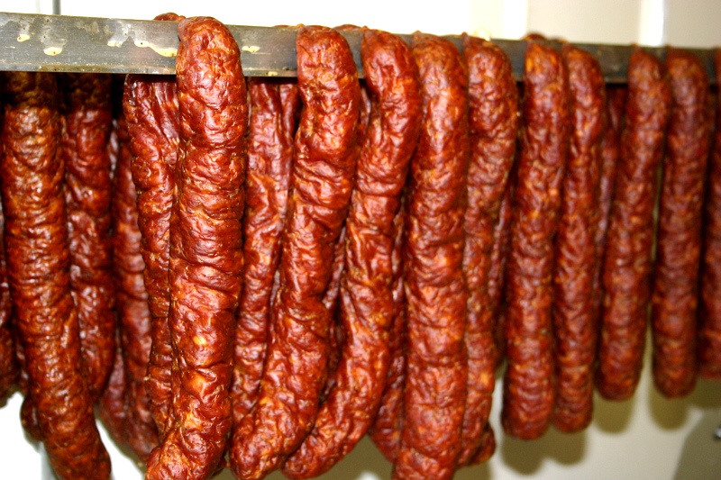
kolbász
(Hungarian sausages)
www.intlmeatsanddeli.com/products.htm

Slide 69
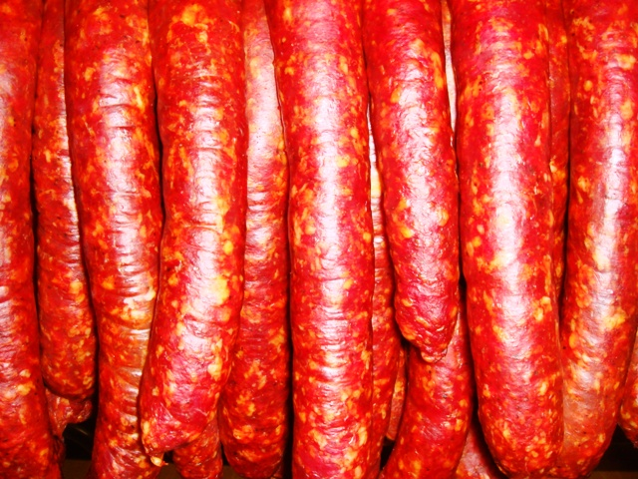
and more Hungarian sausages
www.hungariansupper.com/

Slide 70
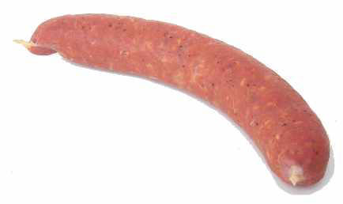
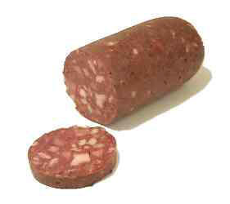
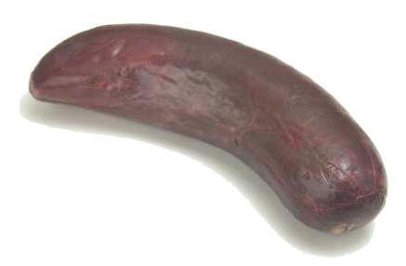
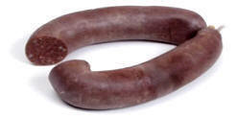
and still more Hungarian sausages
www.hungariansupper.com/

Slide 71
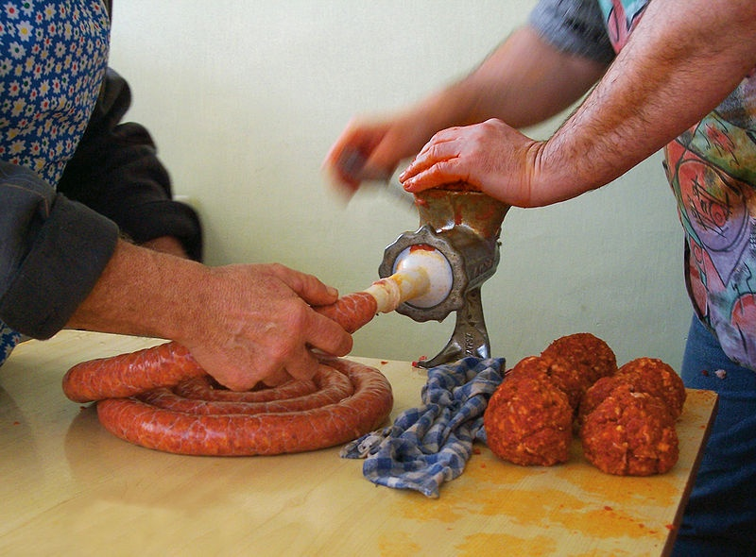
sausage making in Hungary . . .
http://en.wikipedia.org/wiki/File:Sausage_making-H-1.jpg

Slide 72
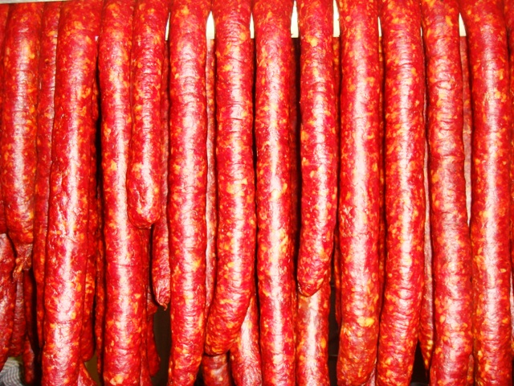
and even more Hungarian sausages
www.hungariansupper.com/

Slide 73
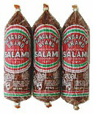
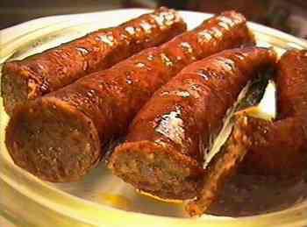
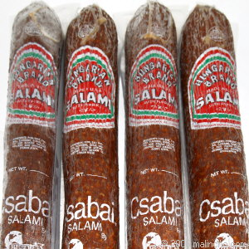
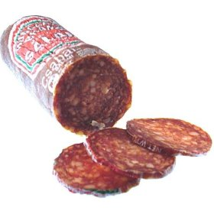
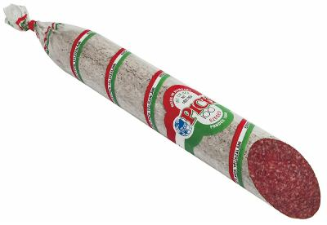
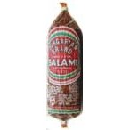
and Hungarian salami
www.hungariansupper.com/

Slide 74
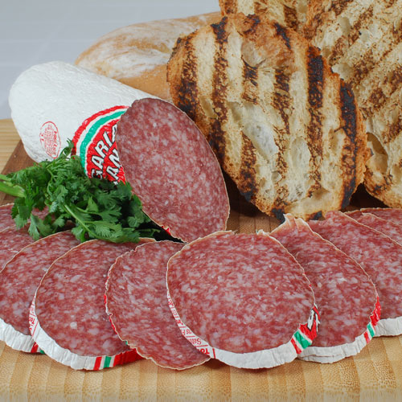
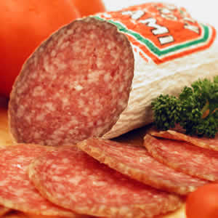
and more Hungarian salami . . .
www.intlmeatsanddeli.com/products.htm

Slide 75
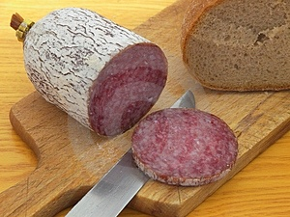
and still more Hungarian salami . . .
http://news.bbc.co.uk/1/hi/world/europe/4307700.stm

Slide 76
and . . .

Slide 77
2007
http://news.bbc.co.uk/1/hi/world/europe/4307700.stm

Slide 78
and . . .

Slide 79
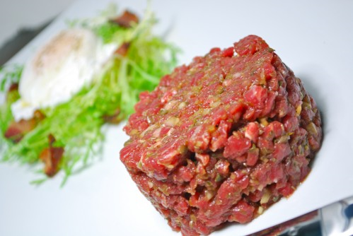
Steak Tartare
http://dhaleb.com/food-type/meat/steak-tartare/

Slide 80
What do you think of
when someone says . . .
“Hungary” or Hungarian”?
and
Tokaji and Egri wines
(from and Tokaj & Eger)
named after
the villages/regions
where they are produced . . .

Slide 81
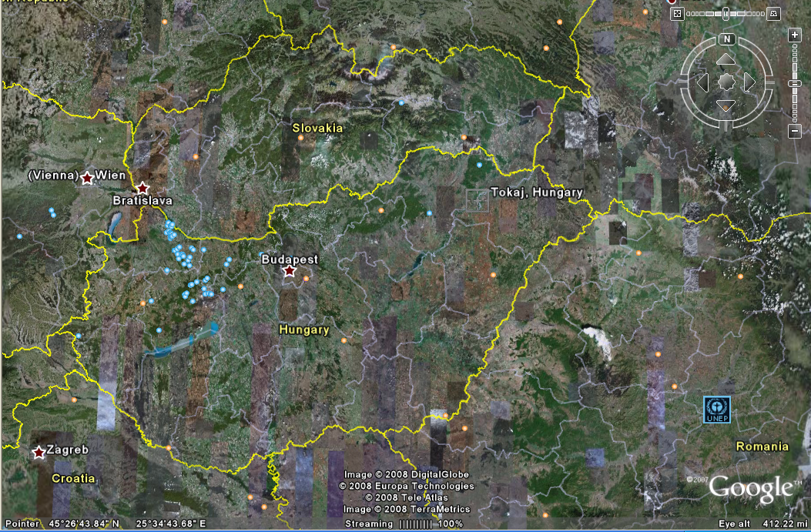
Tokaji
Tokaji, Hungary

Slide 82
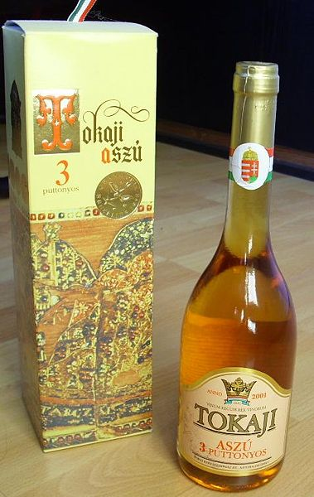
Tokaji, "Wine of Kings, King of Wines“, Louis XIV
http://en.wikipedia.org/wiki/Hungary

Slide 83
Tokaji, "Wine of Kings, King of Wines“, Louis XIV
http://en.wikipedia.org/wiki/Hungary

Slide 84
Tokaj-Hegyalja Wine Region
http://en.wikipedia.org/wiki/Hungary

Slide 85
Tokaj-Hegyalja Wine Region
http://en.wikipedia.org/wiki/Hungary

Slide 86
Tokaji
Tokaji
http://news.bbc.co.uk/1/hi/world/europe/4307700.stm

Slide 87
Eger
Eger
http://news.bbc.co.uk/1/hi/world/europe/4307700.stm

Slide 88
Eger
Egri Bikavér
“Bull’s Blood of Eger”

Slide 89
Egri Bikavér Wine
“Bull’s Blood of Eger”
http://en.wikipedia.org/wiki/Hungary

Slide 90
Egri Bikavér Wine
“Bull’s Blood of Eger”
http://en.wikipedia.org/wiki/Hungary

Slide 91
Eger Vinyard
http://en.wikipedia.org/wiki/Hungary

Slide 92
Eger
http://en.wikipedia.org/wiki/Hungary

Slide 93
Eger
http://en.wikipedia.org/wiki/Hungary

Slide 94
The Concept of Culture
macrocultures can include groups across nations
e.g., Basques
e.g., Rom (Gypsies)
e.g., ? Al Qaeda

Slide 95
The Concept of Culture
macrocultures can include groups across nations
e.g., Basques
e.g., Rom (Gypsies)
e.g., ? Al Qaeda
what is the cuisine of
Al Qaeda?
avoidance of pork
can you define a cuisine by avoidance of food?

Slide 96
The Concept of Culture
microcultures can include ethnic groups within nations
Aztec
Maya
Zapata
Mixtec
Otomi
Tarascan
Yaqui
Tarahumara . . .
contemporary
and
prehistoric

Slide 97
The Concept of Culture
microcultures can include ethnic groups within nations
e.g., Anishinabe (Chippewa; Ojibwa)
e.g., Irish “Travellers”
sometimes incorrectly called “Gypsies”
e.g., Australian Aboriginals
e.g., Cajan
e.g., Rom (Gypsies)
e.g., Basques
e.g., Kurds
. . . but sometimes a microculture just shares the cuisine
of its “mother culture” . . .…

Slide 98
The Concept of Culture
microcultures can include ethnic groups within nations
e.g., Anishinabe (Chippewa; Ojibwa)
e.g., Irish “Travellers”
sometimes incorrectly called “Gypsies”
e.g., Australian Aboriginals
e.g., Cajun
e.g., Rom (Gypsies)
e.g., Basques
e.g., Kurds

Slide 99
Gitana
Raimundo Madrazo
1841-1920
http://en.wikipedia.org/wiki/Main_Page

Slide 100
Roma boy in bear costume, part of entertainer team for working Christmas crowds. Budapest
http://en.wikipedia.org/wiki/Main_Page

Slide 101
Sándor Buffo Rigó
Tata Gypsy Band
Budapest Gypsy Orchestra
www.romaniworld.com/gal41.htm

Slide 102
(Hippocrene 2004)

Slide 103
more
JEOPARDY . . .

Slide 104
answer:
boxty
soda bread
stew
Guinness

Slide 105
http://en.wikipedia.org/wiki/Boxty

Slide 106
clues . . .

Slide 107
answers:
boxty
soda bread
stew
Guinness

Slide 108
one more clue . . .

Slide 109
answers:
boxty
soda bread
stew
Guinness

Slide 112
(RPC International Publications Ltd.; 2nd edition,1988)

Slide 113
http://en.wikipedia.org/wiki/Boxty

Slide 114
https://www.dublinpass.com/dublin-attractions/the-boxty-house.htmlhttps://www.dublinpass.com/dublin-attractions/the-boxty-house.html

Slide 115
https://www.dublinpass.com/dublin-attractions/the-boxty-house.htmlhttps://www.dublinpass.com/dublin-attractions/the-boxty-house.html

Slide 116
“The average consumption of potatoes per person in Ireland
[before the great potato famine of 1845]
was almost 8 lbs / day . . . and sometimes [potatoes were] the sole source of energy. . . .”
(Jeremy MacVeigh, International Cuisine, Delmar Cengage, 2009, p. 147)
The Irish are famous for their potato dishes
Wikipedia

Slide 117
Whole wheat soda bread
(known as “wheaten bread” in Northern Ireland)
Wikipedia

Slide 118
The Irish are famous for their corned beef and cabbage
http://s184.photobucket.com/albums/x318/RennyBA/StPatricksDayOslo2008/IrishStew.jpg

Slide 120
But that
is changing . . .
Gill & Macmillan, 2009

Slide 121
The Concept of Culture
microcultures can include ethnic groups within nations
e.g., Anishinabe (Chippewa; Ojibwa)
e.g., Irish “Travellers”
sometimes incorrectly called “Gypsies”
e.g., Australian Aboriginals
e.g., Cajun
e.g., Rom (Gypsies)
e.g., Basques
e.g., Kurds

Slide 122
Compare . . .
The Irish Tinkers: The Urbanization of an Itinerant People
by George Gmelch
1985

Slide 123
more
JEOPARDY . . .

Slide 124
answers:
gumbo
jambalaya

Slide 125
Roux-less gumbo with okra
http://en.wikipedia.org/wiki/Gumbo

Slide 126
Creole Jambalaya with shrimp, ham, tomato, and Andouille sausage
http://en.wikipedia.org/wiki/Jambalaya

Slide 127
The Concept of Culture
microcultures can include ethnic groups within nations
e.g., Anishinabe (Chippewa; Ojibwa)
e.g., Irish “Travellers”
sometimes incorrectly called “Gypsies”
e.g., Australian Aboriginals
e.g., Cajun
e.g., Rom (Gypsies)
e.g., Basques
e.g., Kurds

Slide 128
https://en.wikipedia.org/wiki/Louisiana

Slide 130
“Cajuns live to eat, not eat to live.”

Slide 131
“Cajuns live to eat , not eat to live.”
Wikipedia
Crab Legs, Crawfish Étouffée, Shrimp Gumbo, Shrimp, Corn, and Potatoes

Slide 132
Wikipedia
http://www.cajuncrawfishpie.com/cajun-recipes.html

Slide 133
[ by the way . . . ]
the local cultures of the
Cajuns
should not be confused with Creoles

Slide 134
Cajuns are
descendants of Acadian exiles (French-speakers from Acadia in what are now The Maritimes of Eastern Canada)
In the United States Creoles are “people of any race or mixture thereof who are descended from settlers in colonial French Louisiana before it became part of the United States in 1803 with the Louisiana Purchase”
https://en.wikipedia.org/wiki/Cajun
https://en.wikipedia.org/wiki/Creole_peoples#Louisiana

Slide 135
Creole cuisine is similar to Cajun,
but they are not the same
http://en.wikipedia.org/wiki/Louisiana_Creole_cuisine

Slide 136
just ask Paul Prudhomme
http://www.nola.com/175years/index.ssf/2012/02/paul_prudhomme_the_times-picay.html

Slide 137
more
JEOPARDY . . .

Slide 138
answers:
Vegemite
ANZAC biscuits
Pavlova (maybe)

Slide 140
clue . . .

Slide 141
answers:
Vegemite
ANZAC biscuits
Pavlova (maybe)

Slide 142
answer:
Vegemite
ANZAC biscuits
ANZAC biscuits
http://en.wikipedia.org/wiki/ANZAC_biscuit

Slide 143
answers:
Vegemite
ANZAC biscuits
Pavlova (maybe)

Slide 144
http://en.wikipedia.org/wiki/Pavlova_(food)

Slide 147
Except that . . .

Slide 148
Except that . . .
New Zealand wants in on the action . . .

Slide 150
The Pavlova Story: A Slice of
New Zealand's Culinary History

Slide 151
The Pavlova Story: A Slice of
New Zealand's Culinary History
A New Zealand Professor of Anthropology

Slide 152
And there are all of the other foods mentioned elsewhere . . .

Slide 154
baklava

Slide 155
A Tate of Greece
25th Annual Food Festival 2017

Slide 156
Montgomery, Minnesota

Slide 157
Czech
Montgomery, Minnesota
Kolacky Days Festival, est. 1929

Slide 158
Ely, Minnesota

Slide 159
Slovenia
http://www.duluthbudgeteer.com/community/4121672-simple-cooking-leads-success
Notes:
159

Slide 160
Duluth, Minnesota

Slide 161
Finland
lutefisk
Duluthian Beatrice Ojakangas inducted into the Scandinavian-American Hall of Fame
http://www.duluthbudgeteer.com/community/4121672-simple-cooking-leads-success
Notes:
161

Slide 162
http://www.mprnews.org/story/2016/09/13/npr-pho-central-to-vietnamese-identity
Notes:
162

Slide 163
Green Bay, Wisconsin

Slide 164
Wallonia
(Belgium)
Cadott, Wisconsin
https://www.travelwisconsin.com/events/fairs-festivals/booya-days-40367
Notes:
164

Slide 165
the list of foods central to cultural identity
goes on . . . and on . . .

Slide 166
the list of foods central to cultural identity
goes on . . . and on . . .

Slide 167
The Concept of Culture
microcultures can include ethnic groups within nations
e.g., Anishinabe (Chippewa; Ojibwa)
e.g., Irish “Travellers”
sometimes incorrectly called “Gypsies”
e.g., Australian Aboriginals
e.g., Cajun
e.g., Rom (Gypsies)
e.g., Basques
e.g., Kurds

Slide 168
The Desert People

Slide 169
The Desert People

Slide 170
enough fun and games . . .
back to our
main characteristics of anthropology

Slide 171
Main Characteristics in a Nutshell

Slide 172
American
Main Characteristics of˄Anthropology
1. the four fields of general anthropology
culture as a primary concept
comparative method as major approach
holism as a primary theoretical goal
fieldwork as a primary research technique

Slide 173
American
Main Characteristics of˄Anthropology
1. the four fields of general anthropology
culture as a primary concept
comparative method as major approach
holism as a primary theoretical goal
fieldwork as a primary research technique

Slide 174
ANTH 1080
Global Cultures
The End
Main
Characteristics of
Anthropology
© 2010-2024 Timothy G. Roufs, University of Minnesota Duluth

