Slide 1
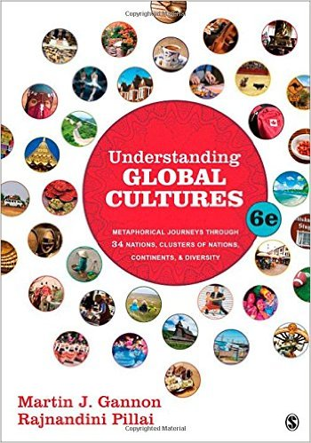
Start deck in “Slide Show” mode,
and use your up/down arrow keys and/or
your space bar to advance the slides
© 2010-2024 Timothy G. Roufs, University of Minnesota Duluth

Slide 2
ANTH 1080
Understanding
Global Cultures
© 2010-2024 Timothy G. Roufs, University of Minnesota Duluth

Slide 3
A Very Brief Outline
of the Course Structure
© 2010-2024 Timothy G. Roufs, University of Minnesota Duluth

Slide 4
The Course Outline in a Nutshell
Course Structure
Course Structure

Slide 5
The Course Outline in a Nutshell
Course Structure . . .
Course Content

Slide 7
In a nutshell, ANTH 1080 Global Cultures
consists of three main segments:
I Orientation and Background
Introduction
Basic Concepts
History
Theory
Methods and Techniques
II Explorations
Comparative / Cross-Cultural
Holistic
Ethnographic Case Studies from the Real World: Real People . . . Real Places from Around the Globe
III Student Presentations on Term Research Project
http://www.d.umn.edu/cla/faculty/troufs/anthfood/afproject.html

Slide 8
In a nutshell, ANTH 1080 Global Cultures
consists of three main segments:
I Orientation and Background
Introduction
Basic Concepts
History
Theory
Methods and Techniques
II Explorations
Comparative / Cross-Cultural
Holistic
Ethnographic Case Studies from the Real World: Real People . . . Real Places from Around the Globe
III Student Presentations on Term Research Project
http://www.d.umn.edu/cla/faculty/troufs/anthfood/afproject.html

Slide 9
In a nutshell, ANTH 1080 Global Cultures
consists of three main segments:
I Orientation and Background
Introduction
Basic Concepts
History
Theory
Methods and Techniques
II Explorations
Comparative / Cross-Cultural
Holistic
Ethnographic Case Studies from the Real World: Real People . . . Real Places from Around the Globe
III Student Presentations on Term Research Project
http://www.d.umn.edu/cla/faculty/troufs/anthfood/afproject.html

Slide 10
In a nutshell, ANTH 1080 Global Cultures
consists of three main segments:
I Orientation and Background
Introduction
Basic Concepts
History
Theory
Methods and Techniques
II Explorations
Comparative / Cross-Cultural
Holistic
Ethnographic Case Studies from the Real World: Real People . . . Real Places from Around the Globe
III Student Presentations on Term Research Project
http://www.d.umn.edu/cla/faculty/troufs/anthfood/afproject.html

Slide 11
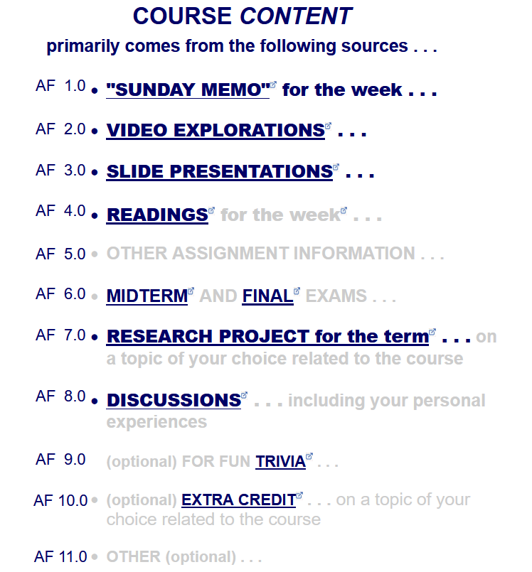
The Course Outline in a Nutshell
Course Structure . . .
Course Content . . .

Slide 13
This is the way your
Canvas Modules
are organized . . .

Slide 15
ANTH 1080
Global Cultures
The End
A Very Brief Outline
of the Course Structure
© 2010-2024 Timothy G. Roufs, University of Minnesota Duluth

