Slide 1
8 and 10 November 2021
Charge Transport Measurement
Hall Effect
Stevenson and Keyes
Haynes-Schockley
Photovoltaic Ramifications

Slide 2
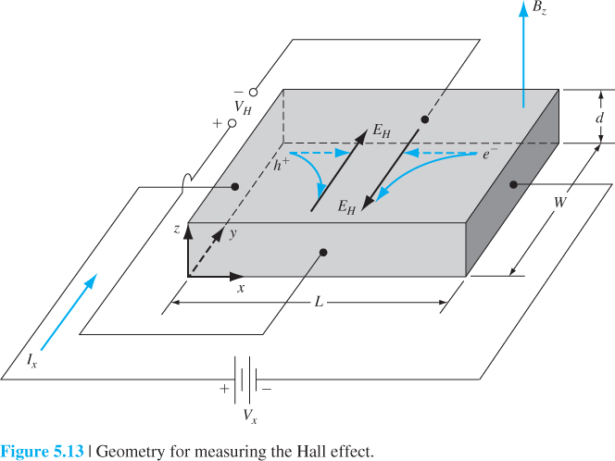

Slide 4
Non-equilibrium Excess Carriers in Semiconductors
When external field (electric, thermal, optical) is applied on the semiconductor, the semiconductor is operating under non-equilibrium conditions
Excess electrons in the conduction band and excess holes in the valence band may exist in addition to the thermal equilibrium condition
Excess carriers’ movements: generation, recombination, drift, and diffusion
4
4
Notes:
4

Slide 5
Total Diffusion Current
Hole diffusion current
D_{p}: hole diffusion coefficient (m²/s⁾
Electron diffusion current
D_{n}: electron diffusion coefficient (m²/s⁾
Total diffusion current
5
5
Notes:
5

Slide 6
Low-Level Injection and High-Level Injection
Low-level injection: excess carrier concentration is much less than thermal equilibrium majority carrier concentrations
n-type material: n_{o}>>p_{o,} δn(t) << n_{o}
p-type material: p_{o}>>n_{o,} δn(t)<<p_{o}
High-level injection: excess carrier concentration is comparable to or greater than the thermal equilibrium majority carrier concentrations
n-type material: n_{o} >> p_{o,} δn(t) >= n_{o}
p-type material: p_{o} >>n_{o,} δn(t)>= p_{o}
6
6
Notes:
6

Slide 7
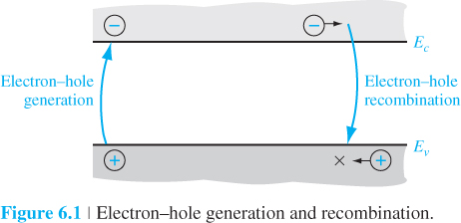
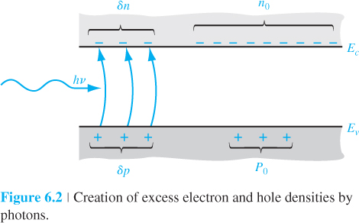
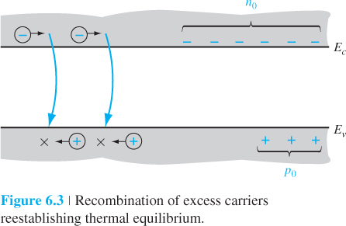

Slide 8
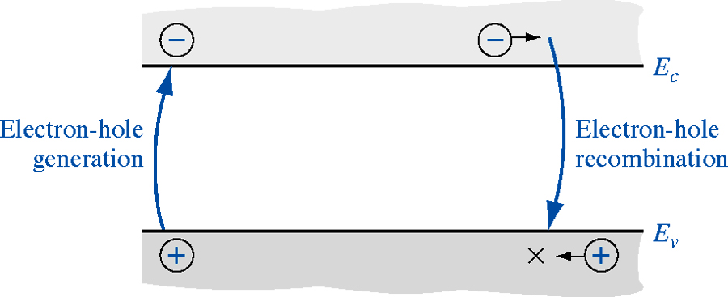
Carrier Generation and Recombination
Mechanisms of generation and recombination: band-to-band, traps (recombination centers)
8
8
Notes:
8

Slide 9
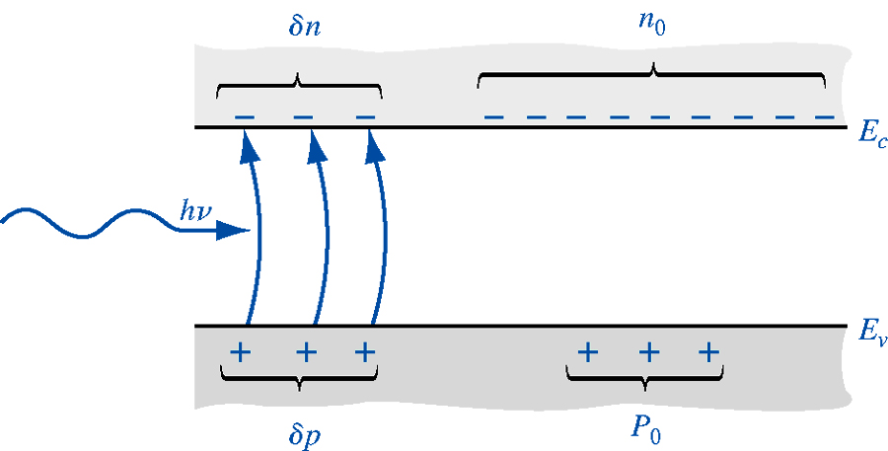
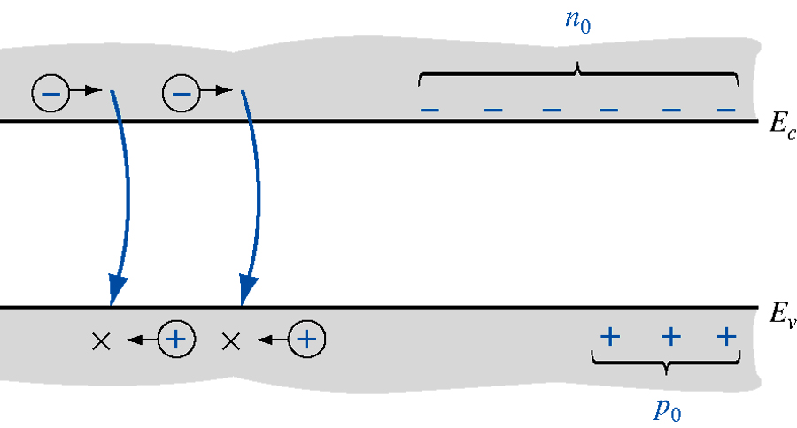
Excess Carrier Generation and Recombination
When external force (electric, optical, thermal) is applied, excess electrons and holes are create in pairs
With generation of excess carriers, concentration of electrons and holes are increased
Electrons and holes are recombined at the same time of generation are equal
9
Notes:
9

Slide 10
Carrier Generation and Recombination in Equilibrium (Band-to-Band)
For direct band-to-band generation, the electrons and holes are created in pairs
For direct band-to-band recombination, the electrons and holes are combined in pairs
In thermal equilibrium, the generation and recombination rates are equal
10
10
Notes:
10

Slide 11
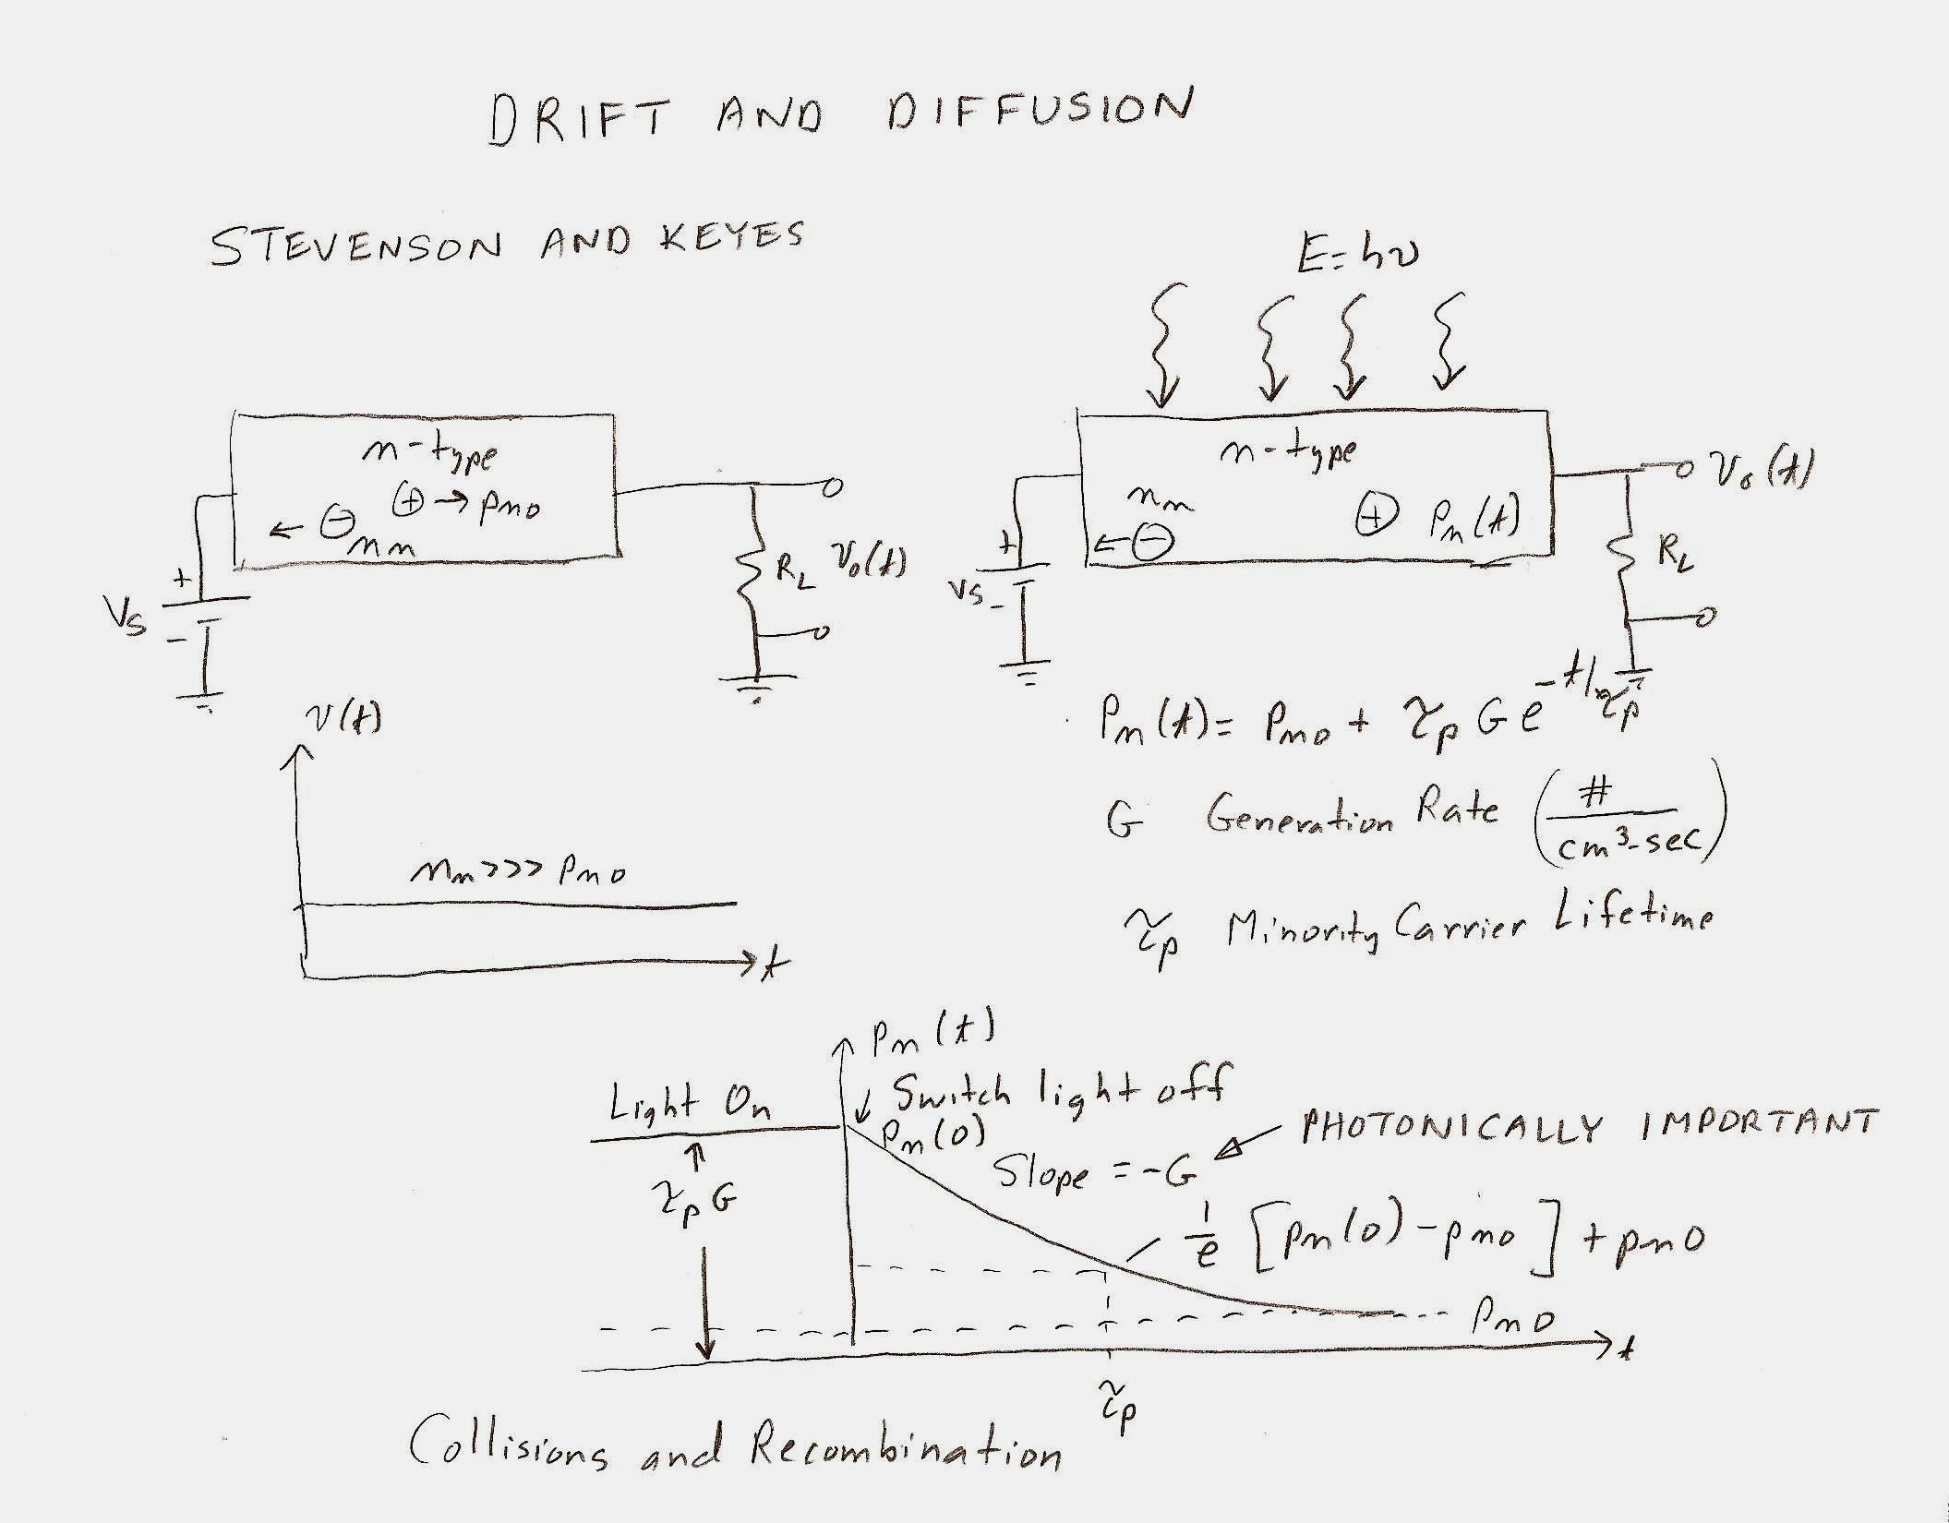

Slide 12
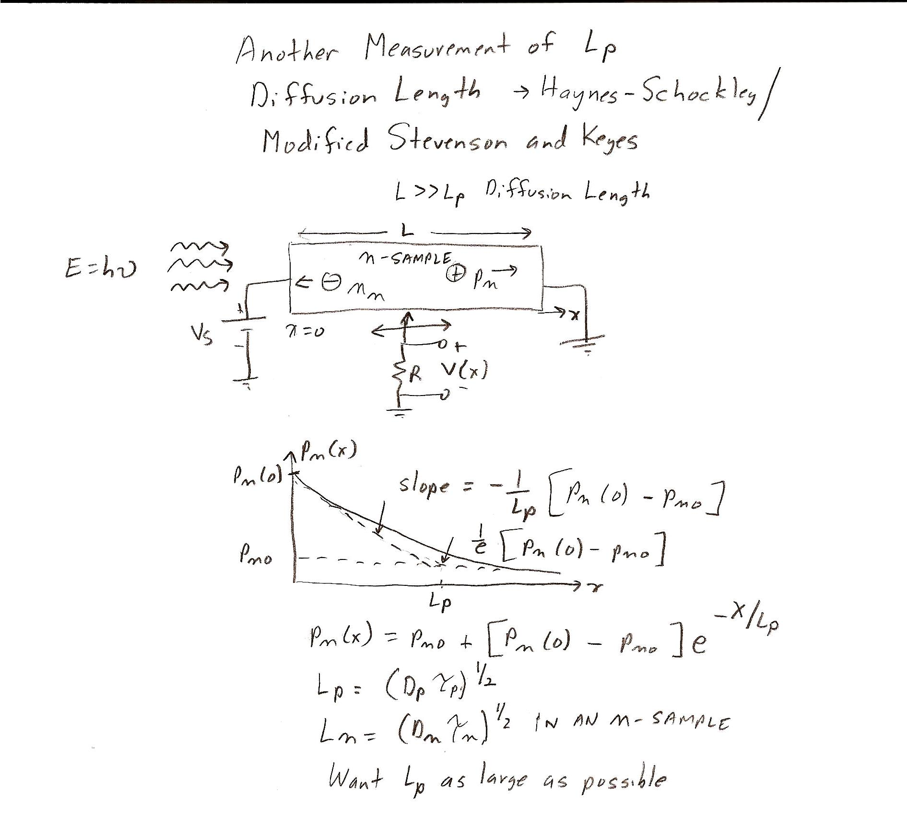

Slide 13
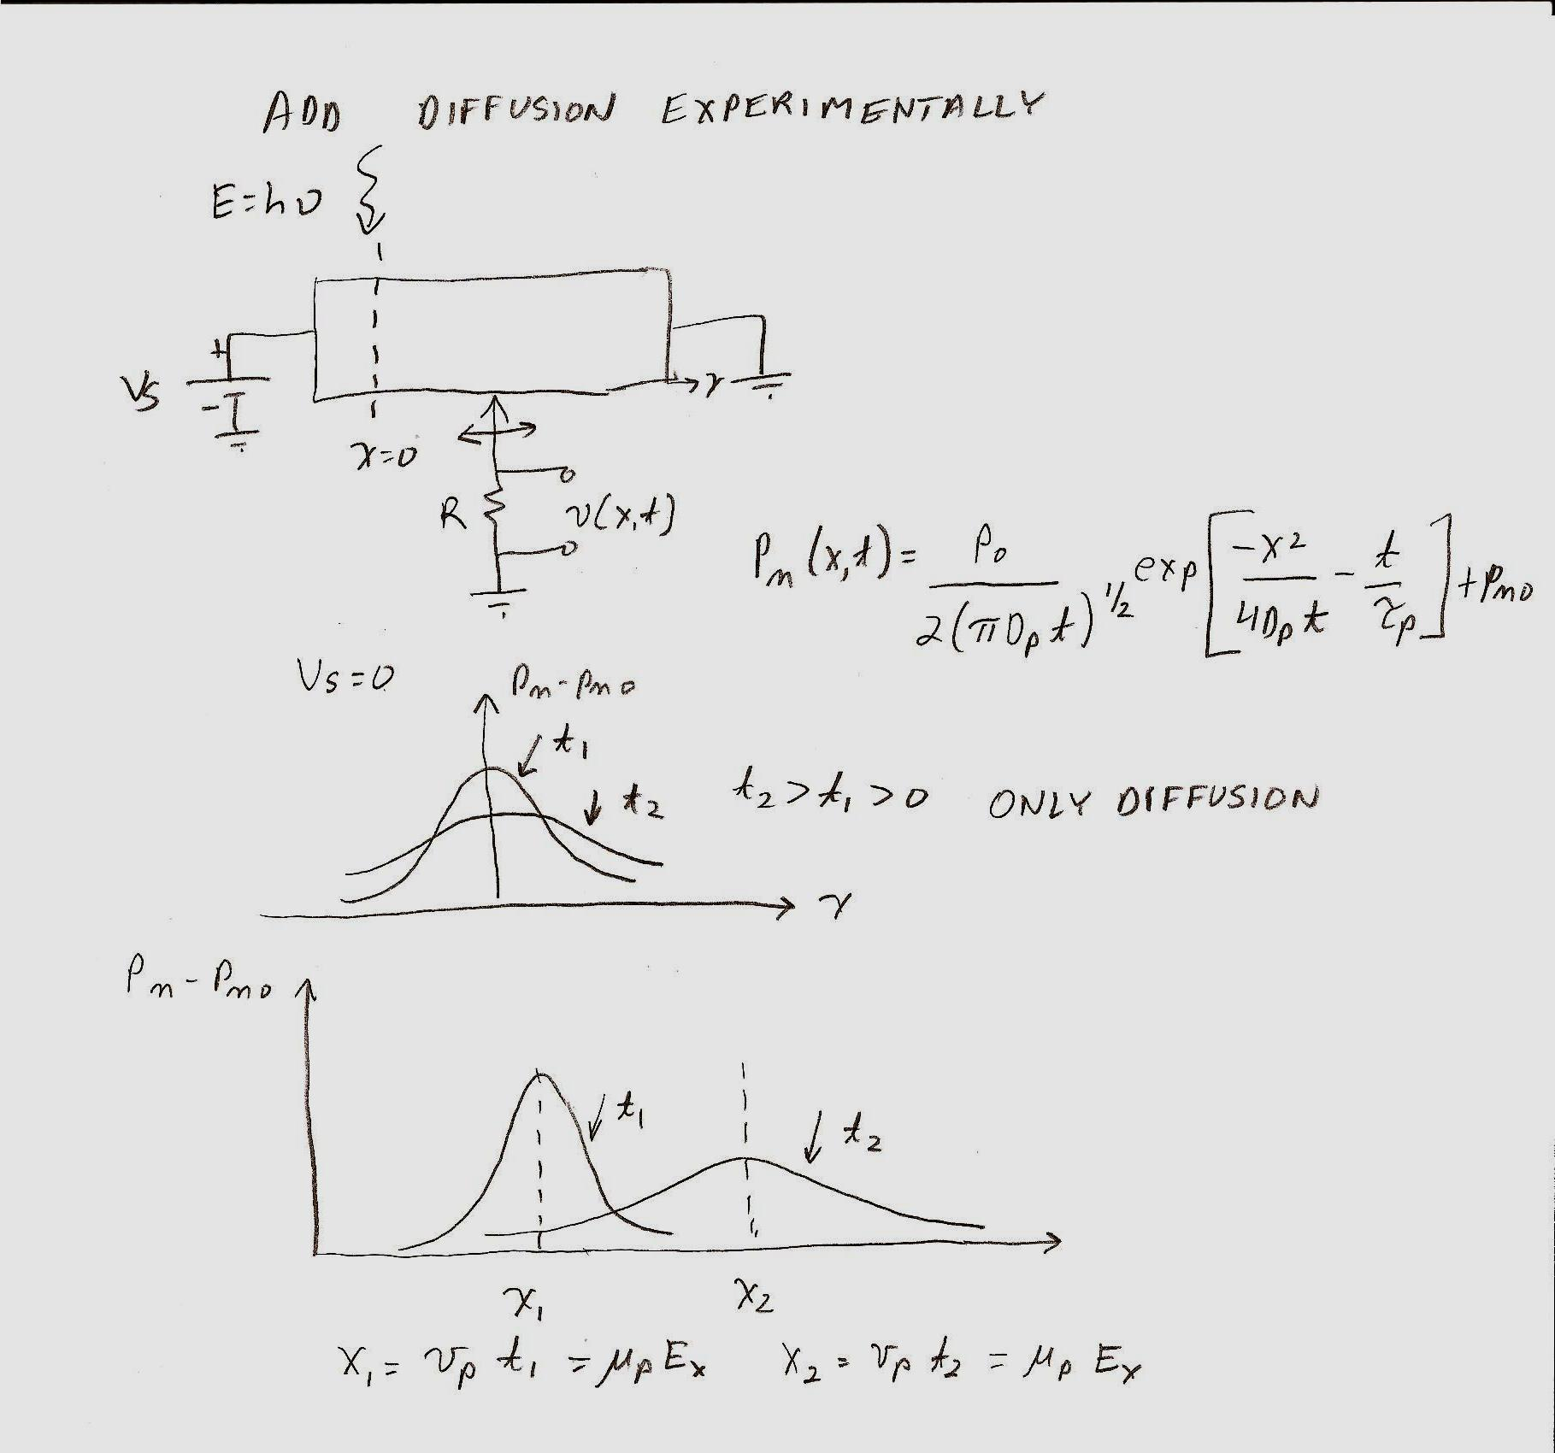

Slide 14
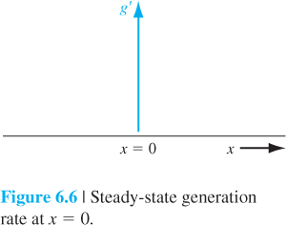
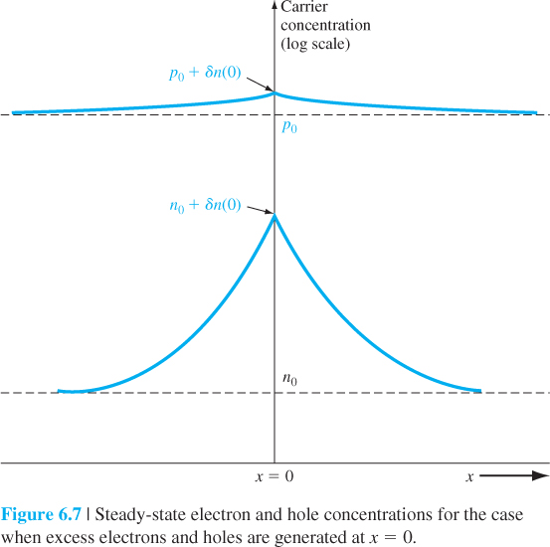
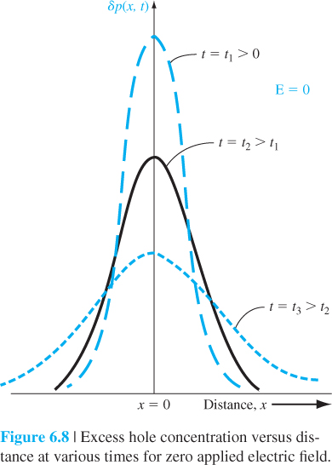

Slide 15
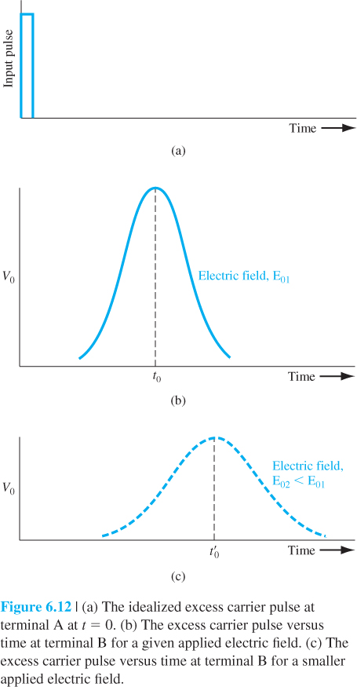
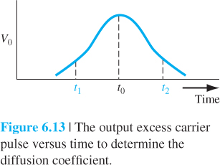

Slide 16
